Slide 1


DURHAM NEIGHBORHOOD COLLEGE 2023
Durham County Department of Public Health
Presented by Rod Jenkins

Slide 2
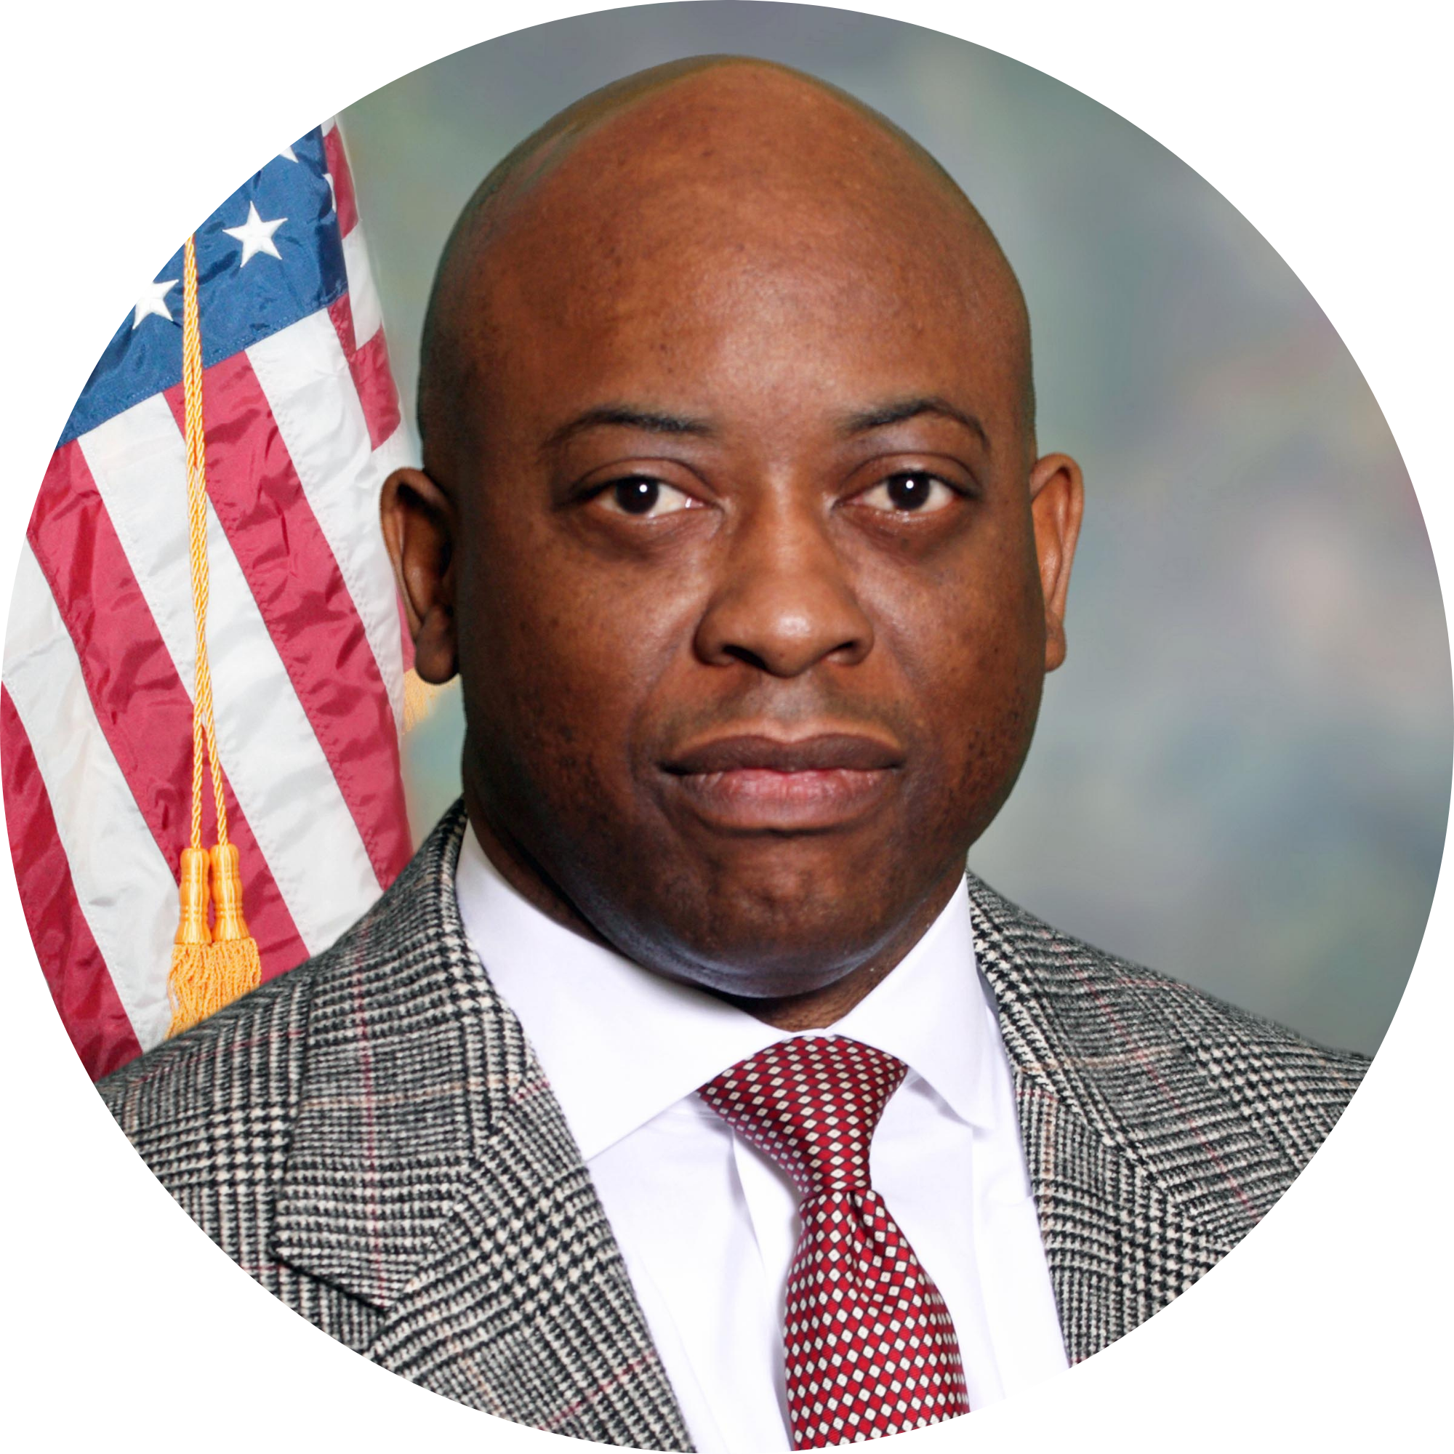

DCoDPH Mission & Vision
Our Mission
Partnering with our community to advance health equity, protect the environment, and promote health and wellness for all.
Our Vision
Collaborating with our community to advocate, empower, and protect the health and environment for all Durham County residents.
Rod Jenkins
Public Health Director
Durham Neighborhood College 2023

Slide 3
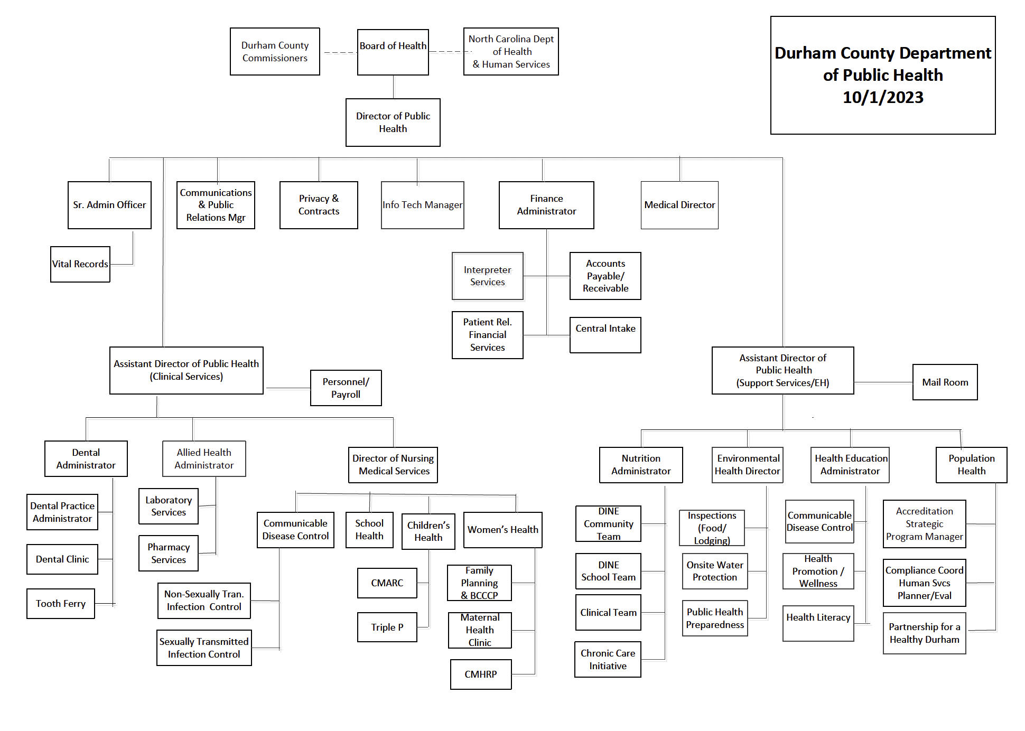
Durham Neighborhood College 2023

Slide 4
DCoDPH
Organizational Chart & Structure
Allied Health is comprised of the laboratory and pharmacy operated within the department. The laboratory provides phlebotomy, specimen procurement, and testing services that aid in the diagnosis, treatment, and prevention of disease for the department’s clinics, Lincoln Community Health Center, and at community outreach events. The pharmacy provides medication services for clinics and the DCo Wellness Clinic. Medications are filled and dispensed by licensed pharmacists and a pharmacy technician. The pharmacy maintains a comprehensive formulary enabling treatment and prevention options for a variety of diseases and conditions. ($1,462,786)
Durham Neighborhood College 2023

Slide 5
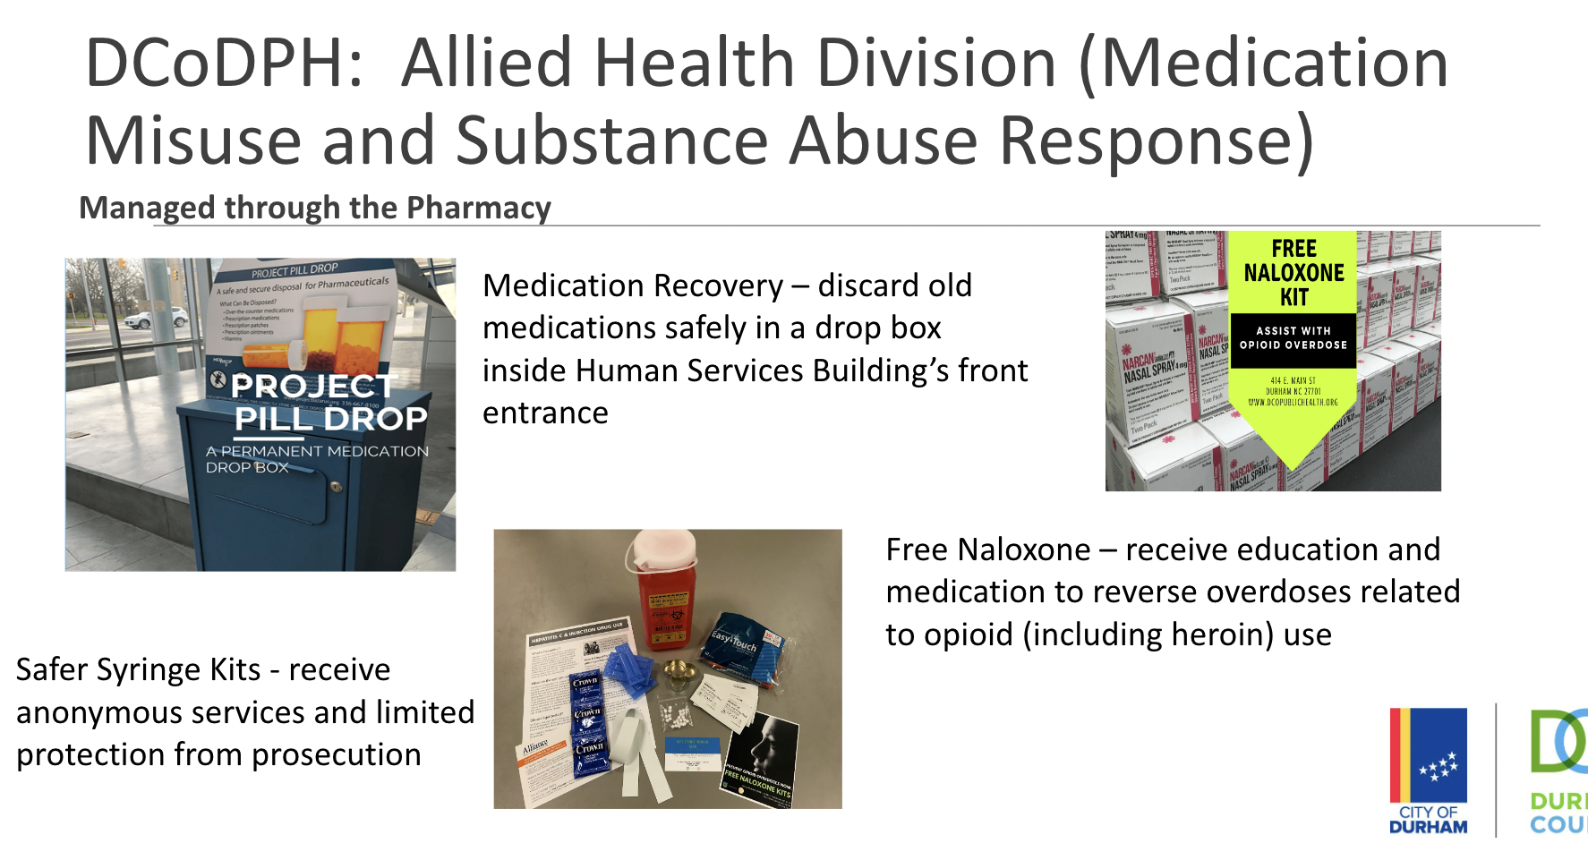
Durham Neighborhood College 2023

Slide 6
DCoDPH
Organizational Chart & Structure
The Dental Division provides access to comprehensive dental care for uninsured and underinsured children and youth up to 20 years old and pregnant women. Services are provided onsite in a state-of-the-art dental clinic and in the Tooth Ferry, a mobile dental unit that visits specific DPS elementary schools. Staff members also provide dental screenings and oral health education sessions. ($1,326,967)
Durham Neighborhood College 2023

Slide 7
DCoDPH
Organizational Chart & Structure
The Environmental Health Division enforces state and local laws to ensure that food & lodging establishments, institutions, child care centers, onsite subsurface wastewater treatment systems, drinking water wells, public swimming pools, tattoo artists and other health related services and industries are designed and operated in a manner that protects public health. Environmental Health staff review establishment plans and design or approve engineered designs, to ensure adequate protection for consumers and the environment before issuing operational permits. Staff also educate operators and residents about issues that affect public health and safety. Information and data obtained via monitoring and inspection is provided to the public and allows people to make informed decisions that might affect their health. The Local Public Health Preparedness program ensures the department has official plans that guide operations during emergency responses. The program coordinator maintains situational awareness and communicates routinely with response partners. They also oversee training and exercises and procure necessary assets to help ensure the department’s readiness and capabilities. ($2,404,148)
Durham Neighborhood College 2023

Slide 8
DCoDPH: Environmental Health
Frequently Asked Questions
Why should I get my well water tested?
Why is my well water cloudy?
Why do I have low water pressure, it was fine a few days ago?
Why do you need me to designate the house and driveway locations on my lot?
Why should I allow you to review my restaurant plans before I move forward with construction?
Why shouldn’t I buy food service equipment from home improvement stores?
Durham Neighborhood College 2023

Slide 9
DCoDPH
Organizational Chart & Structure
The Health Education and Community Transformation Division addresses health by influencing the decisions and actions that individuals, groups, and communities make to promote health and prevent injury, disease and disability. Health Education also educates, mobilizes, assesses, and creates policy, systems, and environmental change to positively influence the health of Durham County residents. Staff members provide in-person and virtual education, screenings, and evidence-based programs to individuals, neighborhoods, faith-based organizations, and workplaces. Health Education focus areas include chronic illness prevention and self-management; community HIV/STI testing and education; substance use prevention; gun safety; adverse childhood experiences; health literacy and more. ($3,683,660)
Durham Neighborhood College 2023

Slide 10
DCoDPH
Organizational Chart & Structure
In order to achieve effective, efficient, and high-quality services that fulfill the department’s mission, the Administration Division provides support, guidance, and sound business management services to all divisions and programs in Public Health. These functions include administrative oversight of all public health domains, including finance, purchasing, patient registration and billing, IT, registering of vital records, contract services, and facilities services. This division also oversees our interpretation team, which provides interpretation services to clients who speak a language other than English. ($6,108,866)
Durham Neighborhood College 2023

Slide 11
DCoDPH
Organizational Chart & Structure
The Medical Services Division is the largest component of the department's budget, providing mandated and other health services that address unmet needs of our community. The Medical Services Division investigates, screens, educates, and provides treatment and other clinical care to those who seek or are referred for care. The division's staff is a multidisciplinary matrix of providers (advanced practice providers and contract physicians), nurses, social workers, and ancillary staff. The primary program areas are Care Management for High Risk Pregancies, Detention Facility Health Services, Care Management for High Risk Children, Refugee Health, School Health, Women’s Health Clinic, and Communicable Disease Control. ($16,219,456)
Durham Neighborhood College 2023

Slide 12
DCoDPH
Organizational Chart & Structure
The Nutrition Division provides population-based and individual clinical services, so Durham County residents can learn and put into practice behaviors that prevent disease and promote optimal health. Clinical services are provided for Durham residents and encompass individual counseling and/or guidance to prevent, treat, or stabilize diagnosed chronic illnesses. The Durham’s Innovative Nutrition Education (DINE) program teaches students in qualifying schools about nutrition and physical activity to move towards healthier behaviors. DINE and the Chronic Care Initiative (formerly Durham Diabetes Coalition) conduct education classes at community sites and work on policy, systems, and environmental changes that impact the nutrition and physical environment in eligible childcare facilities, food retail markets, faith-based organizations, and community sites. The Formerly Incarcerated Transition (FIT) Program provides health care navigation services for eligible individuals recently released from incarceration who are living with a chronic disease. ($2,411,143)
Durham Neighborhood College 2023

Slide 13
DCoDPH – Partnership for a Healthy Durham:
Opportunities for Engagement
The Partnership for a Healthy Durham is a coalition of local organizations and community members with the goal of collaboratively improving the physical, mental, and social health and well-being of Durham’s residents using racial equity principles.
The Partnership has six committees that focus on Durham County health priorities, communications, and systemic equity. There are currently hundreds of active members in the Partnership.
For questions about the Partnership, call (919) 560-7833 or visit www.healthydurham.org .
The Partnership for a Healthy Durham and Data Program area is also responsible for the Community Health Assessment, annual health reports, data analysis, evaluation and grant writing.
For data requests, contact Epidemiologist Savannah Carrico at:
scarrico@dconc.gov or call 919-560-7832.
Durham Neighborhood College 2023

Slide 14
DCoDPH – Partnership for a Healthy Durham:
Opportunities for Engagement
Access to Care: Advocates for changes that will affect health care coverage for residents and develops community and agency-based strategies to make measurable improvements in access to medical and dental care for the uninsured and underinsured residents of Durham.
Communications: Charged with improving the internal and external communications and Partnership branding. Working with community partners to enhance an online community resource directory.
Health and Housing: This new committee focuses on the relationship between health and housing.
Durham Neighborhood College 2023

Slide 15
DCoDPH – Partnership for a Healthy Durham:
Opportunities for Engagement
Physical Activity, Nutrition, and Food Access: Provides a community-based approach to address issues with accessing healthy foods, improving opportunities for physical activity, and supporting school nutrition.
Mental Health: Seeks to increase public awareness of mental illness and access to mental health services.
Poverty: (No standing committee; we work with other existing groups and through our health committees).
Systemic Equity Action Team- Works to cultivate community power and leadership, transform inequitable systems using justice and accountability, operationalize internal equity, connect our humanity, and admit that language and history matter
Durham Neighborhood College 2023

Slide 16
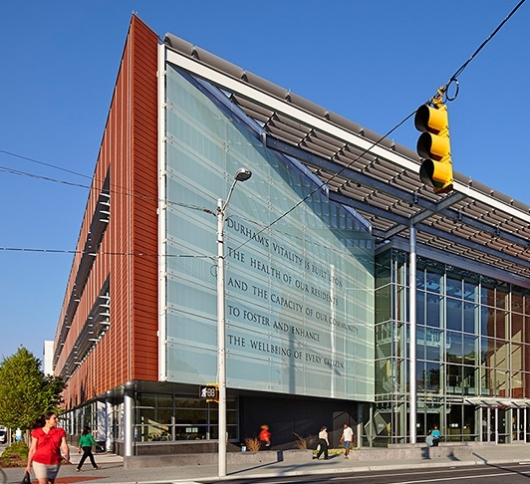
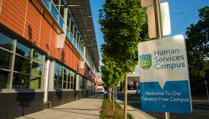
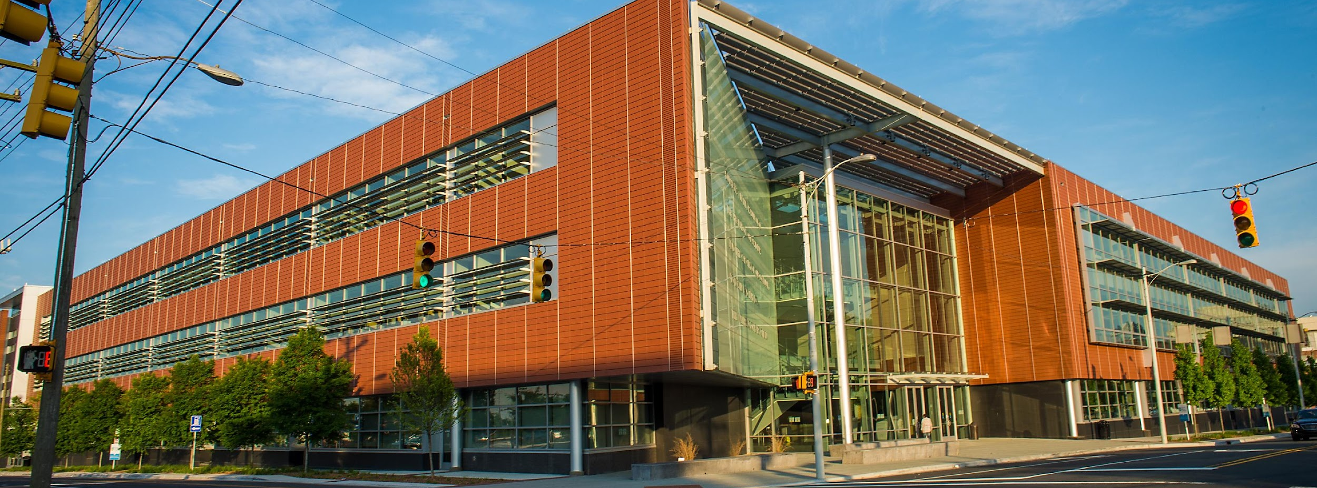

Slide 17
STAY CONNECTED
Durham County Department of Public Health
Elizabeth Stevens
Deputy Public Health Director
estevens@dconc.gov
Kristen Patterson
Deputy Public Health Director
kmpatterson@dconc.gov
Website: www.dcopublichealth.org | Facebook: @DurhamHealthNC
Twitter: @DurhamHealthNC| Instagram: @DurhamHealthNC

