Slide 1
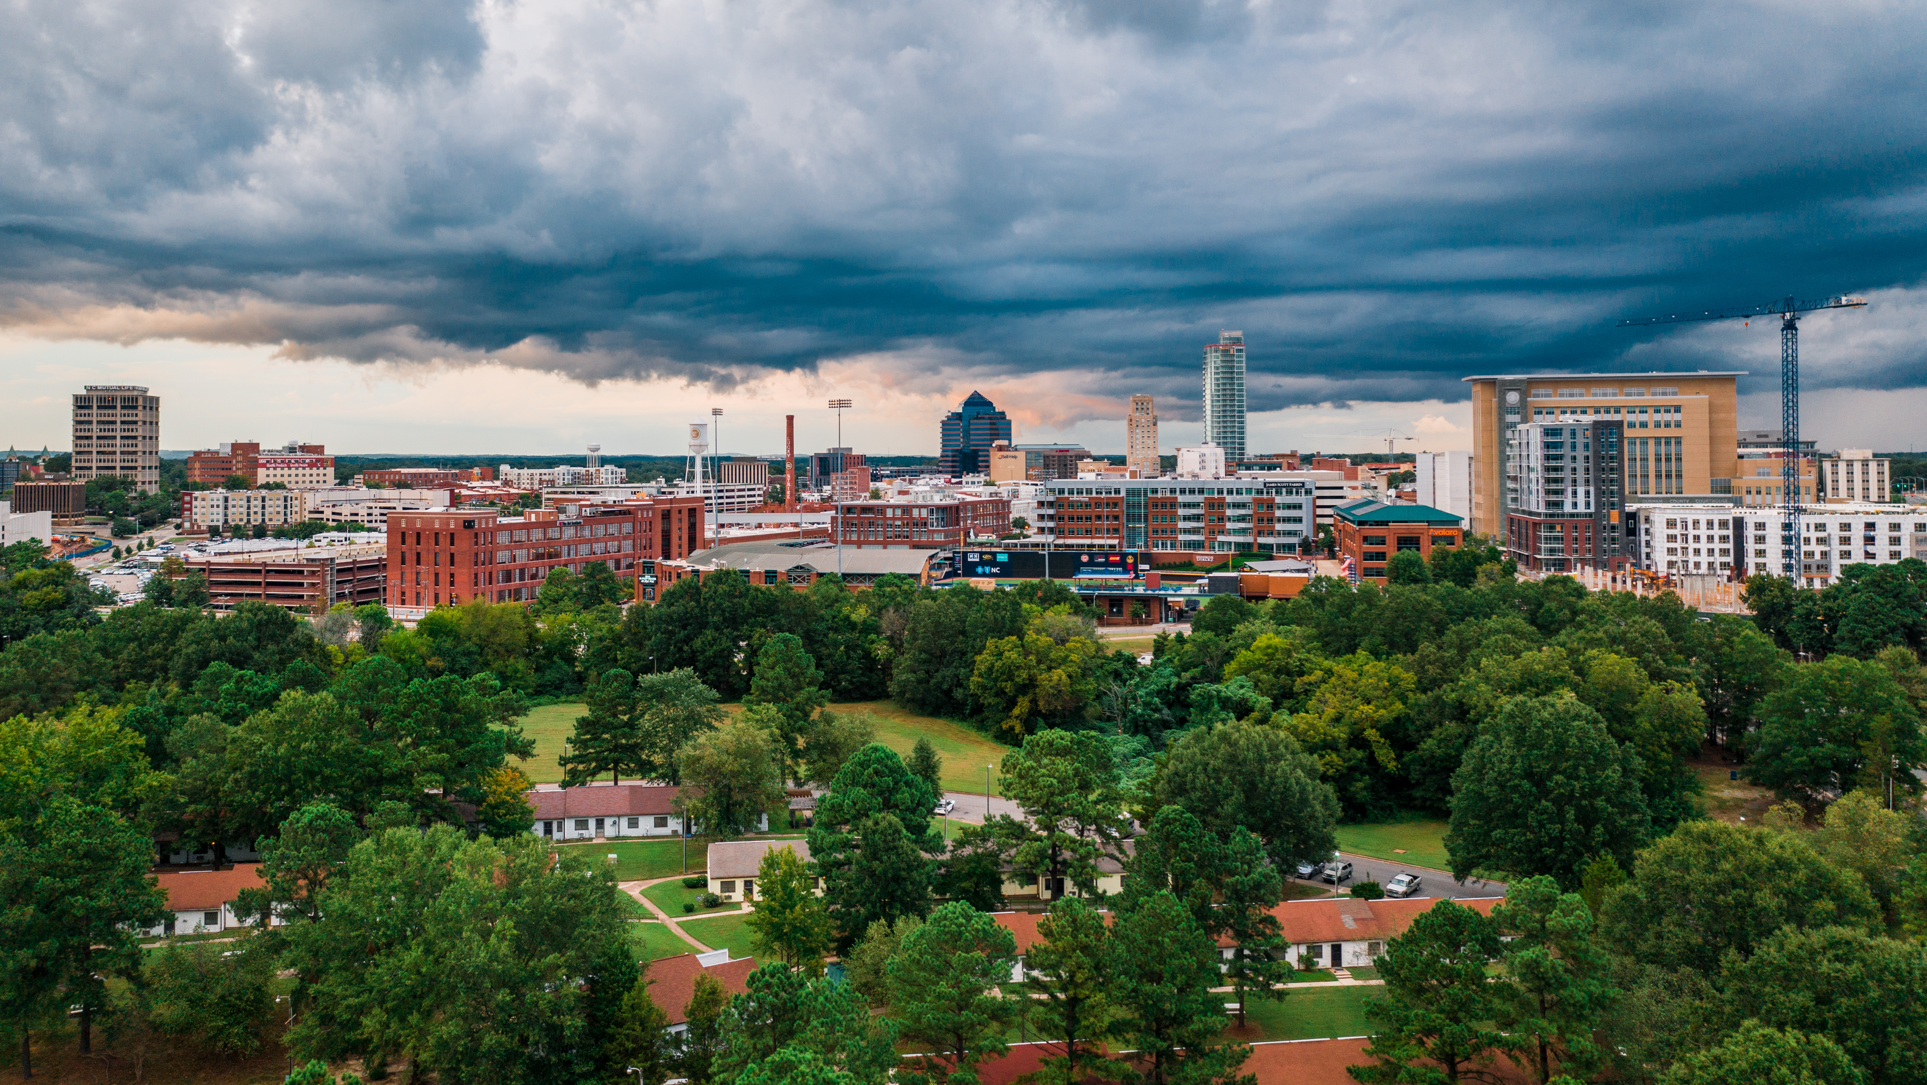

DURHAM NEIGHBORHOOD COLLEGE 2023
City-County Planning Department
Michael Stock, AICP, Planning Manager Michael.stock@durhamnc.gov
Scott Whiteman, AICP, Planning Manager Scott.whiteman@durhamnc.gov

Slide 2
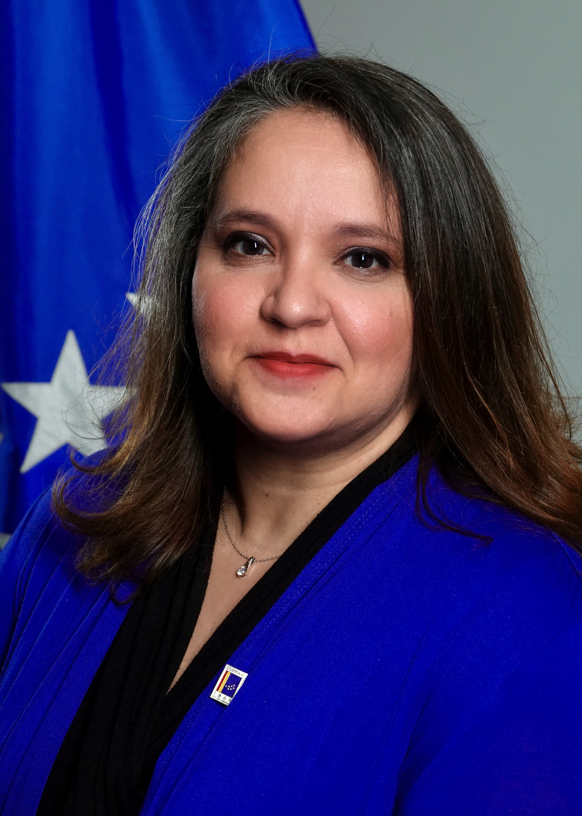

Planning Department Mission & Vision
Planning Director: Sara Young, AICP
Asst. Directors:
Grace Smith, AICP
Bo Dobrzenski, AICP

Slide 3

Planning Department Mission & Vision
The department serves the City and County to:
1. Provide long-range policy guidance for how the City and County develops and grows
(Community Planning, Growth Management).
EngageDurham
New Comprehensive Plan- up for adoption this fall!
Open Space Plans
Historic Preservation
  2. Ensure compliance with development regulations
(Development Review, Zoning Enforcement, Customer Service)
Durham Unified Development Ordinance (re-write to begin this year)
Durham Landscape Manual
Historic Properties Review Criteria
  3. We are not the Building Inspections Department- they handle:
Building permits
Trade permits
Demolition permits

Slide 4
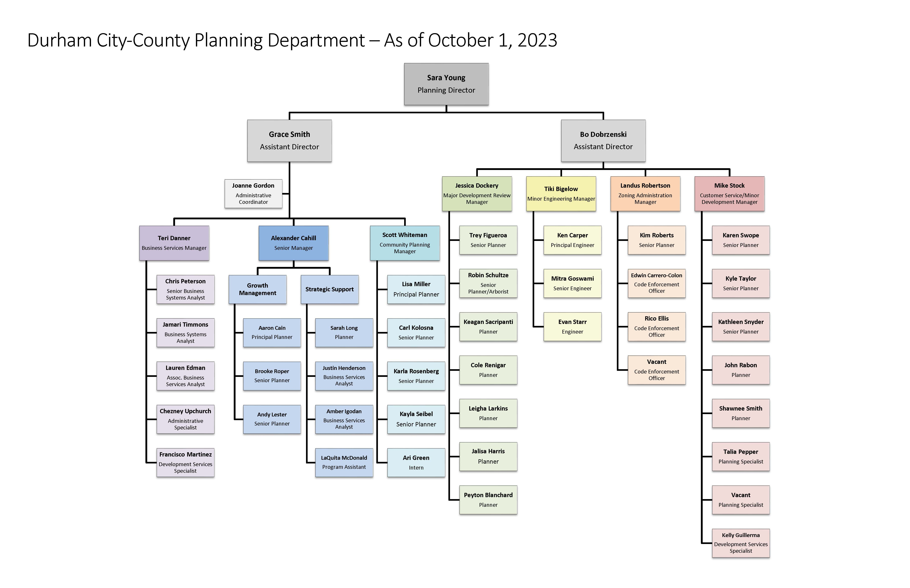
Planning Department Organizational Chart & Structure

Slide 5
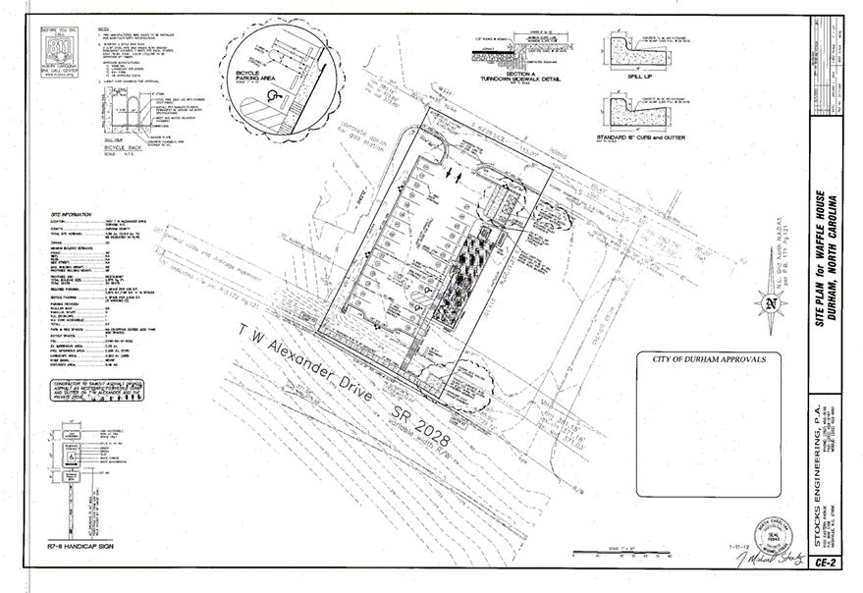
Key Divisions, Programs & Initiatives
Development Review:
Site plan/plat review
Customer service/inquiries
Various other permits-
building permit partner review, home occupation,
verification letters, sign permits
Street closings and renamings
Board of Adjustment cases-
variances, special use permits, appeals

Slide 6
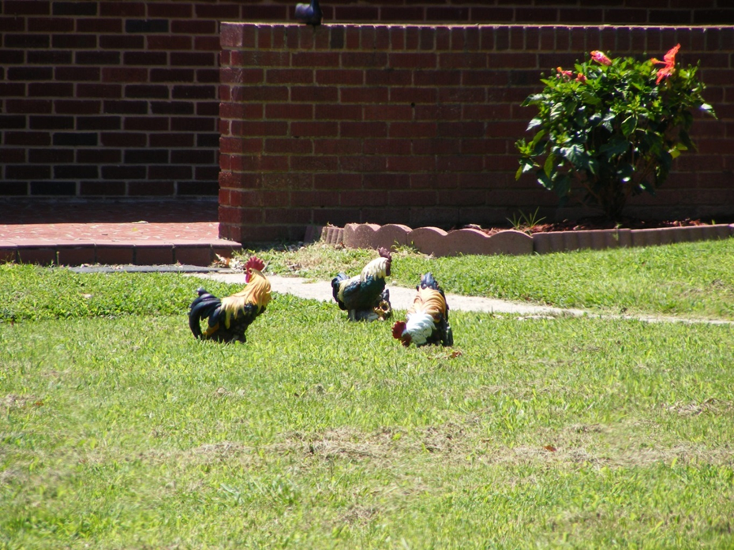
Key Divisions, Programs & Initiatives
Enforcement and Site Compliance:
Responds to violations of zoning requirements
  Illegal use
  Vehicle repair and sales
  Fence height
  Parking in yards
  Signs
  Livestock in the City
  Site plan violations
Performs site compliance for new developments

Slide 7

Key Divisions, Programs & Initiatives
Strategic Planning:
Community Planning:
  Comprehensive Plan
  Other policy development, plans
  Historic Preservation
Rezoning
Annexation
Text Amendments

Slide 8
Frequently Asked Questions
What don’t we get asked?!?!?
What can I do with my property?
What is going on at X location?
How can I do X?
Who’s responsible for X?

Slide 9
Opportunities for Engagement
General Planning/Zoning Questions- planning@durhamnc.gov or 919-560-4137
    Property/zoning information
    Help with rules/regulations
    Other general questions/information
  Rezoning, Annexation, and ordinance amendments-Growth Management Social PinPoint page https://durham.mysocialpinpoint.com/growthmanagement/land-use-home/
    Can view documents and map related to applications.
    Can provide comments
  EngageDurham- https://engagedurham.com/
    Comprehensive Plan meeting and engagement information
    Future UDO re-write engagement platform
    Link to other City projects.

Slide 10
Final Thoughts
The Planning Department serves both the City and unincorporated County.
  We have two bosses
Has various roles:
  Regulatory
  Policy
  Enforcement
Biggest next project: a new, updated Unified Development Ordinance (UDO)-
  Just getting started!

Slide 11


STAY CONNECTED
City-County Planning Department
Planning Department homepage:
https://www.durhamnc.gov/338/City-County-Planning
Some helpful email contacts:
General questions:
Planning@durhamnc.gov
Rezonings and annexation: growth@durhamnc.gov
Historic Preservation:
preservation@durhamnc.gov

