Slide 1
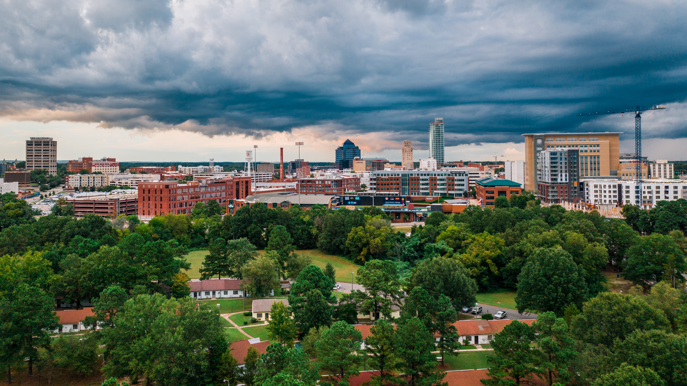

DURHAM NEIGHBORHOOD COLLEGE 2023
Welcome!
Session 5 – Thursday, Oct. 12, 2023
Schedule:
6 – 6:30 p.m.: Dinner & Check-in
6:30-7:20 p.m.: Department Presentations
  City-County Planning
  City Community Development
  Durham County Engineering & Environmental Services
7:20-7:30 p.m.: Break
7:30-7:50 p.m. Questions and Answers Session
7:50-8:30 p.m.: Wrap up, Elect Class President, and Closing
Enjoy your dinner and some conversation.

Slide 2
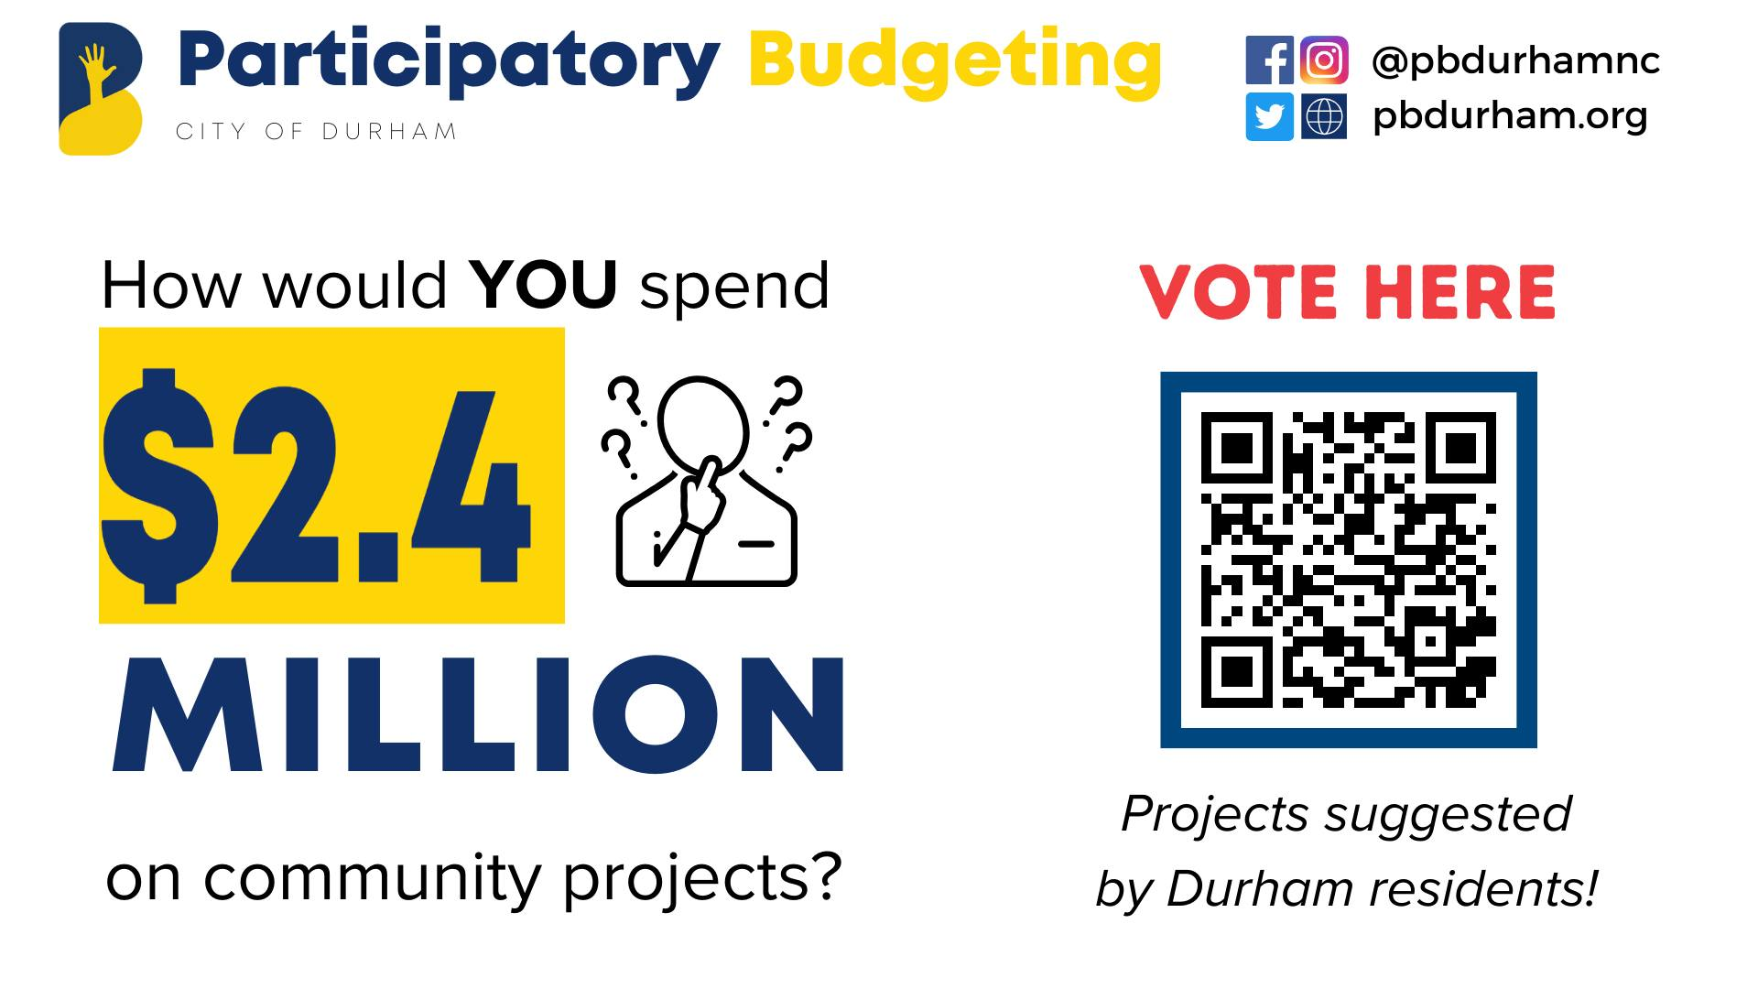

Slide 3
Presentations
ENGINEERING & ENVIRONMENTAL SERVICES​
Celeste Burns​
Real Estate Coordinator​
​
McKenzie Bradshaw, P.E., C.F.M.​
Stormwater Manager​
​
Jim Faress, P.E..​
Senior Project Manager
CITY-COUNTY PLANNING
Scott Whiteman
Community Planning Manager
COMMUNITY DEVELOPMENT
Reginald Johnson
Director

Slide 4
DURHAM NEIGHBORHOOD COLLEGE 2023
Break
Session 5 – Thursday, Oct. 12, 2023
Schedule:
6 – 6:30 p.m.: Dinner & Check-in
6:30-7:20 p.m.: Department Presentations
  City-County Planning
  City Community Development
  Durham County Engineering & Environmental Services
7:20-7:30 p.m.: Break
7:30-7:50 p.m. Questions and Answers Session
7:50-8:30 p.m.: Wrap up, Elect Class President, and Closing
Enjoy a 10-minute break

Slide 5

Q&A Panel
CITY-COUNTY PLANNING
Scott Whiteman
Community Planning Manager
COMMUNITY DEVELOPMENT
Reginald Johnson
Director
ENGINEERING & ENVIRONMENTAL SERVICES​
Celeste Burns​
Real Estate Coordinator​
​
McKenzie Bradshaw, P.E., C.F.M.​
Stormwater Manager​
​
Jim Faress, P.E..​
Senior Project Manager

Slide 6
DURHAM NEIGHBORHOOD COLLEGE 2023
Wrap Up
Session 5 – Thursday, Oct. 12, 2023
Schedule:
6 – 6:30 p.m.: Dinner & Check-in
6:30-7:20 p.m.: Department Presentations
  City-County Planning
  City Community Development
  Durham County Engineering & Environmental Services
7:20-7:30 p.m.: Break
7:30-7:50 p.m. Questions and Answers Session
7:50-8:30 p.m.: Wrap up, Elect Class President, and Closing
What’s Next?
Complete end of Session Survey

