Slide 1
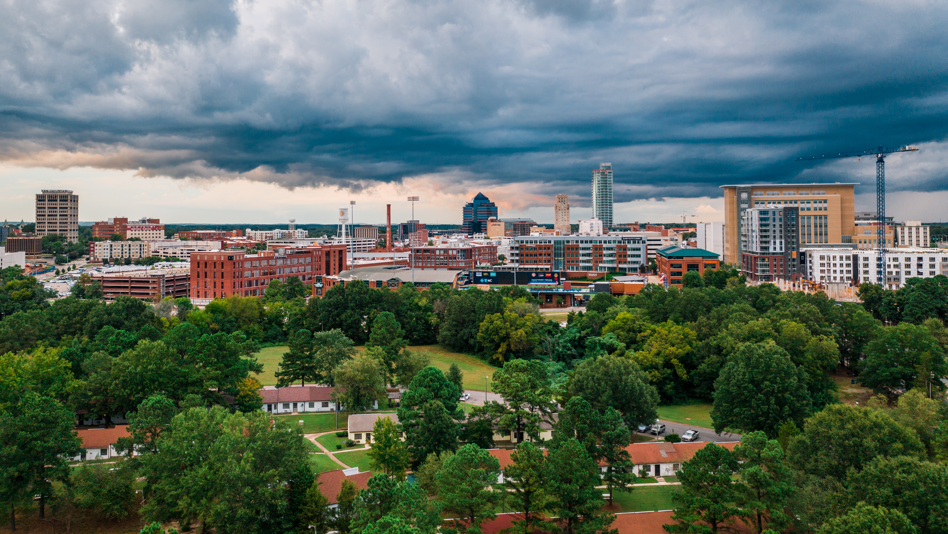

DURHAM NEIGHBORHOOD COLLEGE 2019
Engineering and Environmental Services
Presented by: Peri Manns
[This is a placeholder image – Feel Free to replace it with an image that relates to your department.]

Slide 2

Engineering and Environmental Services Mission & Vision

Slide 3

Jay Gibson, Jr.
General Manager
Joyce Dennis
Administrative Officer
Peri Manns
Deputy Director
G. Elaine Laws
Senior Administrative Support
Assistant
Deborah Waterman
Contract Specialist
Utility
Division
Project Management
James Faress
Division Manager
Storm Water & Erosion
Ryan Eaves
Division Manager
Sustainability
Tobin L. Freid
Division Manager
Open Space/Real Estate
Vacant
Division Manager
See Attached
Utility Division
Organization Chart
Joel Jones
Project Manager
McKenzie Bradshaw
Storm Water Manager
Megan Pendell
Sustainability Specialist
Brendan Moore
Open Space Coordinator
Celeste Burns
Open Space Coordinator
Brenda Hayes- Bright
Project Manager
Meredith Stull
GIS Analyst
Haley Williamson
Renewable Energy
Project Manager
David Bradley
Open Space Coordinator
Dan Nosbusch
Project Manager
Jonathan McNeill
S &E Control Supervisor
Nancy Mitchell
Senior Real Estate Officer
Dan Nosbusch
Project Manager
Robert Stewart
Cody Schmoyer
Malik Clark
S&E Control Technicians
Travis Marion
Stormwater Technician

Slide 4
DURHAM COUNTY UTILITY DIVISION
FY 2019 - 2020
Deputy Director
Stephanie Brixey
D5
40001831 – C116001
Sr. Project Manager
Vince Chirichella, PE
D2
40001833 – C102003
Lab & Compliance Mgr.
Amy Moore
D2
40007353 – C810001
Safety Project Coord.
Mike Garver
C2
40001834 – C213001
Utility Superintendent
VACANT
D2
40005475 – C741001
Utility Technician
Elyssa Monzingo
C1
40009379 – C111005
Administrative Officer
Corinna Somers
C3
40008125 – C056011
Project Coordinator
Blake Fite
C2
40009024 – C213004
Prtrtmt. Project Coord.
Laura Melton
C2
40002376 – C213G03
Utility Supervisor
Shawn Davis
C5
40005525 – C120007
Utility Supervisor
Stephen Phillips
C5
40005526 – C873001
Senior Admin. Assistant
Angela Rigsbee
C2
40008126 – C055012
Utility Technician
Michael Dean
C1
40001826 – C111003
Plant Lab Analyst
Kelley van de Kamp
C1
40007881 – C780001
O & M Specialist II (M-F 4p-12a)
William Clayton
B5
40001828 – C748001
SCADA/Instrumentation Tech.
VACANT
C2
40005580 – C754001
O & M Specialist II
Larry Davis
B5
40005581 – C744003
Senior Plant Maint. Tech.
Les Shifflett
C1
40005600 – C746001
O & M Specialist II
Bryan Chavis
B5
40008959– C744004
Plant Maintenance Tech.
Scott Shepherd
B5
40005582 – C745003
O & M Specialist II (Shared)
Rob Bonne (PT), Jason Faison, Joe Toong
& Wayne Clemons (Temp./Relief)
B5
40005578 – C744001
Plant Maintenance Tech.
Tom Kutch
B5
40005579 – C744002
O & M Specialist I
Robert Hilliard
B3
40005576 – C743001
25 POSTIONS
23 FTE’S / 1 PTE / 3 TRE’S
O & M Specialist I
Jason Trimnal
B3
40005577 – C743002
Plant Maintenance Tech.
Johnny Heard
B5
40008960 – C745002
Maintenance Tech.
Thomas “Lee” Williams
B3
40006803 – C487G33
Updated 10/8/19

Slide 5
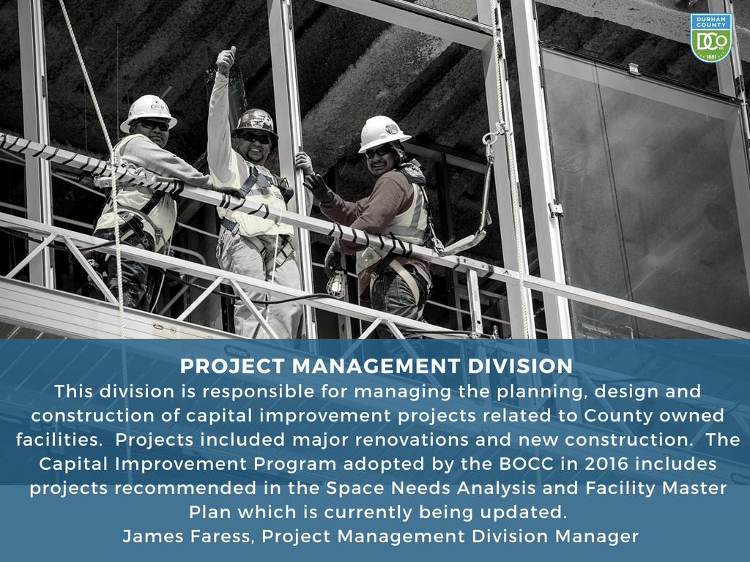
Engineering and Environmental Services
Project Management Division

Slide 6
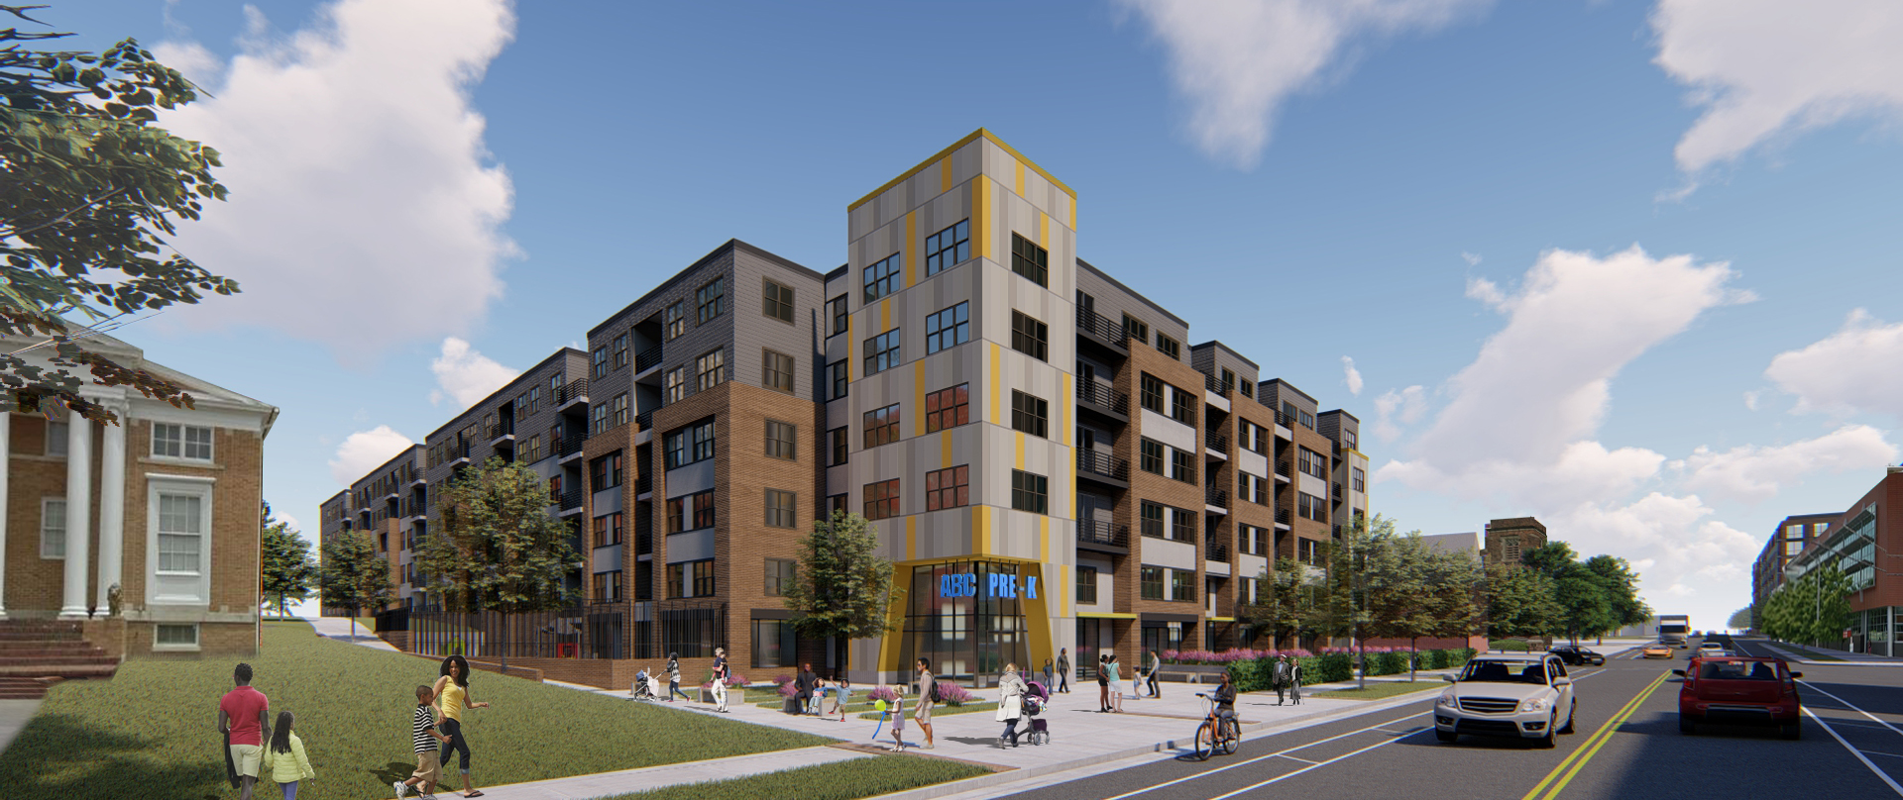
300 E. Main Street
Mixed Use Development
Durham County Government
www.dconc.gov

Slide 7
ONGOING PROJECTS
The 300 E. Main St. project includes a 757 space structured parking garage with a 110-unit mixed income affordable housing wrapper with a childcare space and commercial/retail component.
The 500 E. Main St. project includes a 847 space structured parking garage with 195-unit mixed income affordable housing structure and a 246-unit market rate housing wrapper with commercial/retail space suitable for a grocer and other tenants.
Durham County Government
www.dconc.gov

Slide 8
300 E Main St – Development PROGRAM
Affordable Housing
Childcare & Commercial Space
Unit Type | 30% AMI | 60% AMI | 80% AMI | TOTAL
STUDIO | 3 | 12 | 0 | 15
1BR | 7 | 18 | 5 | 30
2BR | 9 | 30 | 11 | 50
3BR | 3 | 8 | 4 | 15
TOTAL | 22 | 68 | 20 | 110
Description | Sq. Ft.
Childcare | 10,243
Commercial | 3,900
TOTAL | 14.143
Diverse unit mix to allow the buildings to be
Mixed-Income
Mixed-Use
Intergenerational
Commercial Space:
Activate Queen Street
Non-Profits
Socially Responsible
Durham County Government
www.dconc.gov

Slide 9
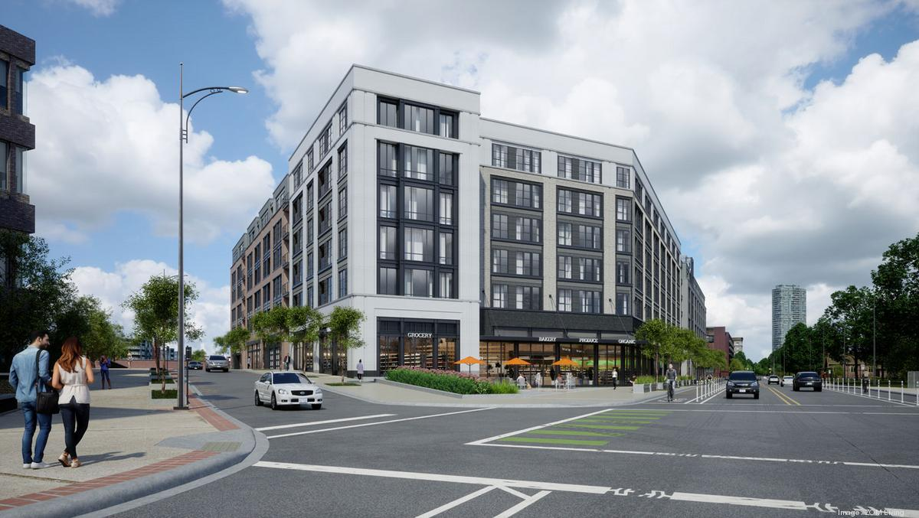
500 E. Main Street
Mixed Use Development
Durham County Government
www.dconc.gov

Slide 10


500 E Main St- Development PROGRAM
Market Rate Housing
Affordable Housing
Unit Type | Avg Sq. Ft | No. of Units | % of Units
STUDIO | 562 | 43 | 17%
1BR | 695 | 118 | 48%
2BR | 1198 | 80 | 33%
3BR | 1506 | 5 | 2%
TOTAL | 845 | 246 | 100%
Unit Type | 30% of AMI | 60% of AMI | 80% AMI | TOTAL
STUDIO | 13 | 14 | 15 | 42
1BR | 27 | 42 | 24 | 93
2BR | 5 | 34 | 7 | 46
3BR | 1 | 12 | 1 | 14
TOTAL | 46 | 102 | 47 | 195
500 East Main St Market Rate
Activates the street on three sides
Provides housing for all sizes and ages
Conceals 847 space parking deck
500 East Main Affordable
Five story building fronting Ramseur St
200 mixed income units
Unit mix serves a range of incomes
Durham County Government
www.dconc.gov
9

Slide 11
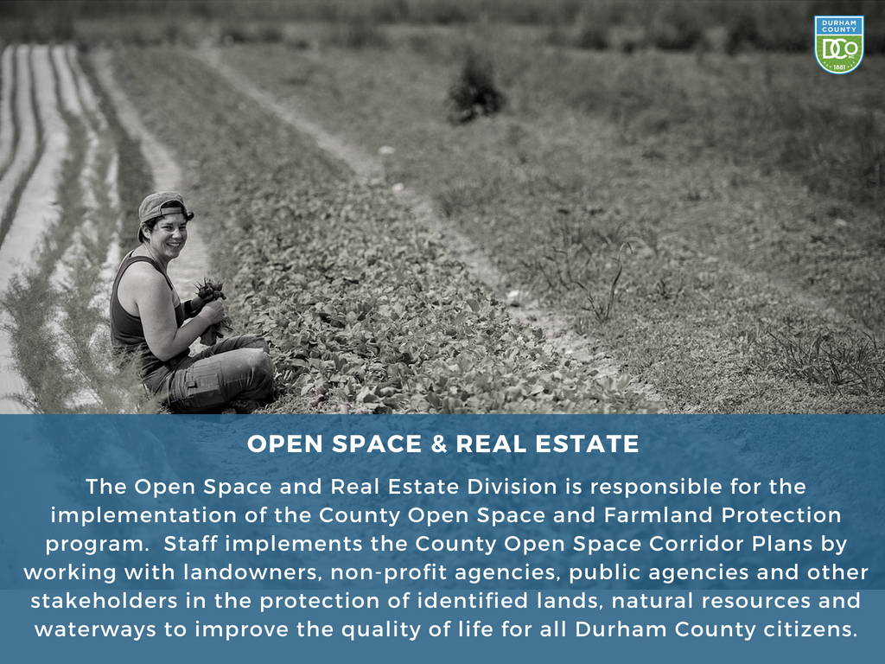
Engineering and Environmental Services
Open Space and Real Estate

Slide 12
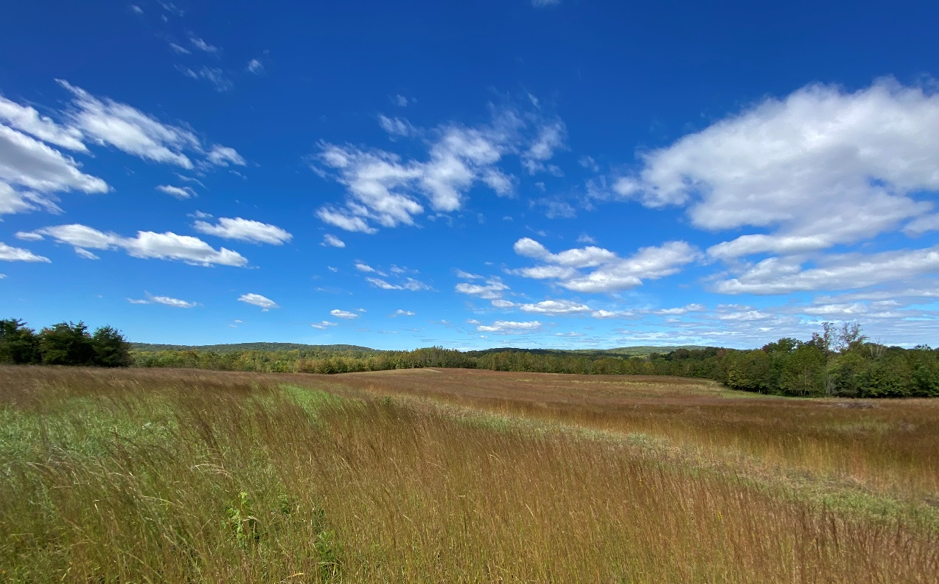
Engineering and Environmental Services
Open Space and Real Estate
3,792 acres preserved to date
  1,293 acres owned in fee simple by County
  2,499 acres protected with conservation easements
  Administer the County’s Open Space Matching Grants Program – APPLY NOW through November 15!

Slide 13
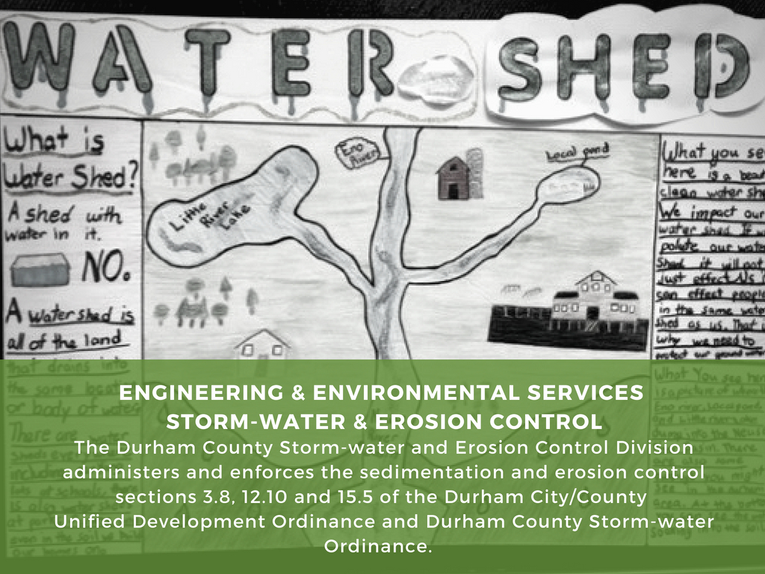
Engineering and Environmental Services
Stormwater and Erosion Control

Slide 14
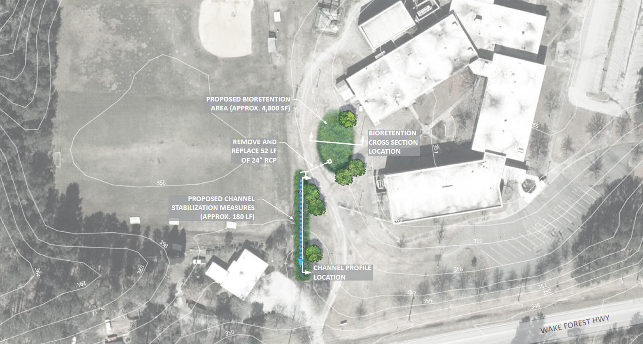
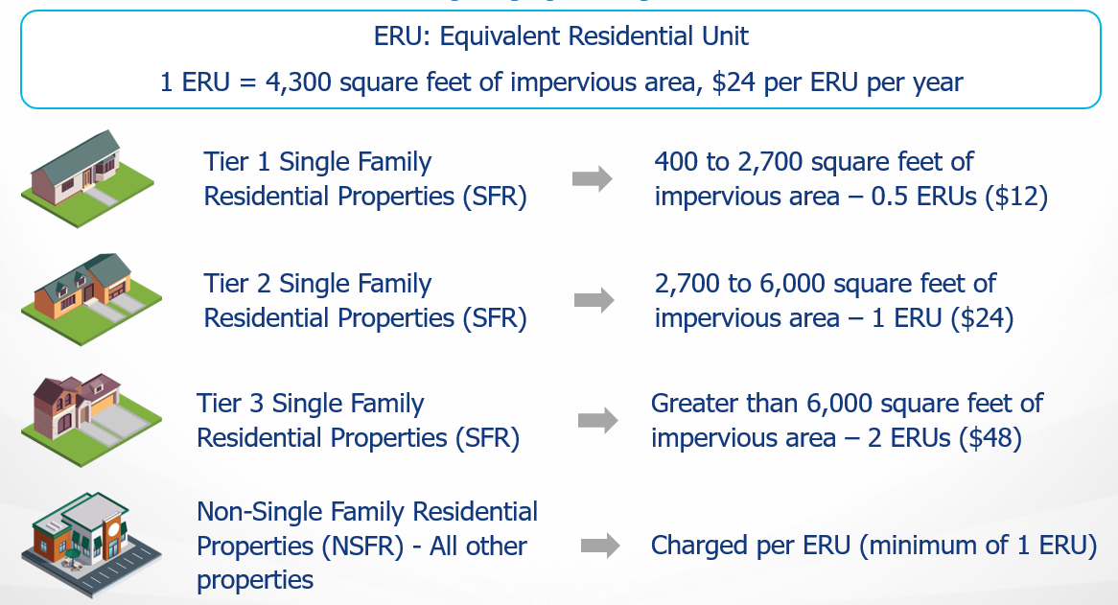
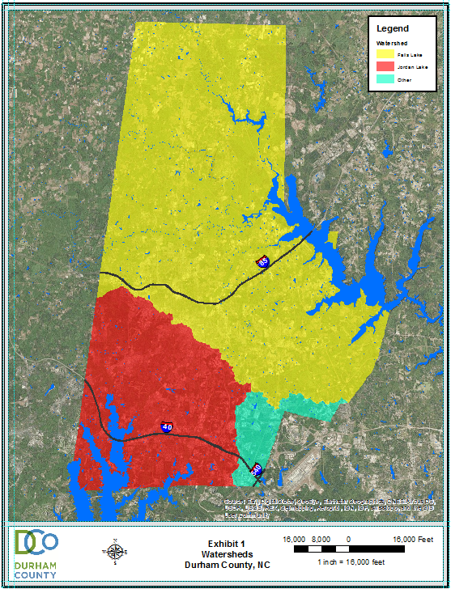
Engineering and Environmental Services
Stormwater and Erosion Control
Stormwater Utility Fee
Grant Opportunities
Rules and Regulations

Slide 15
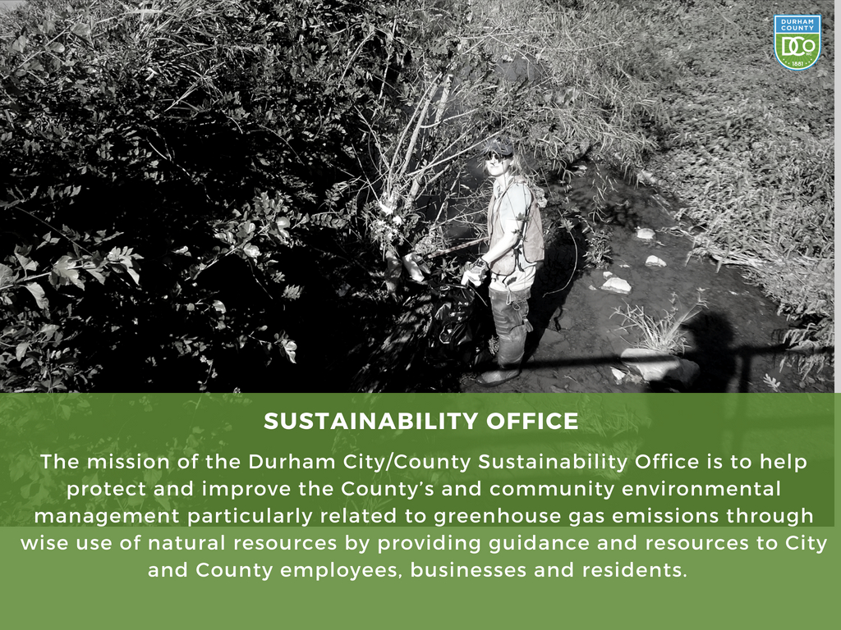
Engineering and Environmental Services
Sustainability Division

Slide 16
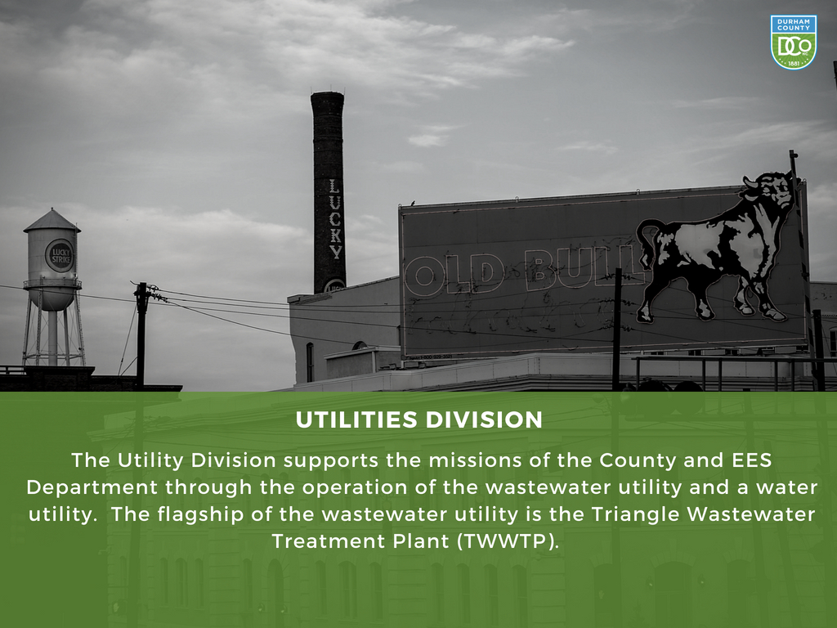
Engineering and Environmental Services
Utilities Division

Slide 17
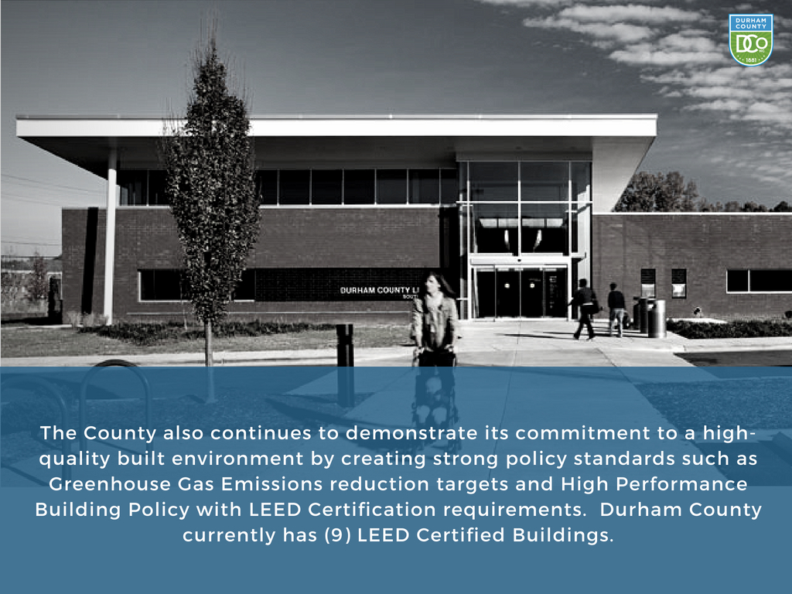
Engineering and Environmental Services
Final Thoughts

Slide 18
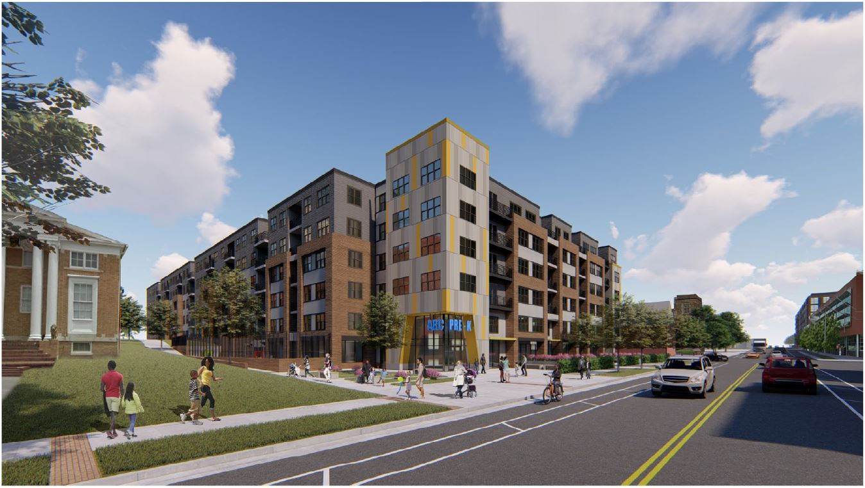
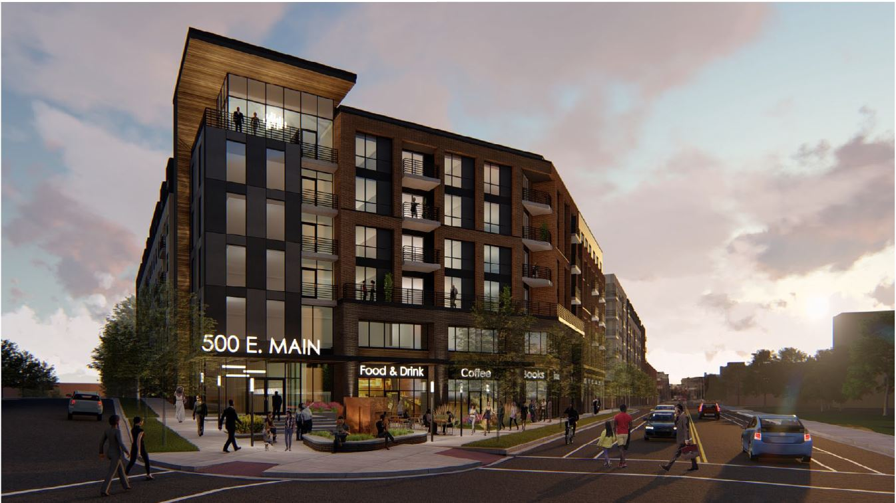
Engineering and Environmental Services
Opportunities for Engagement

Slide 19
Engineering and Environmental Services
Opportunities for Engagement
Come meet Laurel Street and ZOM Living and hear about the future of the 300 and 500 blocks of East Main Street. The Durham Board of County Commissioners (BOCC) selected Laurel Street and ZOM Living to execute on its vision for the two County-owned sites. The proposed plan includes a mix of affordable and market-rate apartments, commercial space along East Main Street, and parking for tenants and County employees.
Please join Durham County and the development team at one of the following informational sessions:
Saturday, November 2, 2019 at 10 AM at the Holton Career and Resource Center located at 401 N. Driver St., Durham NC.
Tuesday, November 12, 2019 at 7PM at the Durham County Human Services Facility located at 414 E. Main St., Durham NC.
To learn more about the redevelopment of the 300 and 500 blocks of East Main, please visit www.dconc.gov/EMainSt

Slide 20
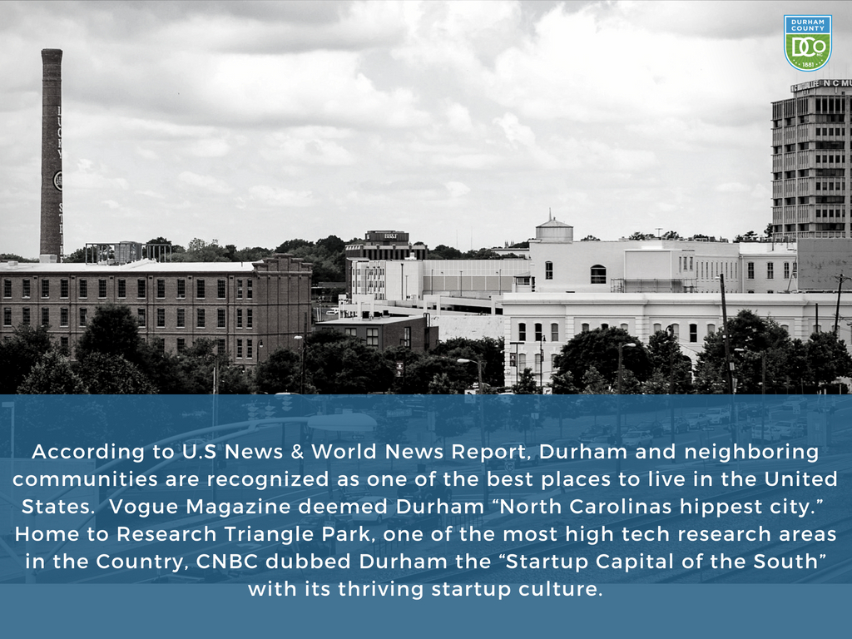
Engineering and Environmental Services
Final Thoughts

Slide 21
STAY CONNECTED
Engineering and Environmental Services
Peri Manns, ASLA, LEED GA
Deputy Director
pmanns@dconc.gov
Website: [URL] | Facebook: [@handle] | Twitter: [@handle] | Instagram [@handle]
[This is a placeholder image – Feel Free to replace it with an image that relates to your department.]

