Slide 1
DCo THRIVES
Counties for Guaranteed Income
BOCC Work Session
August 7, 2023

Slide 2
History
In June 2020, Mayors for Guaranteed Income (MGI) was founded as a guaranteed income pilot by former Mayor of Stockton, Michael Tubbs.
The MGI coalition has grown to over 100 mayors. The City of Durham launched its pilot in January 2022.
Counties for Guaranteed Income (CGI) launched in 2023. Chair Brenda Howerton and Commissioner Nida Allam are founding members of the CGI coalition.
Mission: Counties for Guaranteed Income is a coalition of county elected officials from across the United States working to ensure that all Americans have an income floor.

Slide 3
Pilot Program
Eligible participants in Durham County’s Guarantied Income Program DCo THRIVES are defined as low-income families with children under 18. Data based on 748 residents currently receiving ERAP funds. 63% of those, 471 residents, are at or below 30% of the AMI.
Selected participants will be randomly sorted into two groups: stipend recipients and comparison participants.
Stipend recipients will receive financial support each month in addition to compensation for survey completion. Comparison participants will only receive compensation for survey completion.
We estimate 125 stipend recipients and 125 comparison participants for a total of 250 participants in the pilot program.

Slide 4
Why Families?
The Grown in Durham research study: Designing a Feasible and Effective Guaranteed Basic income Pilot to Improve Early Childhood Outcomes for Durham County, North Carolina found:
  Family economic insecurity is a root cause of many of the challenges families face.
  Parents feel additional income would make a big difference in their lives and ability to support their children.
  Research on basic income pilots point to clear outcomes including increased savings, reduced stress, and improved mental health.

Slide 5
Demographics
The Grown in Durham research study further identified the following:

Slide 6
Program Administration
The County will provide guidance on the administration of the program through a Program Manager who will serve as liaison to partners.
Via a Memorandum of Understanding, Counties for Guaranteed Income (CGI) will operate as a consultant, technical assistance provider, convener, and strategist for the guaranteed income pilot.
Via a Funds Provision Agreement (FPA), a contracted party will promote the program, recruit participants, manage applications, identify participants, confirm eligibility, and provide disbursements to pilot participants. Additionally, the third party will track and measure results of the pilot via surveys of participants and other tools.
Counties for Guaranteed Income Research (CGIR) at the University of Pennsylvania School of Social Policy & Practice will facilitate data collection and assessment.

Slide 7
Funding & Expenses
Durham County will seed the DCo THRIVES Program through ARPA funds
  Pilot stipends - $1.125M at $750/month for 125 recipients
  Pilot surveys - $300,000 at $100/month for 250 participants, stipend recipients will also receive compensation for surveys
  Contracted party administration - $150,000
  Program Manager salary and benefits - $75,000
  Marketing and branding - $25,000
  Supplies and incentives - $15,000
Total pilot estimated cost: $1,690,000

Slide 8
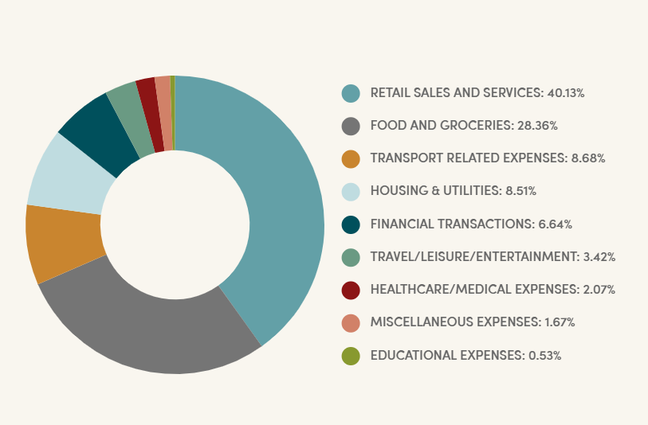
GI Data
According to the Guaranteed Income Pilots Dashboard Home | Guaranteed Income Pilots Dashboard
7,533 total participants
The largest share of expenditures went to retail sales and services, at 40%. Food and groceries were the second highest at around 28%. Transport and housing/utilities were next, at 9% and 9% respectively, followed by financial transactions at 7% and travel/leisure/entertainment at 3%. Healthcare, education, and miscellaneous expenses made up the final 4%.

Slide 9
Excel, City of Durham
The City of Durham launched the Excel pilot as part of the MGI program in 2022
Excel provides payments of $600/month to 115 Durham residents who are within 5 years of incarceration and are at 60% AMI
Excel partners with StepUp Durham to administer the program and Steady to manage payments
Excel’s goal is to evaluate the effects of cash payments on recidivism and re-incarceration, economic security, physical and mental health, housing, and overall well-being of formerly incarcerated participants
Excel partners with the Counties for Guaranteed Income Research (CGIR) at the University of Pennsylvania School of Social Policy & Practice

Slide 10
Next Steps
Approve recommendation to initiate the Counties for Guaranteed Income program, DCo THRIVES
Recruit Program Manager
Select contracted party via RFQ/RFP
Execute Memorandum of Understanding with Counties for Guaranteed Income
Execute Funds Provision Agreement with contracted party
Counties for Guaranteed Income Launch (proposed date October 26)

Slide 11
Thank you

