Slide 1


Live. Grow. Thrive.
National Opioid Settlement Funding
Status Report May 2023

Slide 2
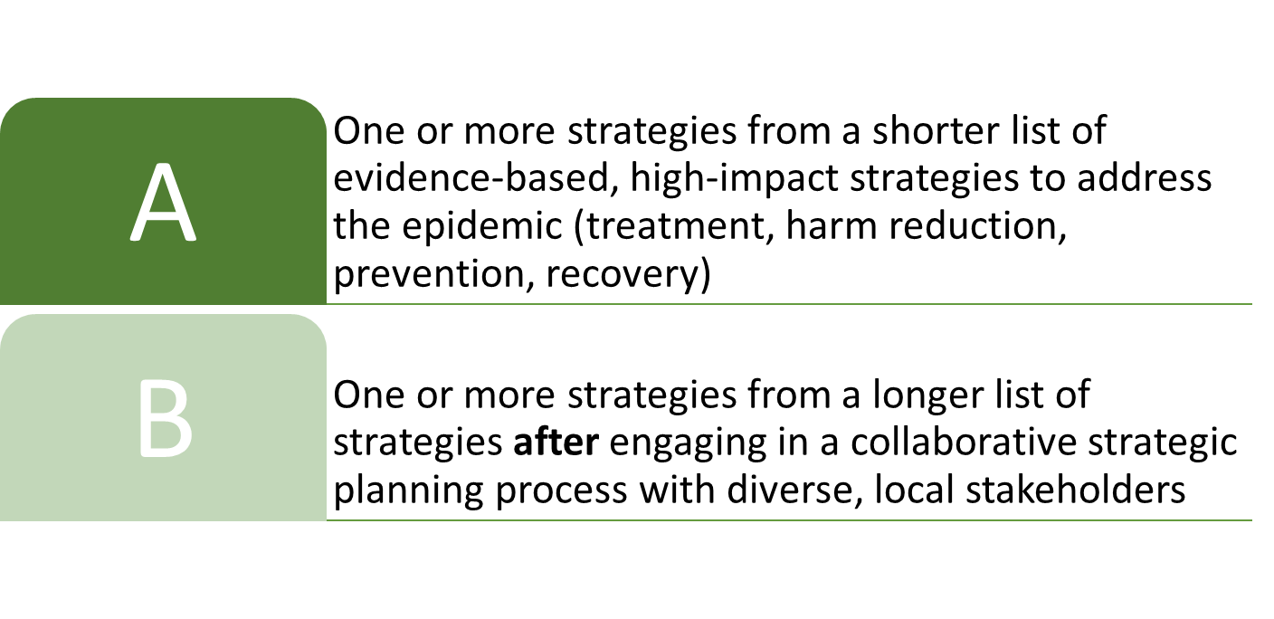
NC Opioid Settlement
In line with the National Settlement Agreement, funds “may support programs or services…that serve persons with Opioid Use Disorder (OUD) or any cooccurring Substance Use Disorder (SUD) or mental health condition.”

Slide 3

Durham County Process
Resolution approving the Memorandum of Agreement (MOA)
Creation of a Special Revenue Fund
Inventory of Existing Efforts
Inviting Community Input
  Dedicated Webpage
  Online Survey
  Community Input Sessions
Resolution to sign on to WAVE 2

Slide 4
DCo Survey Responses
Survey Portal open December 7, 2022 to January 31, 2023
554 Responses

Slide 5
Highest Priority Areas
Highest Priority
Highest Overall Votes
Evidence-Based Addiction Treatment
Early Intervention
Strategic Planning
Recovery Housing
Recovery Support Services
Evidence-Based Addiction Treatment
Recovery Support Services
Recovery Housing
Employment Services
Early Intervention

Slide 6

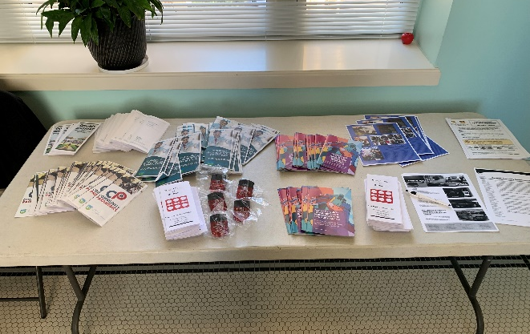
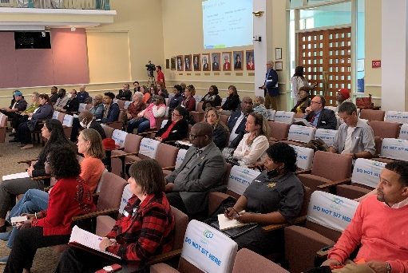
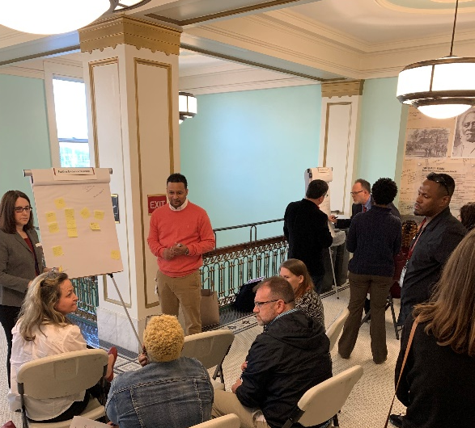
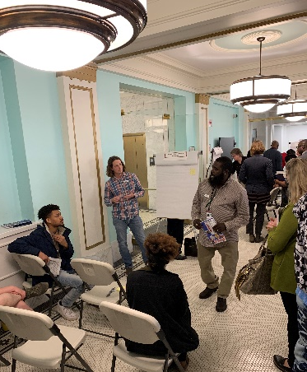
Community Input Session
March 20, 2023
68 Attendees
from a Diverse Group of Stakeholders

Slide 7
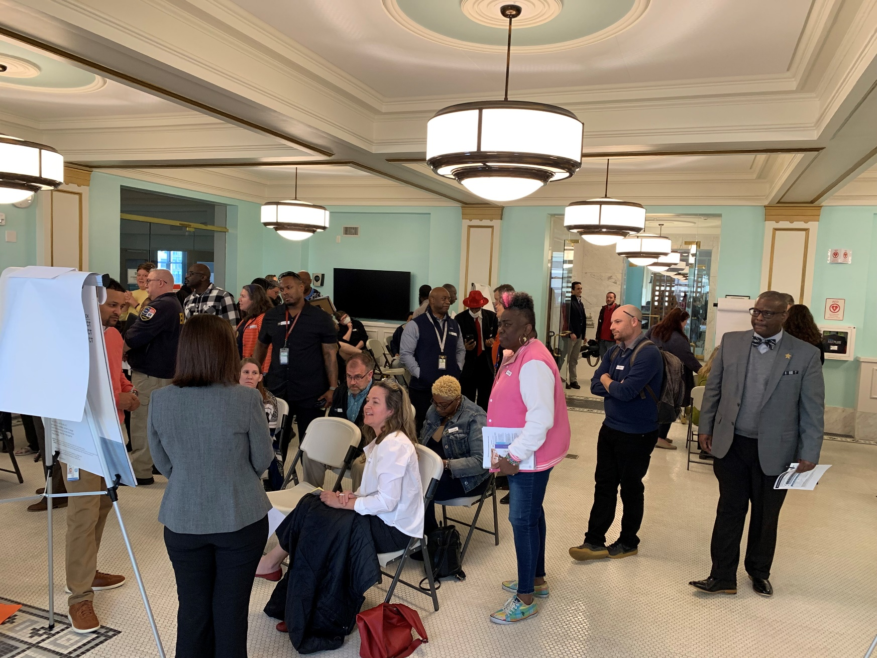
Community Input Session
Strategies – Highest Votes
Evidence-based Addiction Treatment
Evidence-based Recovery Support Services
Recovery Support Housing

Slide 8
Community Priorities
Based on March 20, 2023 Town Hall Attendees
Addiction Treatment
Recovery Support Services
Recovery Support Housing
Support evidence-based addiction treatment consistent with ASAM’s national practice guidelines for the treatment of opioid use disorder – including Medication-Assisted Treatment (MAT) with any medication approved for this purpose – through Opioid Treatment Programs, qualified providers of Office-Based Opioid Treatment, Federally Qualified Health Centers, treatment offered in conjunction with justice system programs, or other community-based programs offering evidence-based addiction treatment.
Fund evidence-based recovery support services, including peer support specialists or care navigators based in settings that support people in treatment or recovery, or people who use drugs, in accessing addiction treatment, recovery support, harm reduction services, primary healthcare, or other services or supports they need to improve their health or well-being.
Fund programs offering recovery housing support to people in treatment or recovery, or people who use drugs, such as assistance with rent, move-in deposits, or utilities; or fund recovery housing programs that provide housing to individuals receiving Medication-Assisted Treatment for opioid use disorder

Slide 9
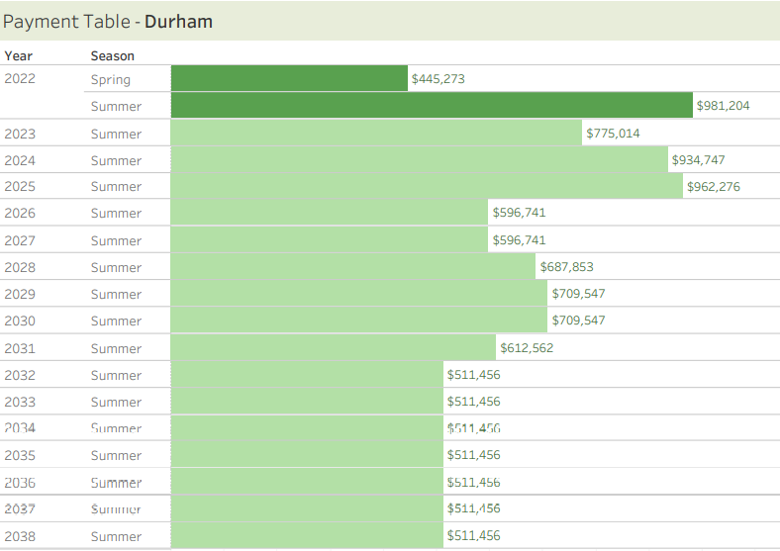
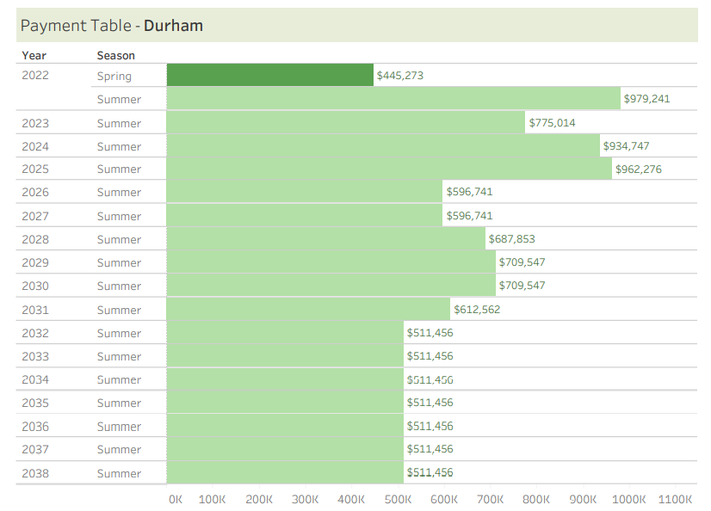


Opioid Settlement

Slide 10
Recommendations
Develop Structure
Establish Coordinator Position
Quick Wins and RFPs
Long-term Planning and Development of Behavioral Health Strategic Action Plan

Slide 11
Suggested Structure
Steering Committee (Project Team of community stakeholders proximate to the impacts of the Opioid Epidemic)
Subcommittees (Based on Funding Priorities)
Evaluation Committee
Behavioral Health Manager
Develop Durham County’s Behavioral Health Strategic Plan
Coordinate Opioid Settlement Planning, Reports and Activities
Community Updates
Time-Sensitive Actions
Authorize Spending for
BH Manager
Harm Reduction, life-saving Interventions: FT-IR for drug checking in the field ($42K), syringes
Community Linkages to Care program continuation

