Slide 1
Durham Joins Together to Save Lives
Co-Chairs
Dr. Wanda Boone
Commissioner Wendy Jacobs
Quarterly Update
December 14, 2021

Slide 2
Prevention Committee
Dr. Wanda Boone, Founder & CEO TRY
Memberships:
NC Institutes of Medicine
Statewide ACEs Advisory Council
National CEPOP Prevention Member
The Society for Prevention Research
Substance Use Prevention Funding Awards Include:
Drug Free Community Support Program
Substance Use and ACEs Prevention
NC Behavioral Health Equity ACEs
& Substance Use
HRSA COVID Vaccine
& Social Determinants of Health

Slide 3
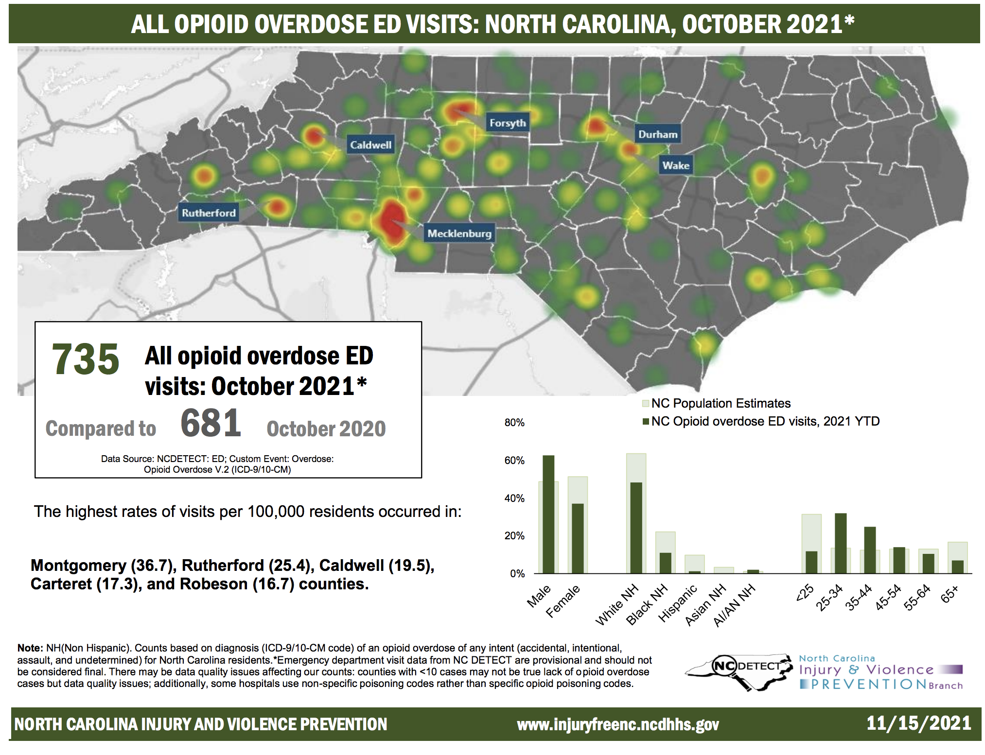
Durham Joins Together to Save Lives
Co-Chairs
Dr. Wanda Boone
Commissioner Wendy Jacobs
Quarterly Update
December 14, 2021

Slide 4
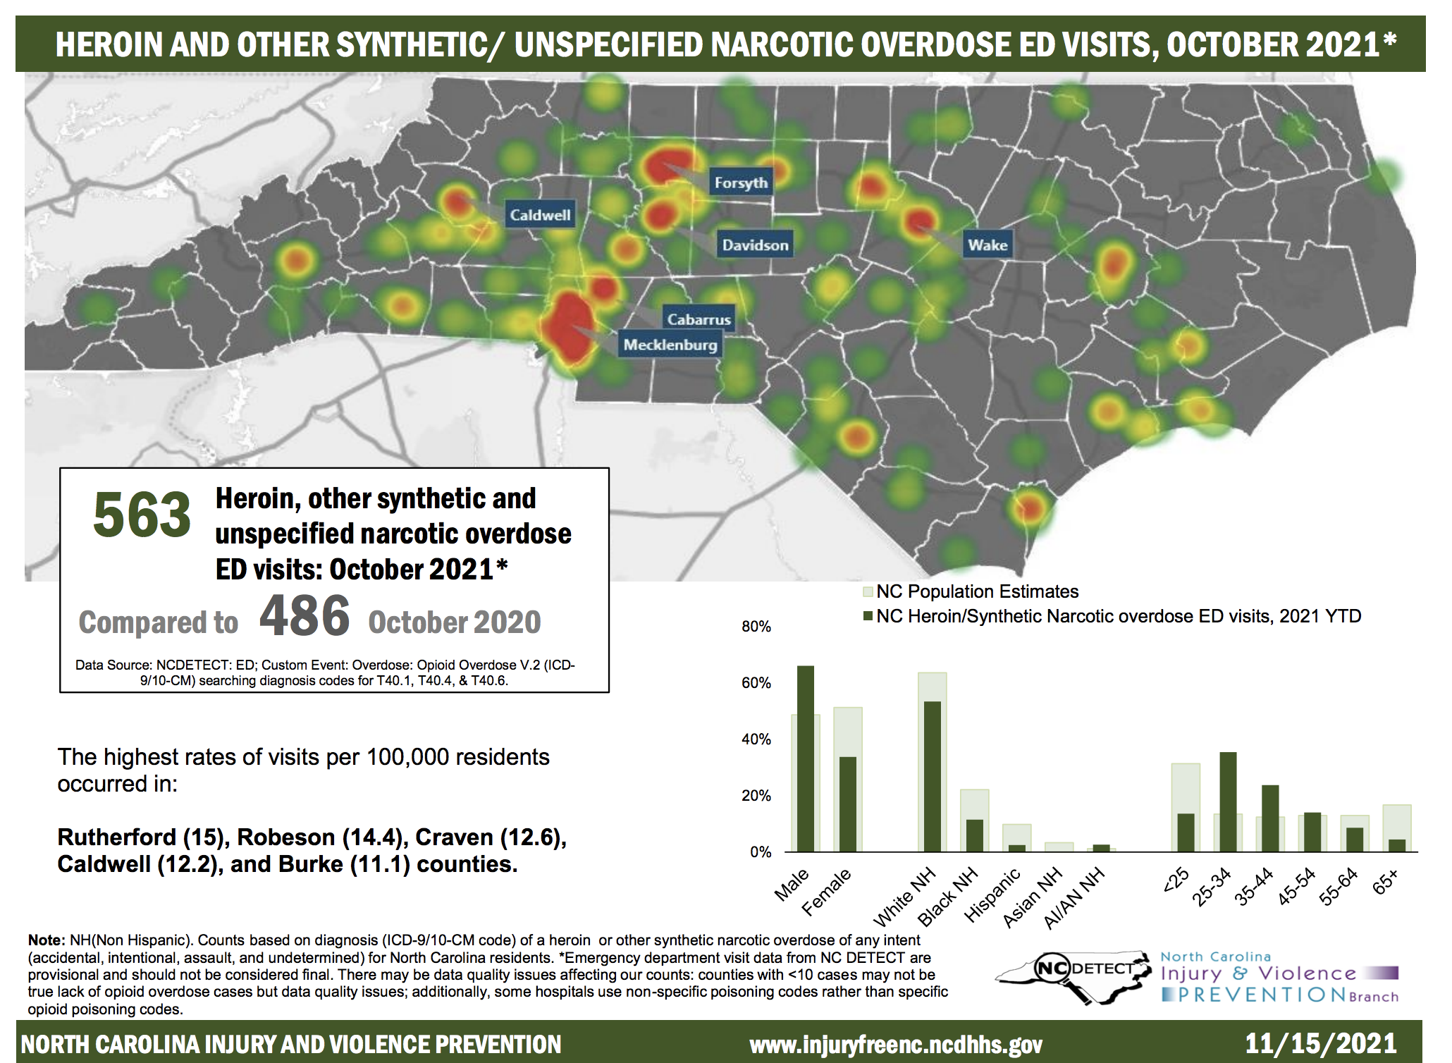
Durham Joins Together to Save Lives
Co-Chairs
Dr. Wanda Boone
Commissioner Wendy Jacobs
Quarterly Update
December 14, 2021

Slide 5
Durham Joins Together to Save Lives
Co-Chairs
Dr. Wanda Boone
Commissioner Wendy Jacobs
Quarterly Update
December 14, 2021

Slide 6
Durham Joins Together to Save Lives
Co-Chairs
Dr. Wanda Boone
Commissioner Wendy Jacobs
Quarterly Update
December 14, 2021

Slide 7
TRY Prevention Sector Program Champions
Environmental Strategies – Earl Boone 550 Businesses, 113 Home use Med Lock Boxes, Installed 7 Permanent Units
Partners Against Crime – Mindy Solie
Schools – Shaneeka Moore-Lawrence &, Franceilia Burwell
Faith – Florine Moore
Parent - Nancy, Coping Together from Kenya to NC
Youth/Student - Nathalia Rosales Substance Use and Mental Health
College Interns – Stephanie Morgan, Mineshia White, Conner Reed
Film Production & Black Farmers – Crystal Taylor
Change Your Words. Change Your World – Shenika Crowell
Community Health Worker Outreach – Keesha Judd
Annual Conference – Nicole Shramm-Sapayta
November 2022
35 Educational Events- 128 attendees 3,404 Views
10,000+ Social Media hits
85 1:1 Conversations
55 Business Engagements
75 information packages/Grief
$7,000 – Donated Social Determinants of Health
TOWN HALL ON OPIOIDS IN JANUARY
CHILDREN LOST DUE TO OVERDOSE

