Slide 1


MyPlate, My Body
2nd Grade
This institution is an equal opportunity provider. This material was funded by USDA’s Supplemental Nutrition Assistance Program-SNAP.
Notes:
Hello boys and girls! My name is ___________ and I am your school nutritionist. I will be coming to your class about once a month to talk all about food. Raise your hand if you like food. Great – me too! Every time I come in, I want you to be a part of each lesson but it is really important that you raise your hand to be called on if you have something to say.
Raise your hand if you have ever had nutrition classes before. I want you all to help me teach by actively answering questions and helping with explanations.

Slide 2
Objectives
1. Students will name at least three activities that contribute to being healthy.
2. Students will name the five food groups on MyPlate.

Slide 3
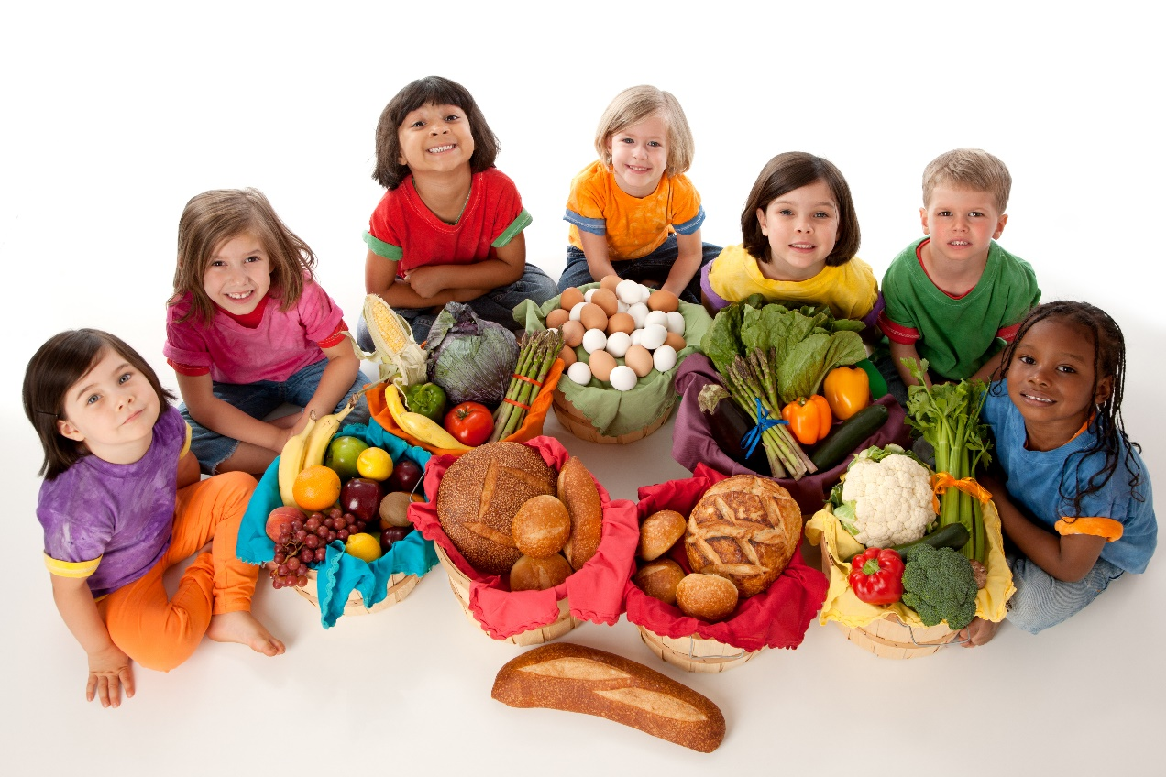
What is NUTRITION?
Notes:
What does the word “nutrition” mean? That’s right! Nutrition is the science of how foods keep our bodies healthy. My job as your nutritionist is to teach you how to choose these foods so your bodies can stay healthy. So that you can build the BEST body for you!
Pictures:
Group of children with food baskets: Purchased from https://www.istockphoto.com

Slide 4
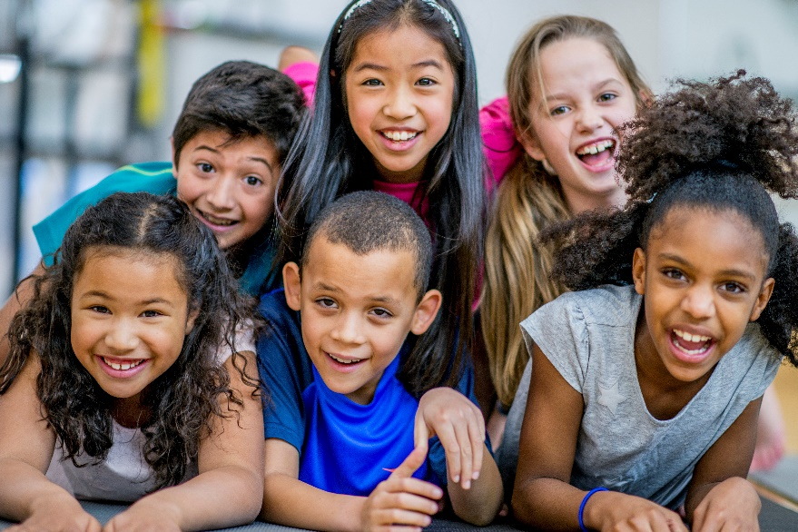
Be the BEST YOU!
We are all different.
Being healthy is about what you do and how you feel, not how you look.
YOU are in charge of your health!
Notes:
What do you think it means to be healthy? When we are healthy:
Our bodies feel good;
We feel strong;
We don’t have a cold, flu, or other sickness;
We’re not injured;
We feel happy and positive;
We have energy to do things and play.
When we are healthy it means that our bodies feel good. When we don’t take care of our bodies, sometimes we feel tired or angry or sad or sick.
It's important to remember that being healthy is NOT about how you look. You can't tell how healthy someone is just by looking at them, and there isn't just one way to be healthy. Our bodies are all different sizes and shapes, and we can all be healthy. We call it "being the best you". Being healthy is about feeling good and having healthy habits. This year, we are going to talk all about keeping our bodies healthy and feeling good.
Pictures:
Happy group of kids: Purchased from https://www.istockphoto.com

Slide 5
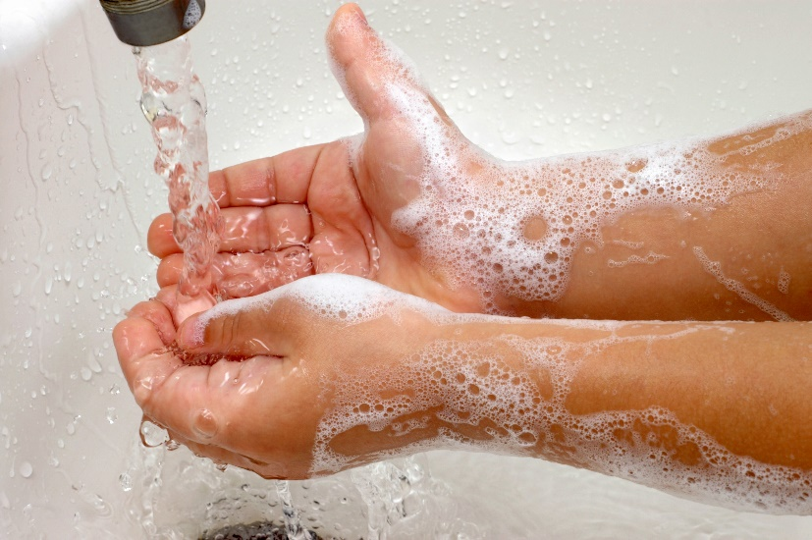
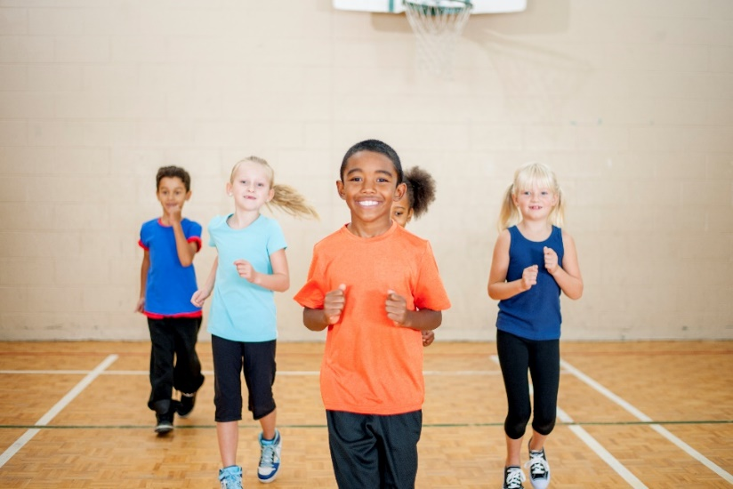
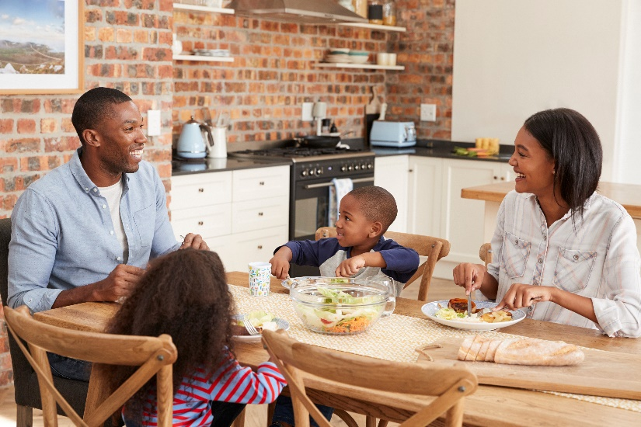
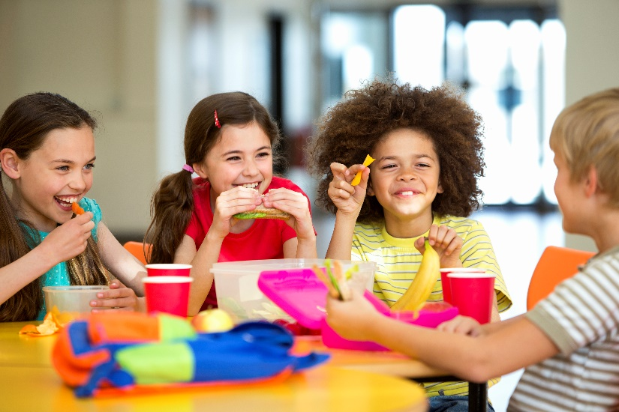
Healthy Habits
Notes:
Things we do every day are called habits. The things we do each day to keep our bodies healthy - we call them healthy habits. What are some things you do to keep your body healthy? Great list! Today we will talk about a few healthy habits, and then we will spend most of the year learning about foods that keep our bodies healthy.
Pictures:
Washing hands: Purchased from https://www.istockphoto.com
Elementary school athletic department: Purchased from https://www.istockphoto.com
Family eating meal: Purchased from https://www.istockphoto.com
School dinner: Purchased from https://www.istockphoto.com

Slide 6
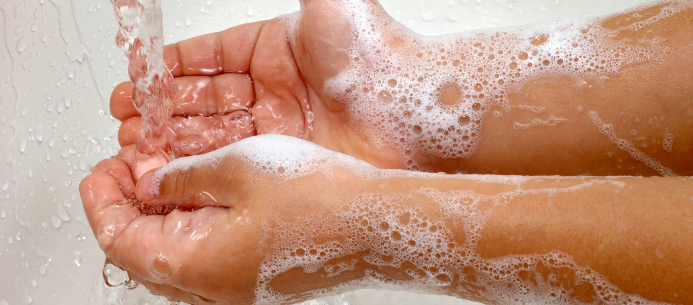
Food Safety
Food safety is keeping our food free from germs so that we don’t get sick.
Notes:
Being safe is one way you can help keep your body healthy. There are lots of ways to stay safe - wearing your bike helmet, putting on sunscreen when you're out in the sun, wearing your seatbelt - but in nutrition class when we talk about being safe, we are mainly talking about FOOD SAFETY. Food safety is about keeping our food safe from germs so we don't get sick.
Pictures:
Washing hands: Purchased from https://www.istockphoto.com

Slide 7

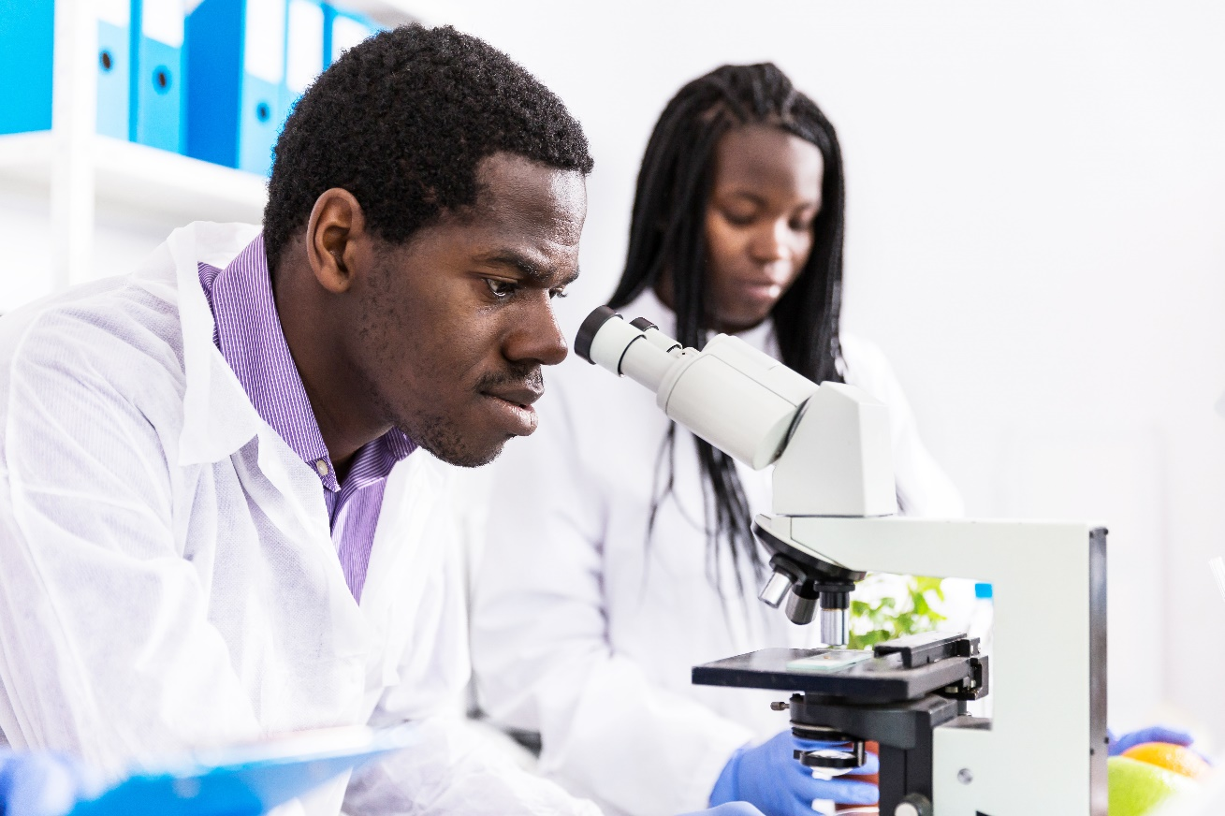
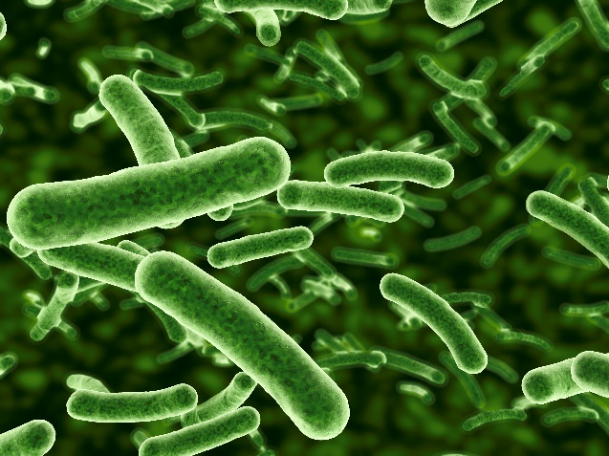
Why clean?
Notes:
The first key to food safety is to clean to get rid of germs. Germs are living creatures that are so tiny we can’t see them without a special tool called a microscope. Germs are everywhere - on our hands, desks, and tables. Even things that look clean may have large amounts of germs on them, but you can’t tell just by looking.
Germs on our hands and skin won’t hurt us, but if they get inside our bodies they can make us sick. Germs can get inside your body when you put your hands in your mouth or when you touch food with dirty hands or put food on a dirty surface and then eat it.
Pictures:
Microbiologists in lab: Purchased from https://www.istockphoto.com
Bacteria: Purchased from https://www.istockphoto.com
Bacterial cell or virus: Purchased from https://www.istockphoto.com

Slide 8
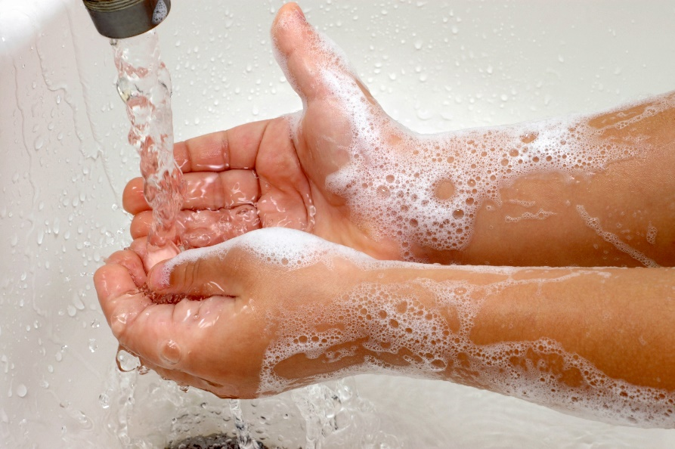
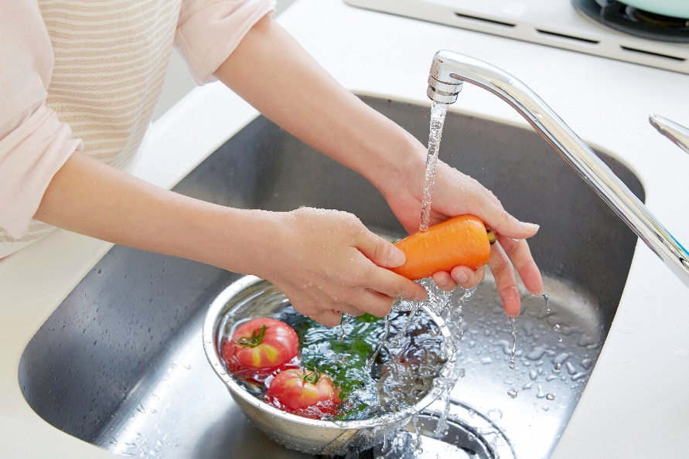
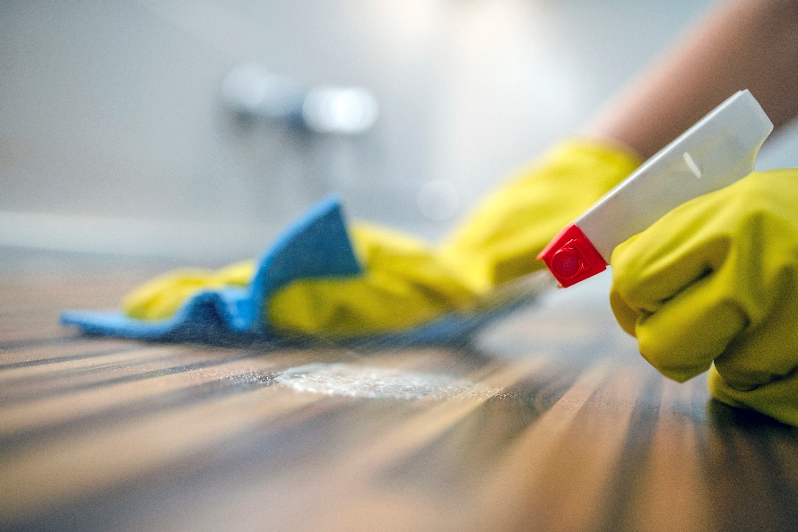
What to clean?
Notes:
The best way to NOT get germs inside your body or spread them to a friend is to wash your hands! We should always wash our hands before handling food or eating. We also need to clean any surface that food will touch (counters, tables, dishes, etc.). And we need to clean fruits and vegetables before eating them and cutting them.
If we clean our hands, surfaces, and produce we can limit the germs that get on our food and inside our bodies.
We will practice food safety this year when we eat foods together.
Pictures:
Washing hands: Purchased from https://www.istockphoto.com
Cleaning kitchen table: Purchased from https://www.istockphoto.com
Washing vegetables: PurchaPurchased from https://www.istockphoto.com

Slide 9
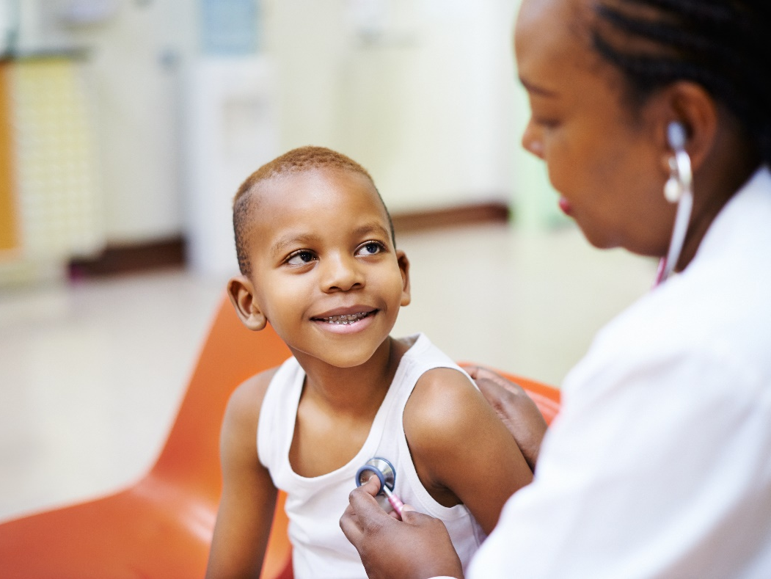

EXERCISE
Exercise is any movement of your arms and legs that makes your heart beat faster.
Notes:
Another important way we can keep our bodies healthy is by exercising every day. Exercise is any movement of your arms and legs that makes your heart beat faster. Your heart is a muscle that is working all the time, even when you are sleeping! When your heart beats faster with exercise that means it is getting stronger.
Your heart is the hardest working muscle in your body, even though it is just about the size of your fist. Your heart needs to be exercised every day to stay healthy and strong just like your body does.
Does anyone know where your heart is? Put your hand on the middle of your chest, about halfway down. What do you feel? Do you feel your heart beating? If not, it’s because it’s beating slowly right now. Your heart beats all the time!
Pictures:
Happy healthy boy: Purchased from https://www.istockphoto.com
Human heart: Purchased from https://www.istockphoto.com

Slide 10
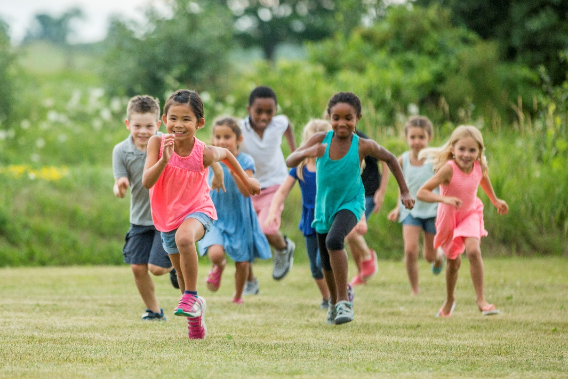

What is EXERCISE?
Notes:
Let’s think of exercises that will help make our hearts stronger! Are playing video games and watching TV activities that will make our hearts stronger?
Pretend like you’re playing a video game with your hands. Now, put a hand over your heart and feel your heartbeat. Is it beating faster? No! It's probably beating about the same speed as it was earlier. When we sit playing video games or watching TV, we aren't making our hearts stronger. Remember, exercise is when we move the big muscles of our body and make our hearts beat faster.
Is running an activity that will make our hearts stronger?
Stand up and run in place. Now feel your heart. Is it beating faster? Mine is! Running is an exercise that makes your heart beat faster and helps it stay healthy and strong.
Is running the only exercise you can do to keep your heart and your body healthy? No, of course not! Let’s act out some other activities that keep your heart and body strong.
Pictures:
Playing outside in a field: Purchased from https://www.istockphoto.com
Two boys playing video games: Purchased from https://www.istockphoto.com

Slide 11
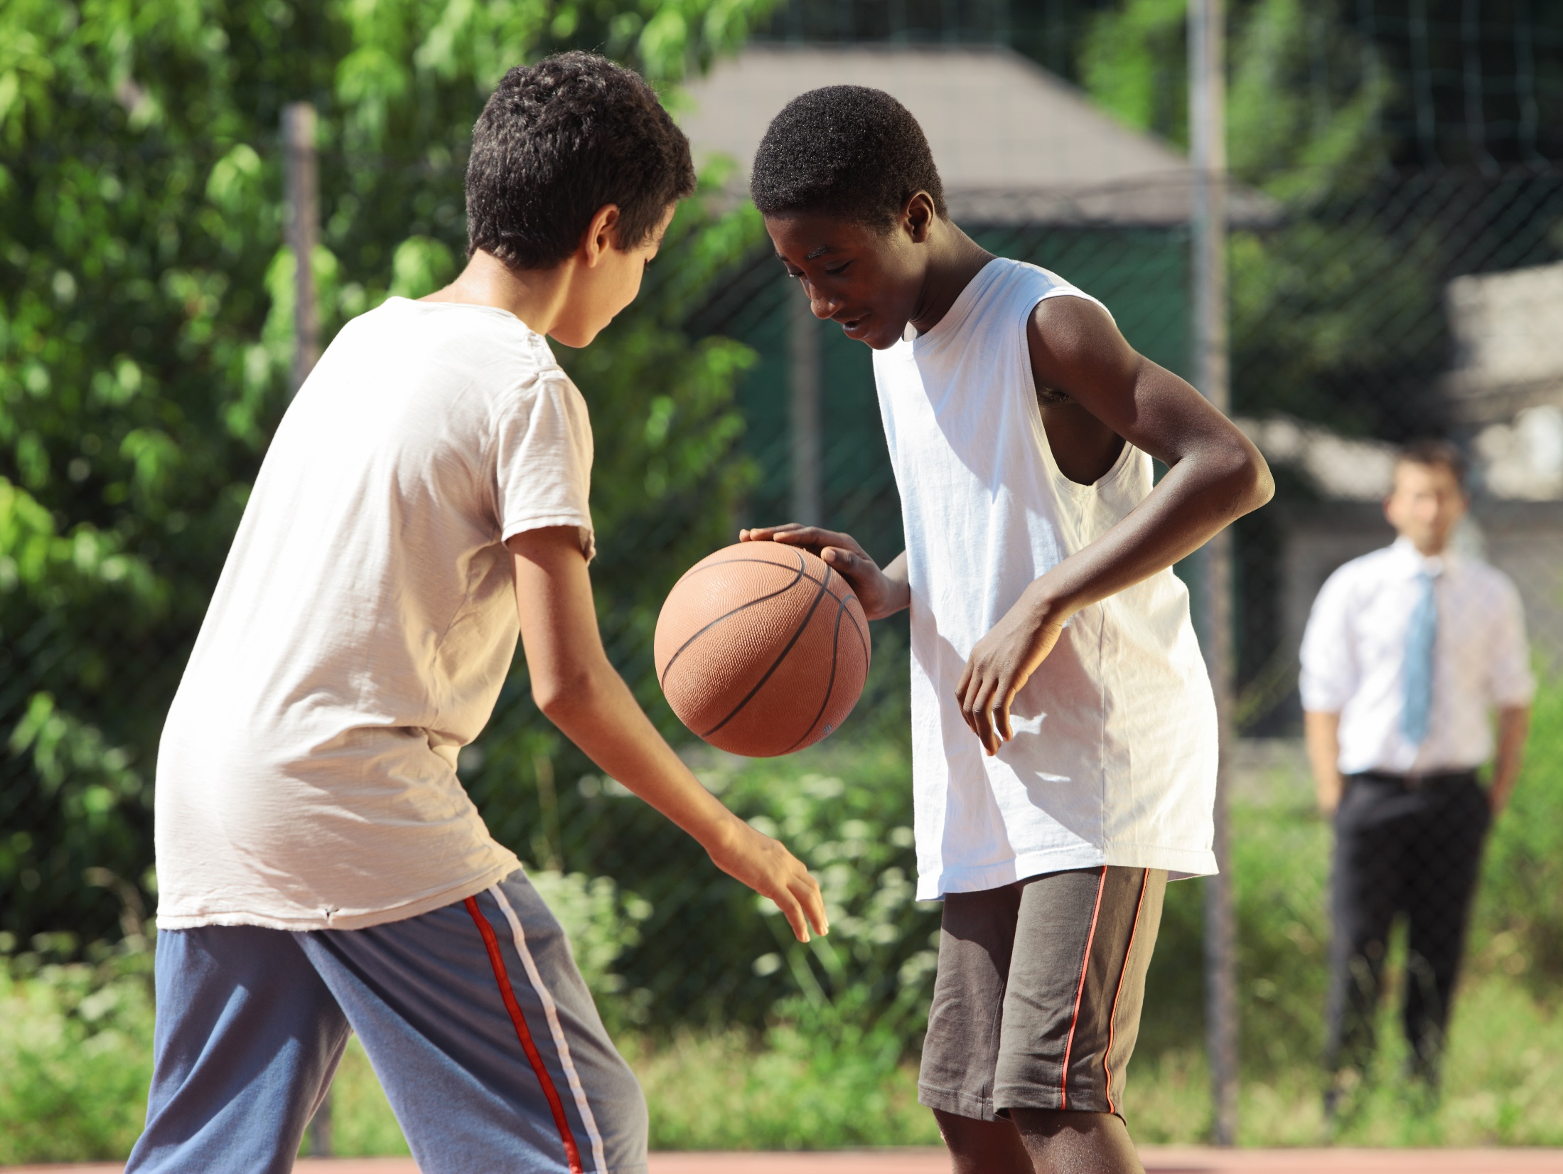
Notes:
Basketball
Pictures:
Basketball: Purchased from https://www.istockphoto.com

Slide 12
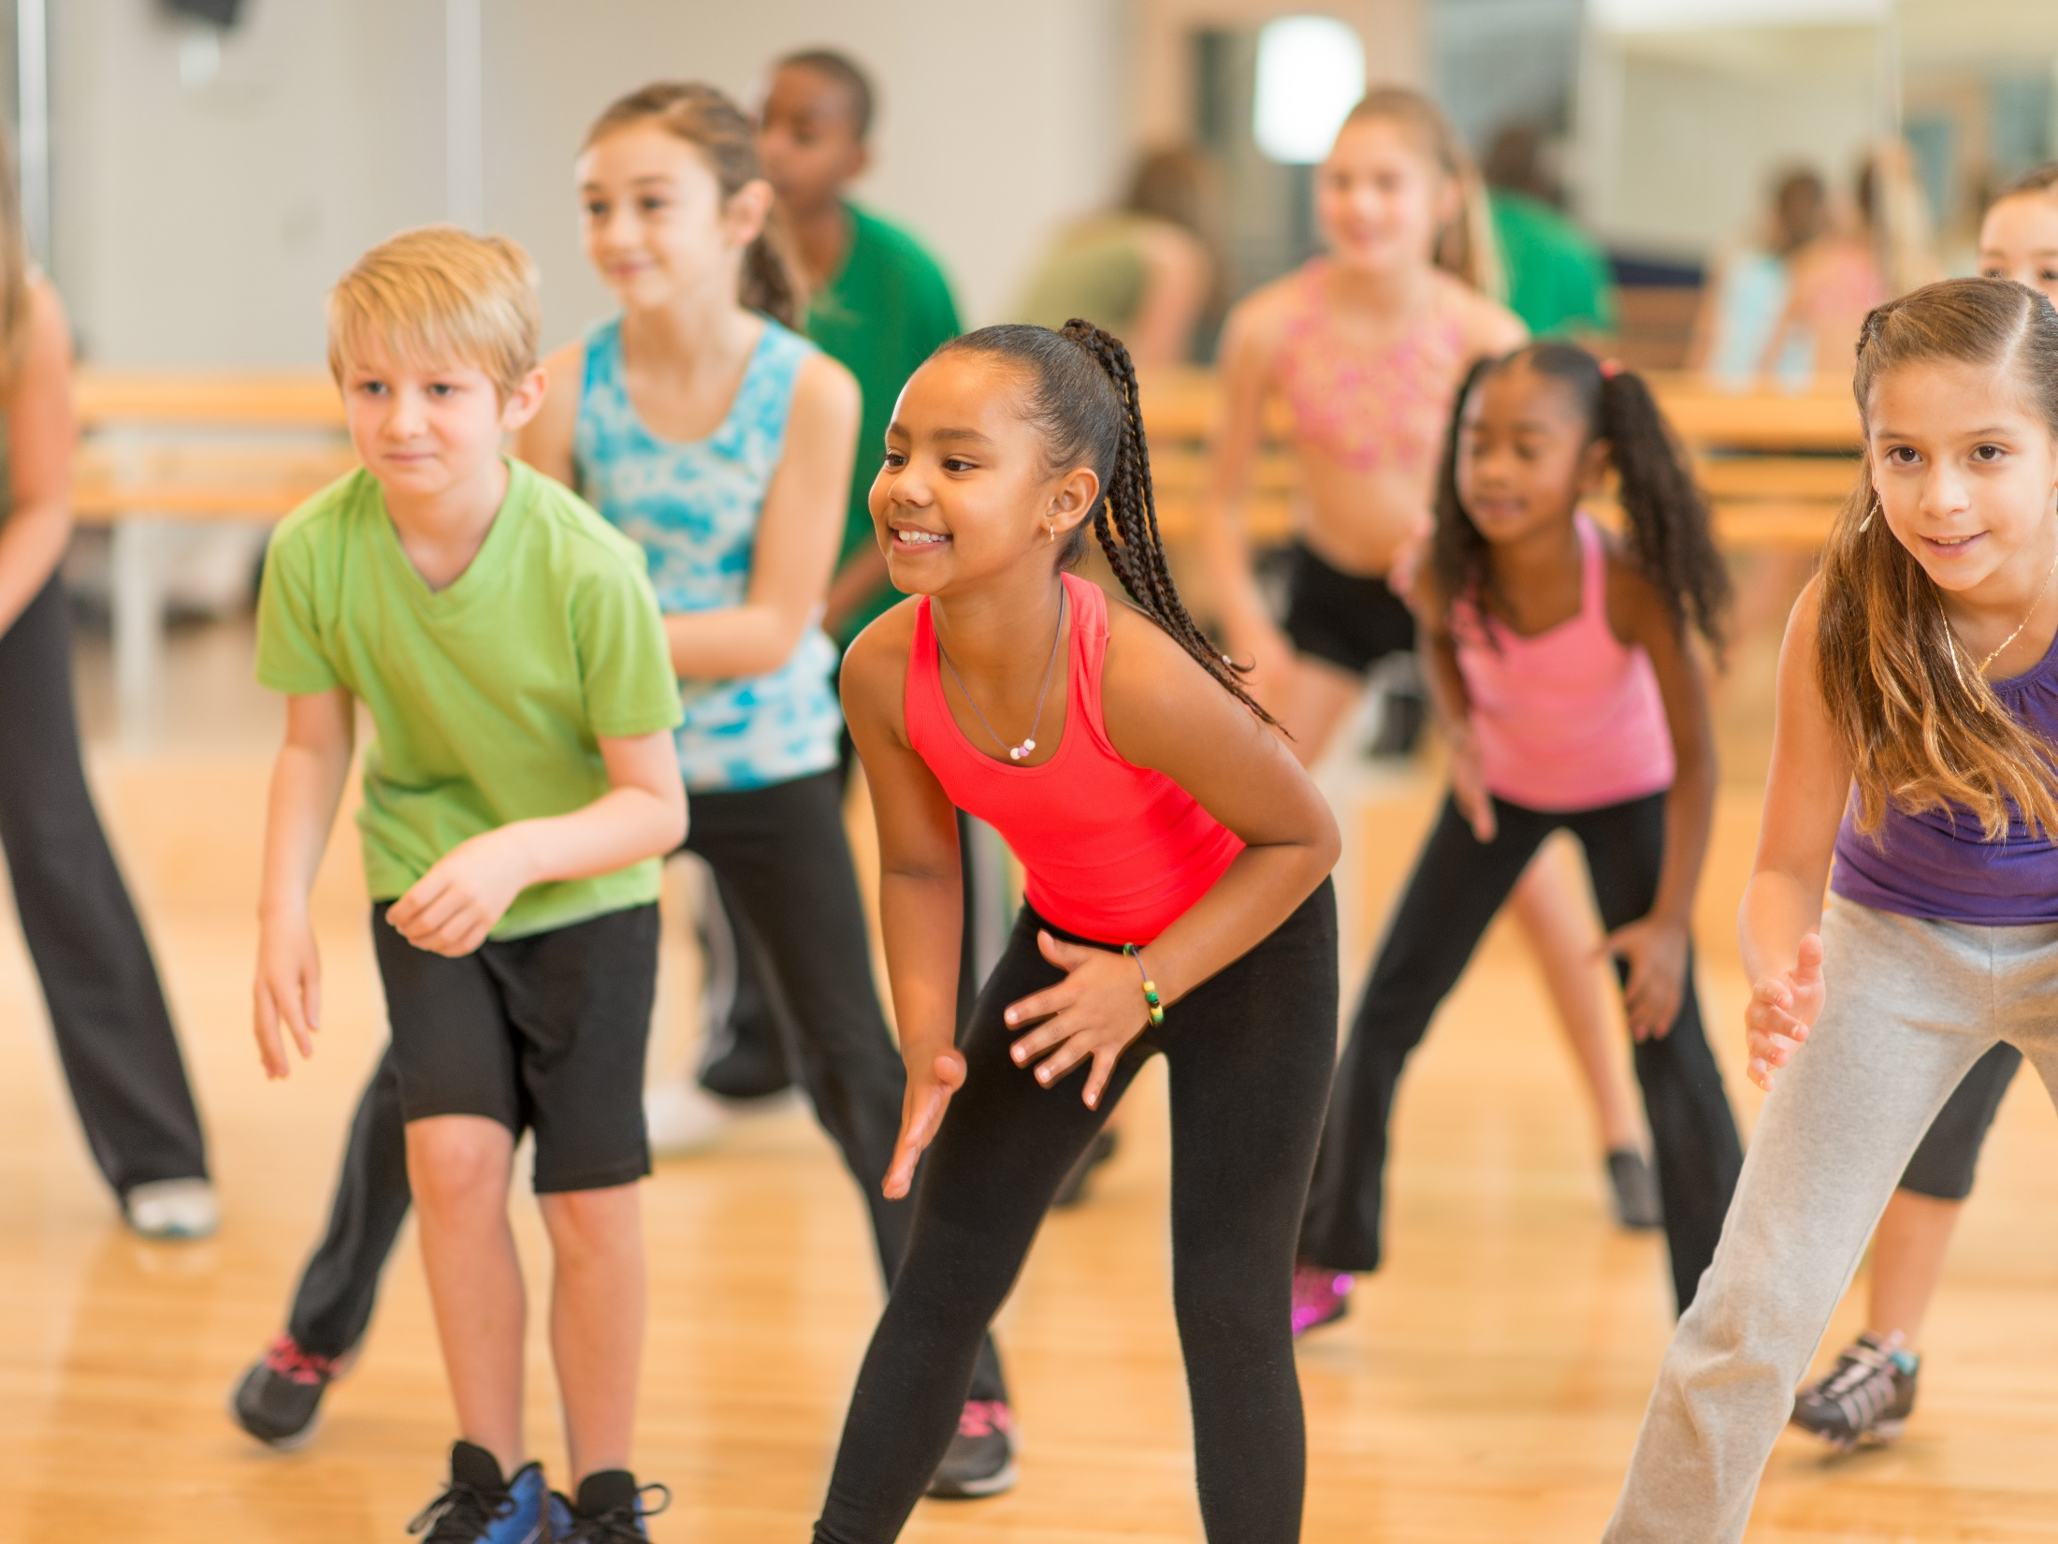
Notes:
Dance
Pictures:
Dance class: Purchased from https://www.istockphoto.com

Slide 13
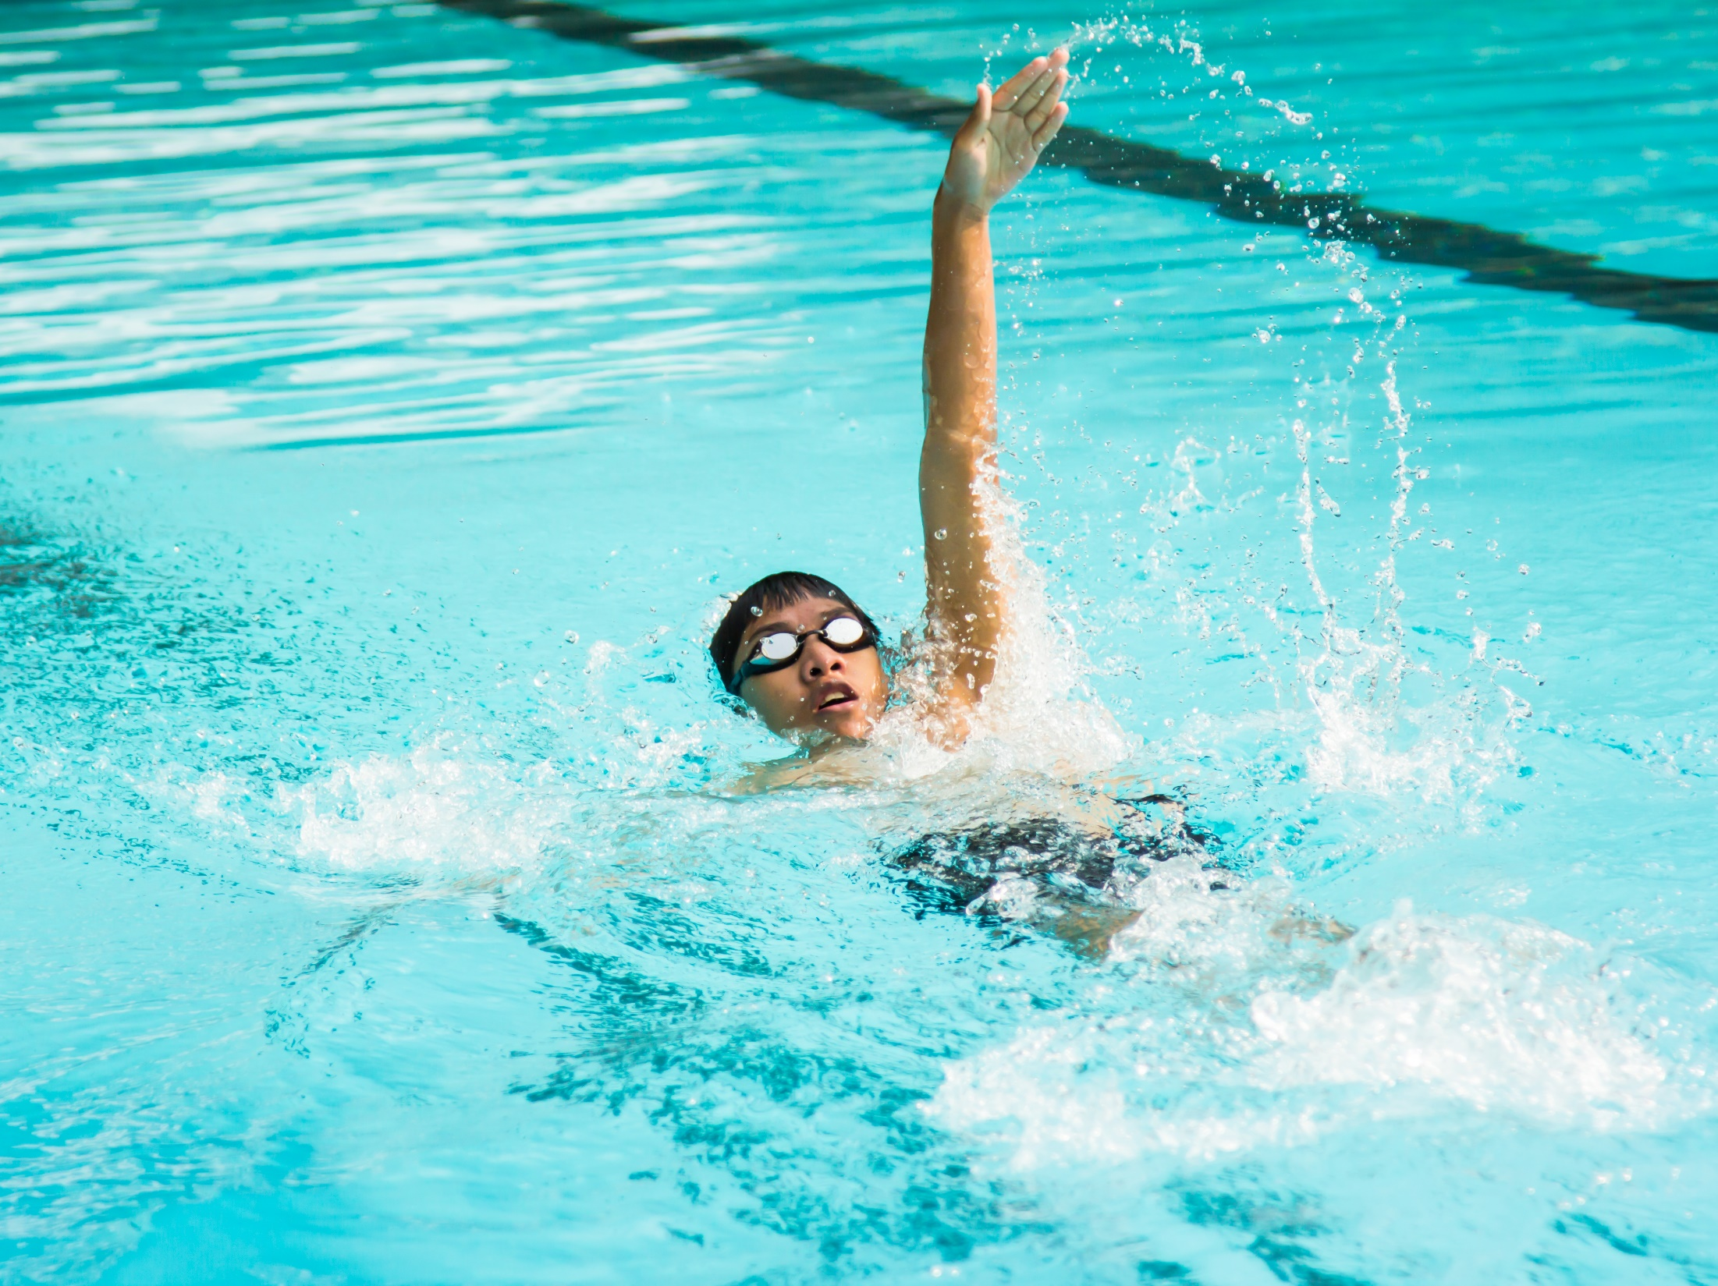
Notes:
Swimming
Pictures:
Swimming: Purchased from https://www.istockphoto.com

Slide 14
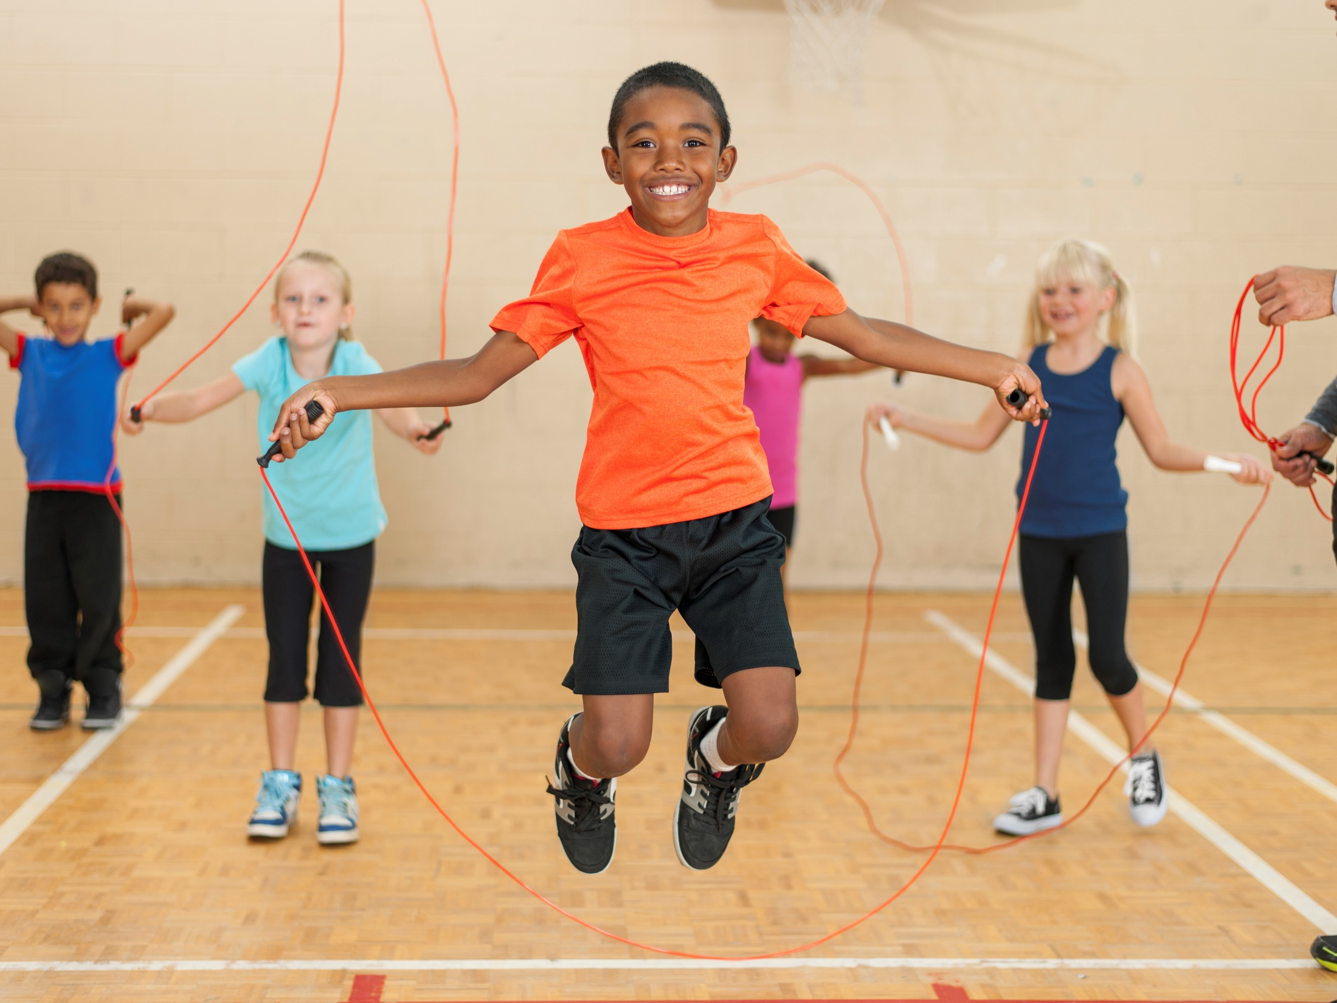
Notes:
Jump Rope
Pictures:
Jump rope: Purchased from https://www.istockphoto.com

Slide 15
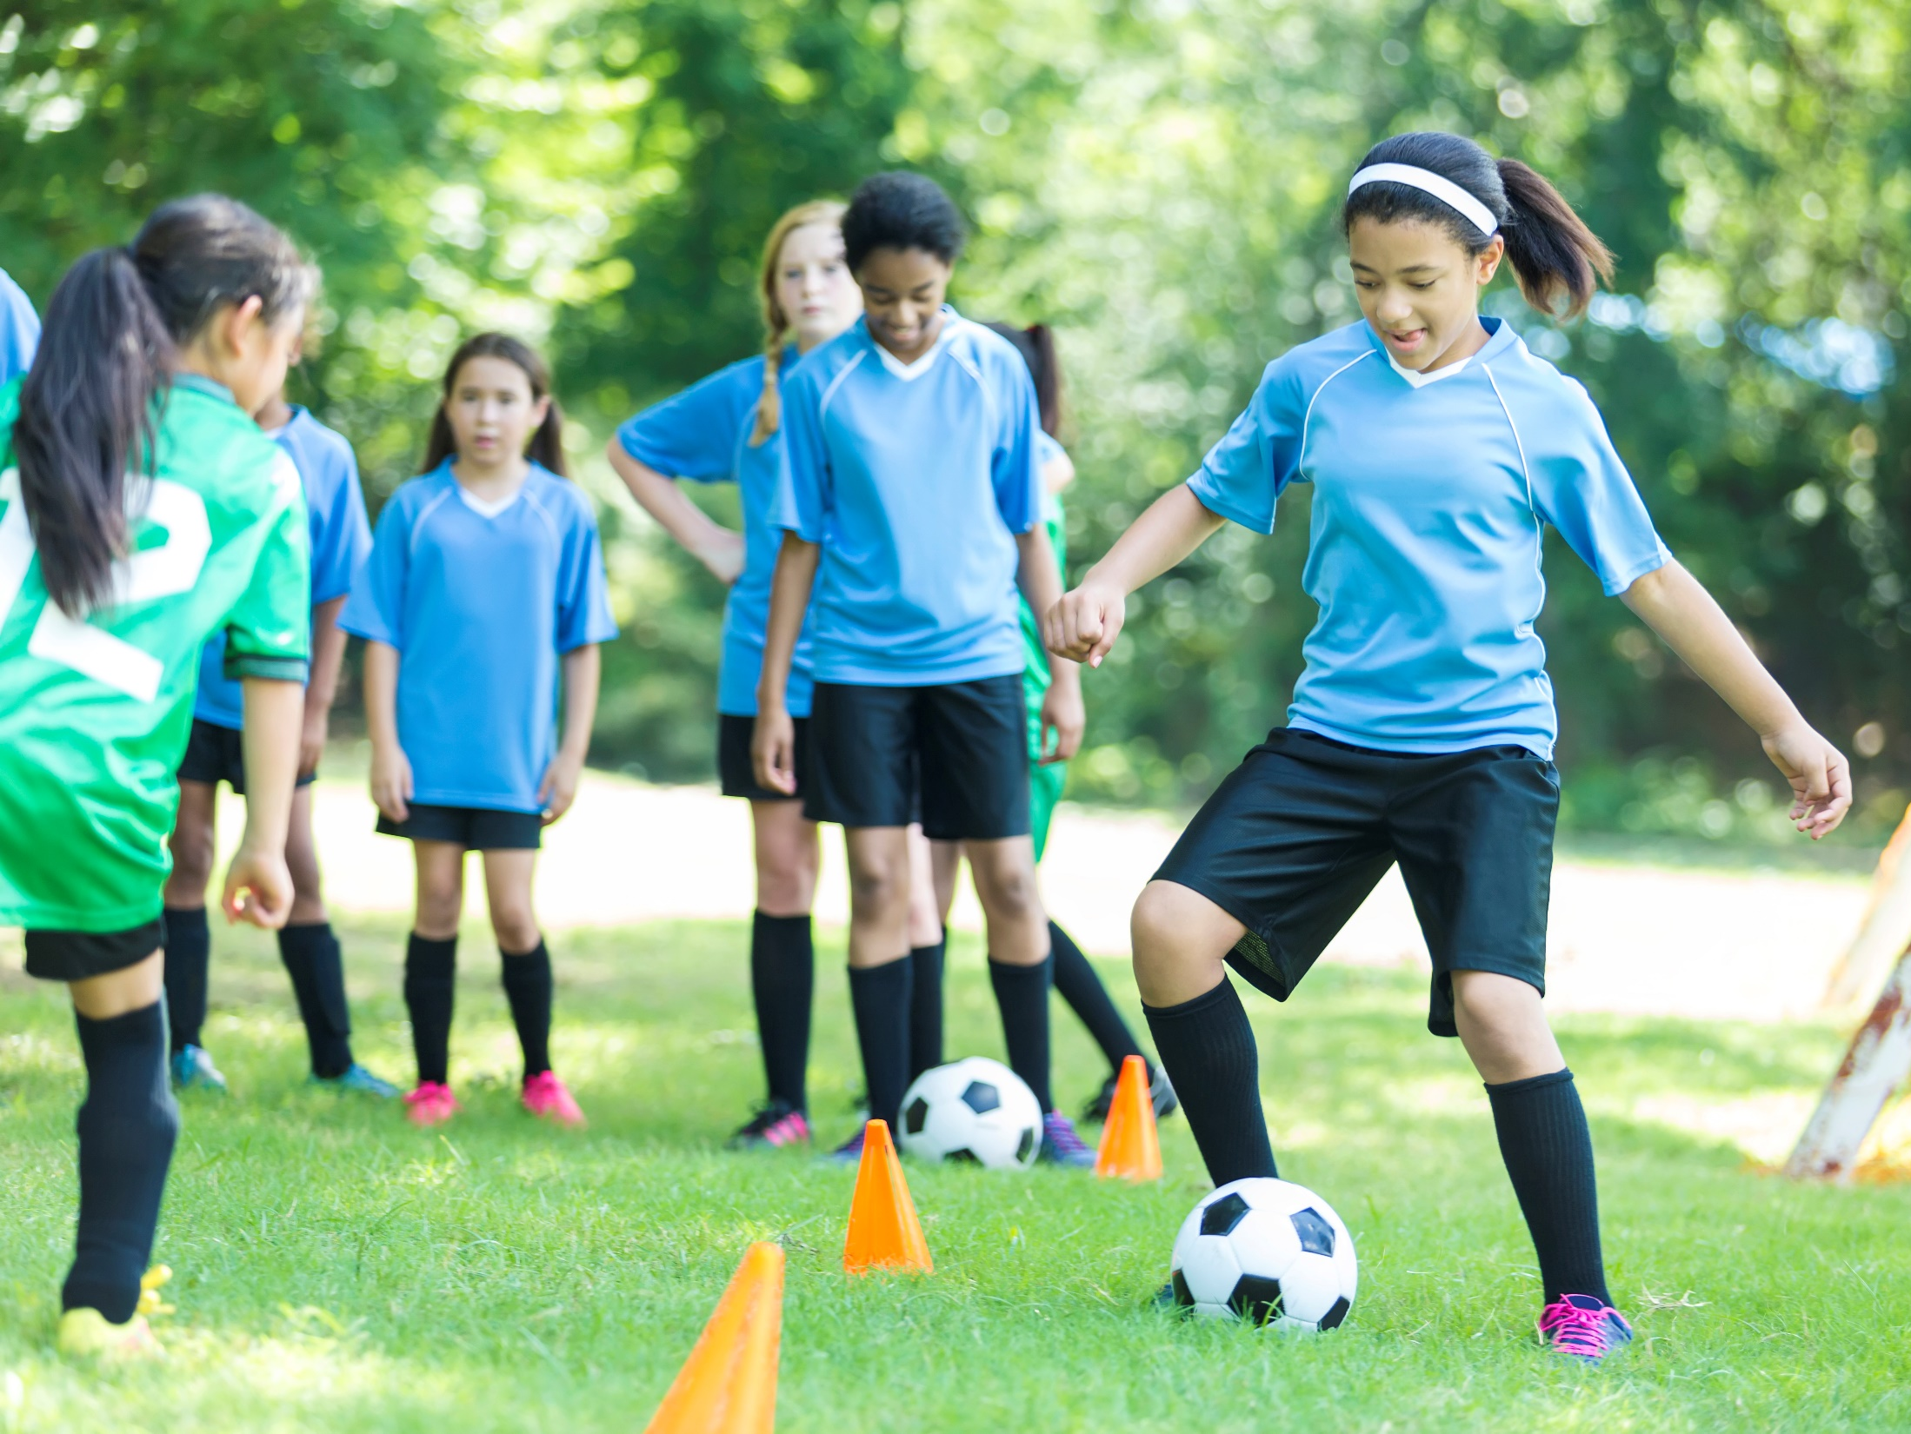
Notes:
Soccer
Pictures:
Soccer: Purchased from https://www.istockphoto.com

Slide 16

What do you like to do for EXERCISE?
Notes:
What do you like to do for exercise? [Can act out a few more activities based on what the students enjoy doing to be active.]
When we exercise and our hearts beat faster, it makes our hearts stronger. To keep our hearts strong and help build the best body we can, we should try to exercise for at least 60 minutes a day.
Pictures:
Playing outside in a field: Purchased from https://www.istockphoto.com

Slide 17
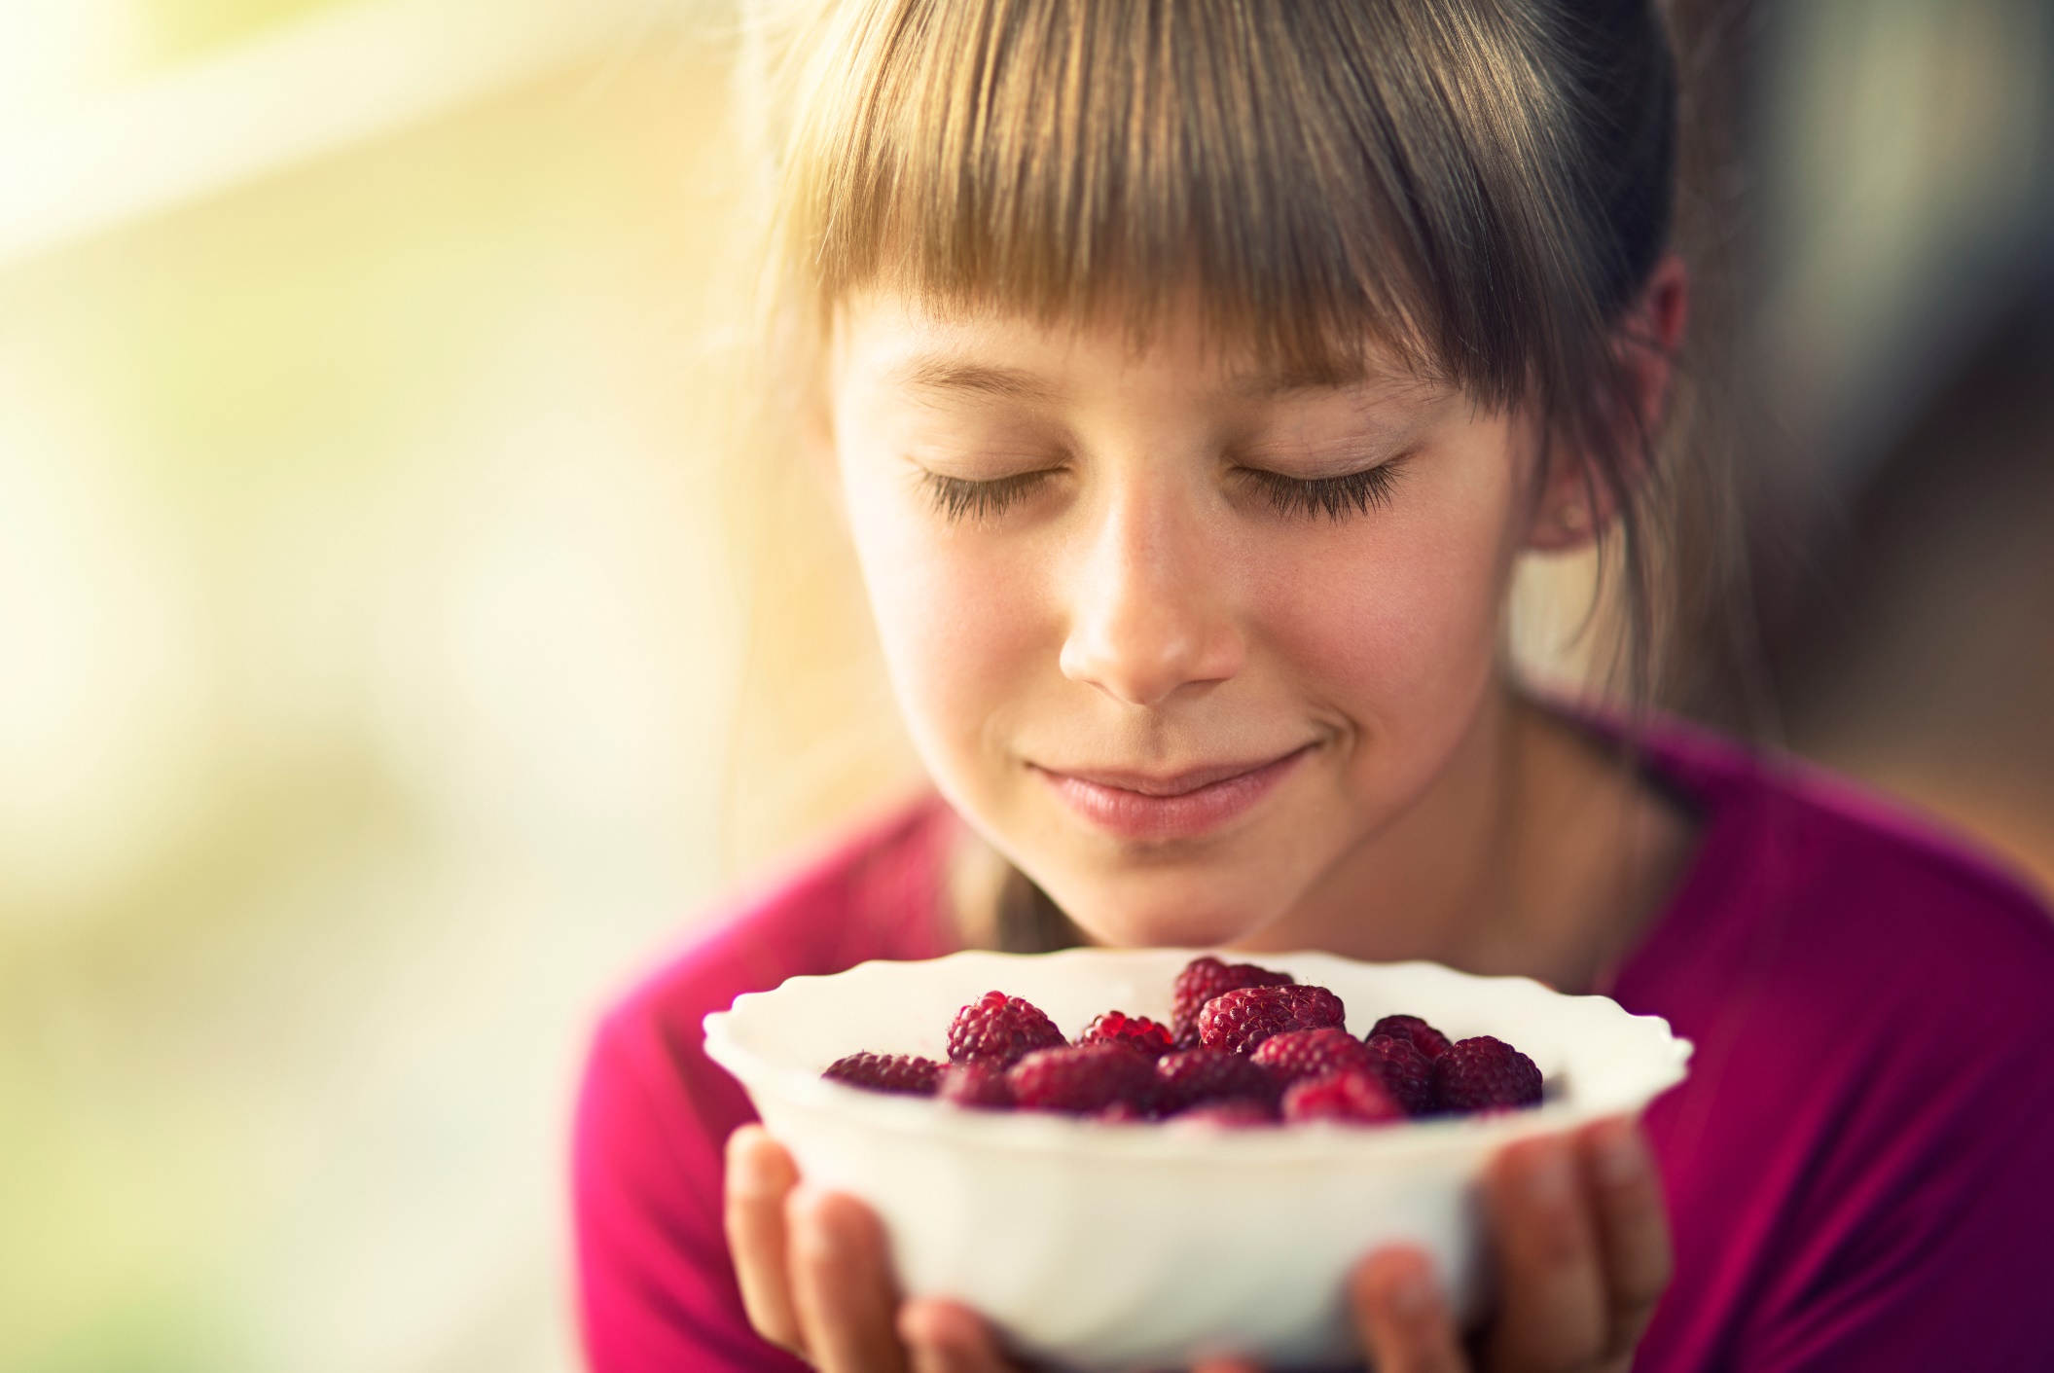
mindful eating
Mindful eating is eating slowly, and taking the time to look at, smell, feel and taste your food.
Notes:
Another healthy habit is called “mindful eating.” Being mindful is also called being aware, or being present. Mindful eating is eating slowly, and taking the time to look at, smell, feel, and taste our foods. It’s also about noticing how our bodies feel. When we talk about mindful eating, it's not about WHAT we eat, it’s about HOW we eat.
Pictures:
Girl with raspberries: Purchased from https://www.istockphoto.com

Slide 18
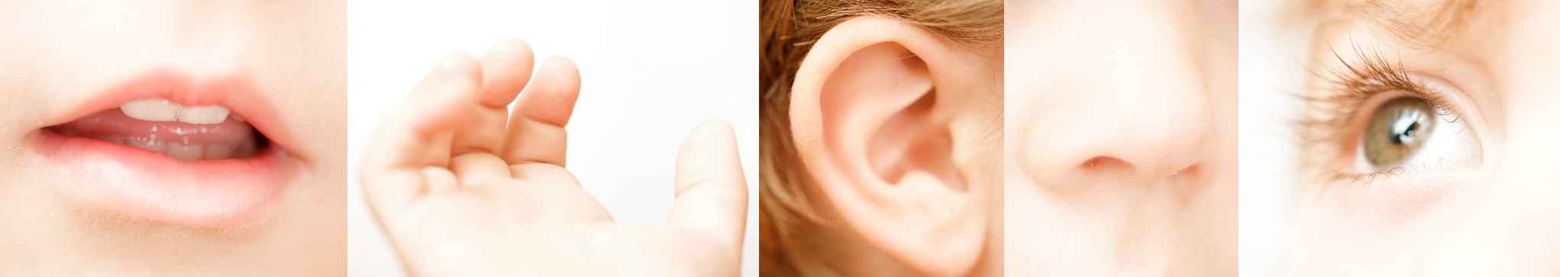
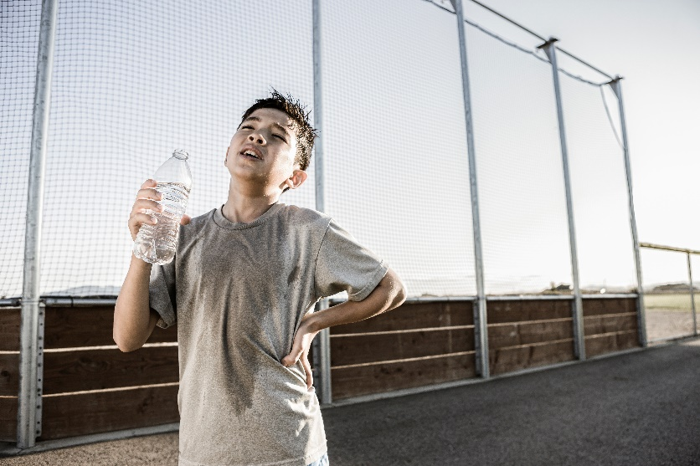
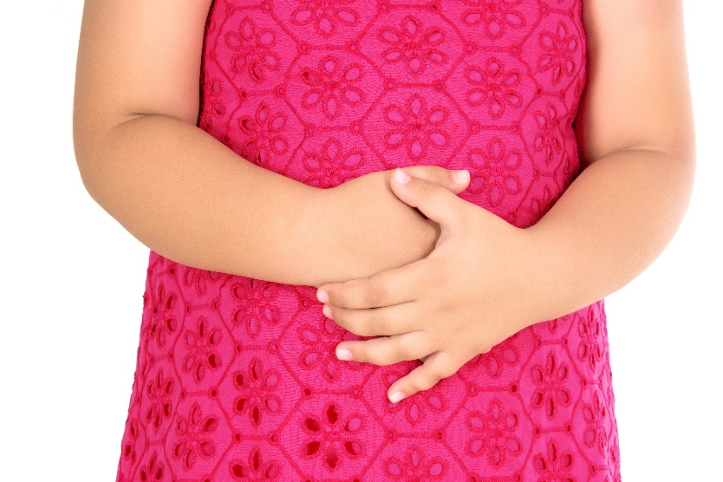
Mindful eating
Using your five senses
Listening to your body
Notes:
When we eat mindfully, we use all our senses to really pay attention and notice things about our food. Can someone name the five senses? Taste, touch, listen, smell, and look. When we eat mindfully, we notice how our food looks, how it feels, how it smells, how it tastes, and even how it sounds while we’re eating it.
Has anyone ever eaten something while distracted, and not even noticed how it tasted? That would be the opposite of mindful eating.
Mindful eating is also paying attention to our body and how it feels. What do you think this boy’s body is telling him? Right, that he is thirsty. What about the girl on the right? Her body might be telling her that she is hungry. When we are mindful, we notice if our bodies are hungry or full. What does hunger feel like? What does fullness feel like?
Has anyone ever eaten more than your body needed? I know I have, and it doesn’t feel very good. When we eat mindfully, we help make sure that we are eating just the right amount of food for our bodies – not too much, not too little.
Pictures:
Five senses: Purchased from https://www.istockphoto.com
Boy shows exhaustion: Purchased from https://www.istockphoto.com
Pain in the abdomen: Purchased from https://www.istockphoto.com

Slide 19




Mindful Eating
NOT Mindful Eating
Notes:
These pictures are examples of mindful eating. The girl is smelling the raspberries and paying attention to what she is about to eat. The family is eating dinner together, sitting around the table without any distractions.
These pictures on the right are examples of NOT mindful eating, or distracted eating. This is when we aren’t paying attention to our food while we are eating – for example, when we eat in front of the television, or while we are using a computer or looking at a phone or tablet.
Why would we want to be mindful while eating?
To enjoy our food more;
To notice things about our food we hadn’t noticed before;
To make sure we eat just the right amount - not accidentally eat too much or too little.
How can we remember to be more mindful with our food?
Eat with the TV off, and don’t use electronics while eating;
Prepare the food ourselves;
Eat slowly;
Eat with someone else, and discuss the food we’re eating.
It’s okay if we don’t eat mindfully all the time, but it is a good thing to try to do at least sometimes. Mindful eating is eating slowly and using your senses to look at, smell, feel and taste your food; it’s also about enjoying your food, and paying attention to your body.
Pictures:
Girl with raspberries: Purchased from https://www.istockphoto.com
Family eating meal: Purchased from https://www.istockphoto.com
Girl watching tv while eating: Purchased from https://www.istockphoto.com
Boy using laptop while eating: Purchased from https://www.istockphoto.com

Slide 20
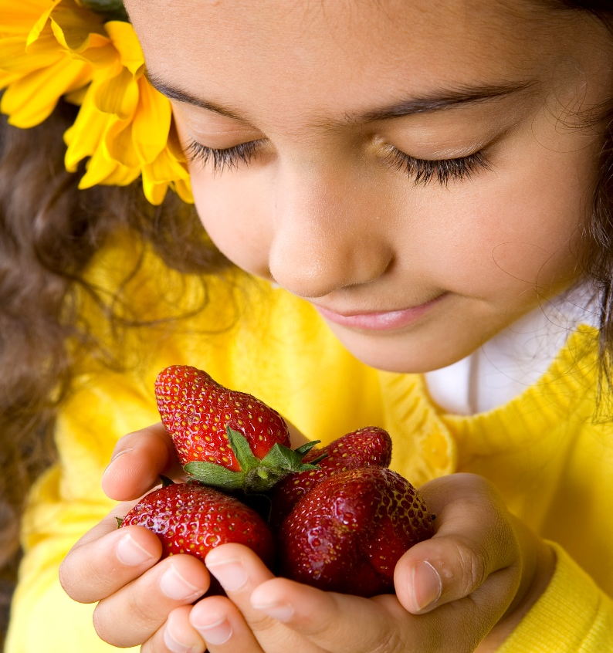
Practice: Mindful Eating
TOUCH
TASTE
LISTEN
LOOK
SMELL
Notes:
[If time allows, have students practice mindfulness while eating a mandarin orange segment, grape, edamame, or other food. After passing out the food, but before eating, have everyone pay attention to the food's appearance, shape, size, color, smell and texture. As students place it in their mouths, have them think about the sensation, all of the food's characteristics, and the whole process of eating it.]
As you eat the food, pay attention to:
TOUCH – how does it feel in your hand? how does it feel in your mouth? how does it feel as you swallow it?
LOOK – how does it look? pay attention to its appearance: shape, color, size
SMELL – how does it smell? notice the aroma as you’re eating it
TASTE – how does it taste? use adjectives to describe it
LISTEN – how does it sound while you are eating it?
What did you notice? How was the experience different than the way you normally eat an orange?
Pictures:
Girl with strawberries: Purchased from https://www.istockphoto.com

Slide 21
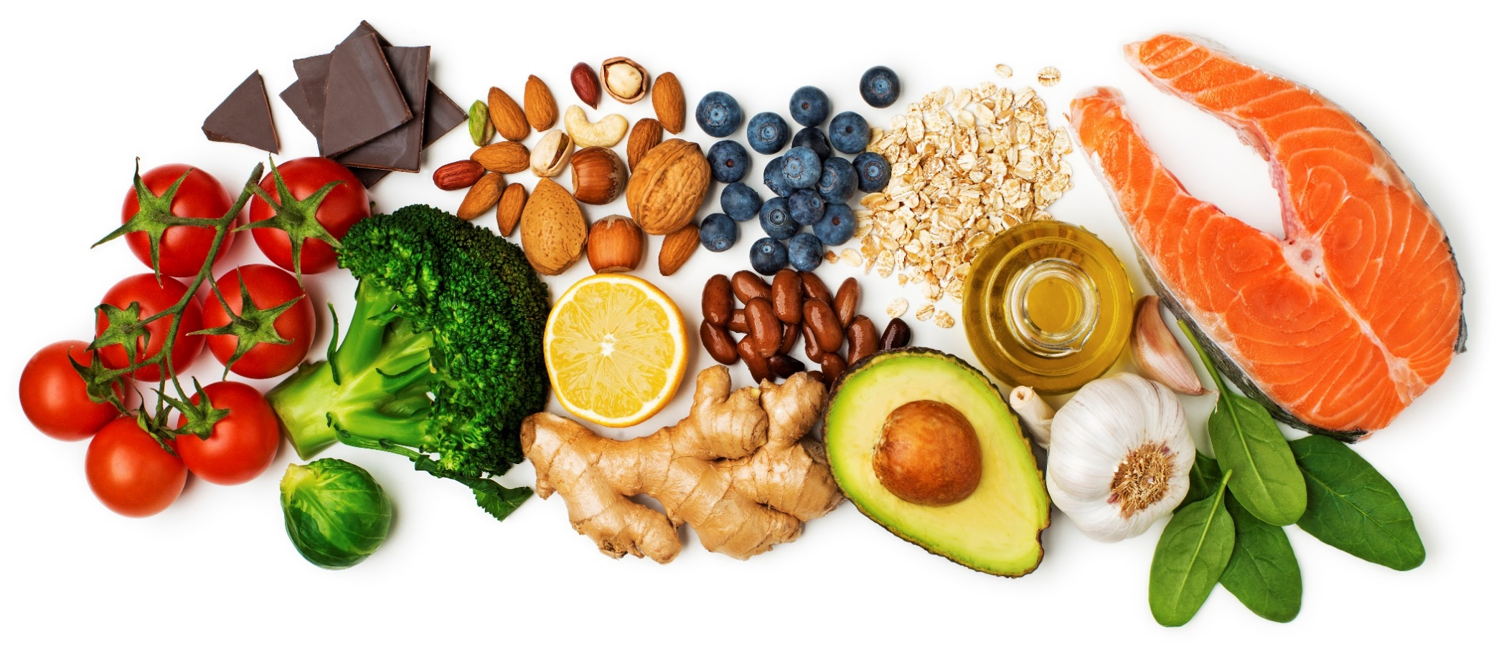
NUTRITION
Nutrition is about eating foods that keep our bodies healthy.
Notes:
Finally, we’re going to talk about nutrition. Remember, nutrition is about eating foods that keep our bodies healthy.
Pictures:
Healthy food: Purchased from https://www.istockphoto.com

Slide 22
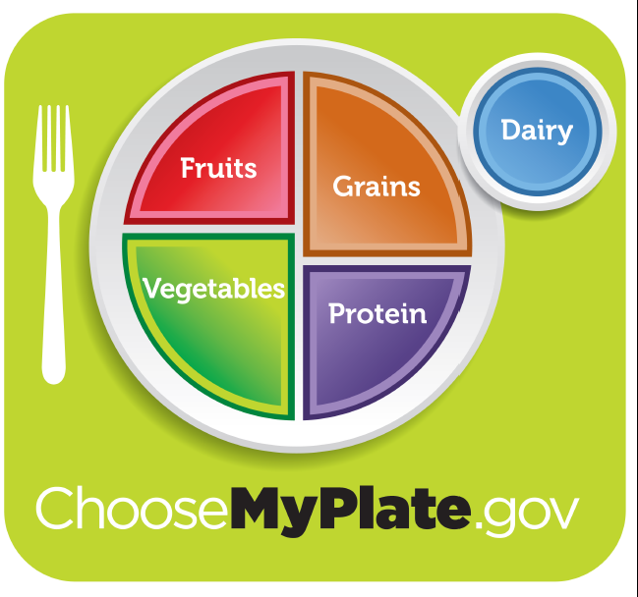
Notes:
How can we make sure that we’re getting all the things our bodies need from the foods we eat? If I just eat mashed potatoes all day, am I healthy? If I just eat blueberries all day, am I healthy? Why not?
We sort foods into five groups. Look at this picture - it's called MyPlate. MyPlate is a picture of a plate that is made of the five food groups – the fruit group, the vegetable group, the grains group, the protein group, and the dairy group. Instead of sorting foods by how they look (their color or shape), we sort them by how they keep our body strong and feeling good when we eat them. The different food groups give our bodies different nutrients to stay healthy. Can you say that word with me, “nutrients”. Good job. Remember that nutrients are something found in our food that helps us grow and be healthy. Vitamins and minerals are two types of nutrients found in all 5 food groups. Raise your hand if you have every taken a vitamin pill or chewy vitamin. Ok, that pill or chewy vitamin has only SOME of the vitamins our bodies need. And sometimes we might take a vitamin pill or chewy to make sure we are getting some of the vitamins our bodies need. BUT, not all the vitamins we need are in the pills. You need to eat some food from all 5 food groups to get ALL the vitamins.
MyPlate is a tool to show us which kinds of foods to eat every day, and to not eat too much of any one kind. Remember, all foods can fit into a healthy way of eating; however, some foods provide more of what our bodies need.
Let's see if we can remember which foods belong in which food groups.
Pictures:
MyPlate Image: www.choosemyplate.gov

Slide 23
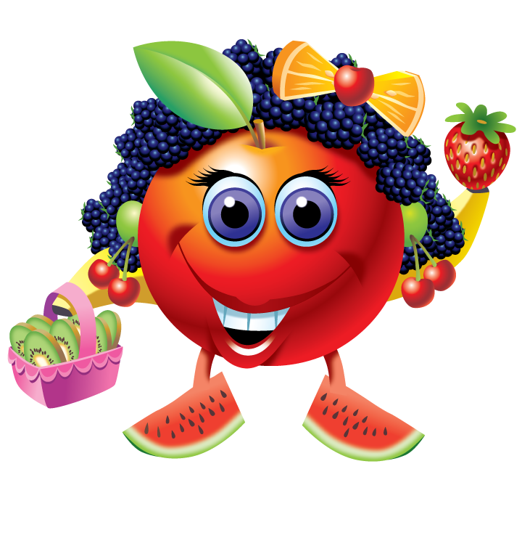
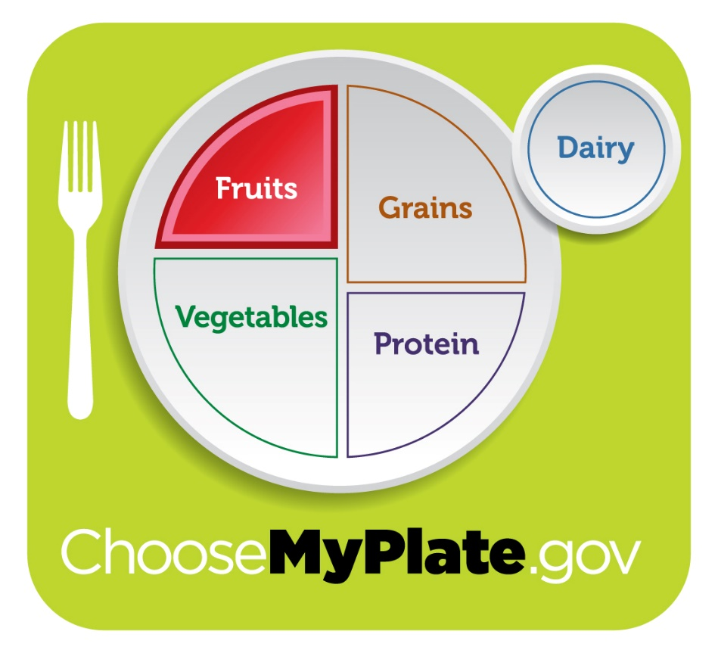
Farrah Fruit
Notes:
Foods in the Fruit Group give our bodies a RAINBOW of colors to keep all parts of our bodies working correctly. Fruits are sweeter than vegetables. Who can name a food that belongs in the Fruit Group? Great list! Farrah Fruit is our friend from the Fruit Group; she is made from different fruits.
Pictures:
MyPlate Image: www.choosemyplate.gov
Food Group Friends Image: https://www.fns.usda.gov/tn/discover-myplate-nutrition-education-kindergarten

Slide 24
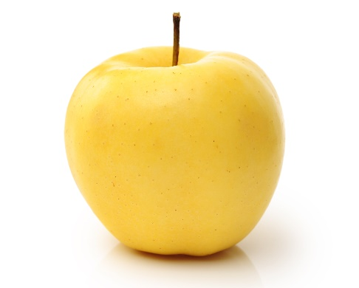
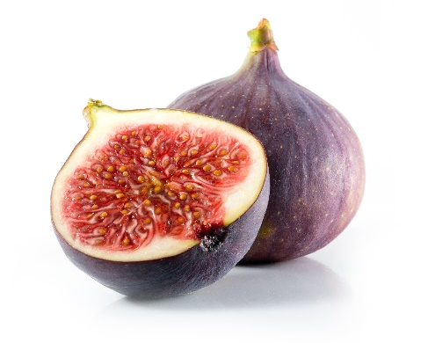
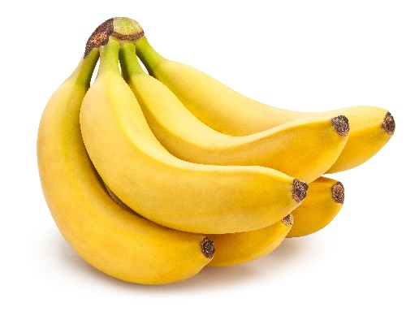
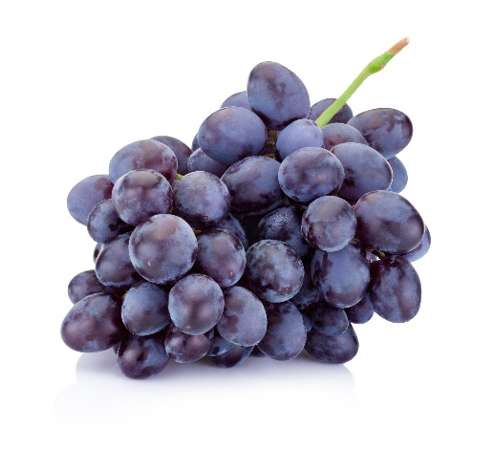
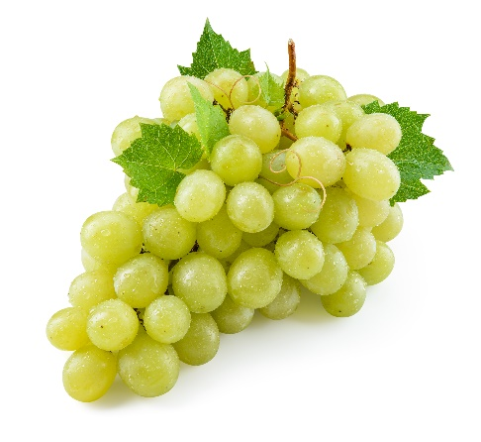
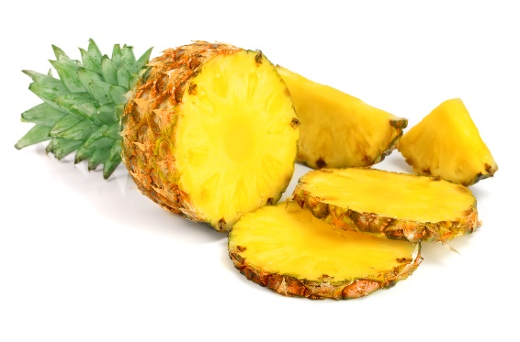
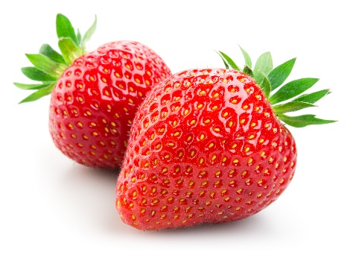
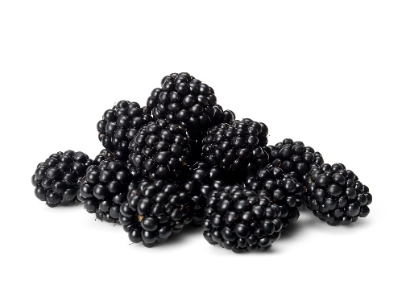
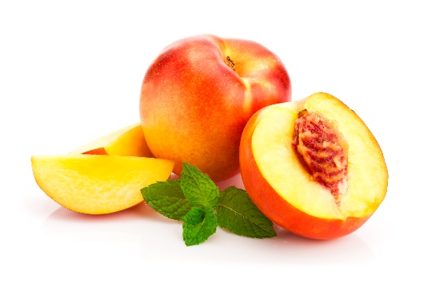
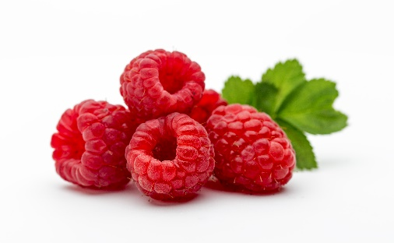
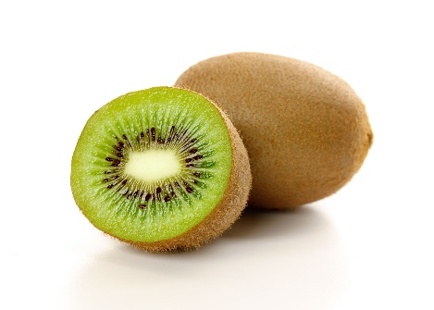
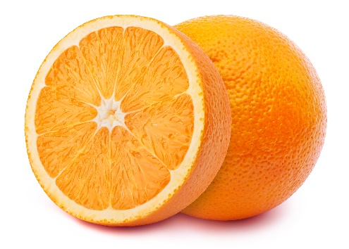
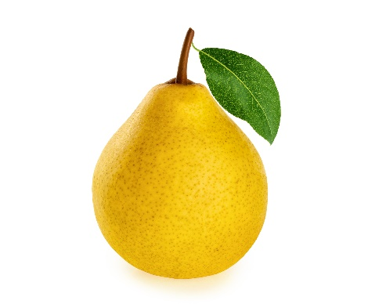
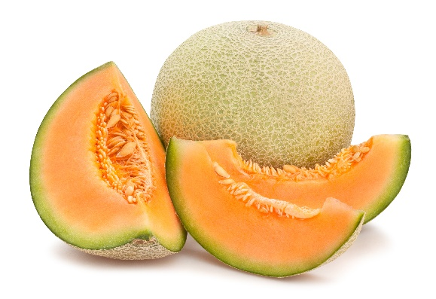
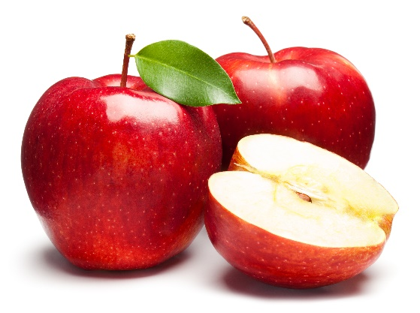
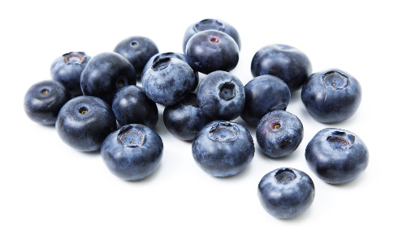
Notes:
Here are some other foods from the Fruit Group. See how many different colors of fruits there are?
Pictures:
All fruit photos Purchased from https://www.istockphoto.com

Slide 25
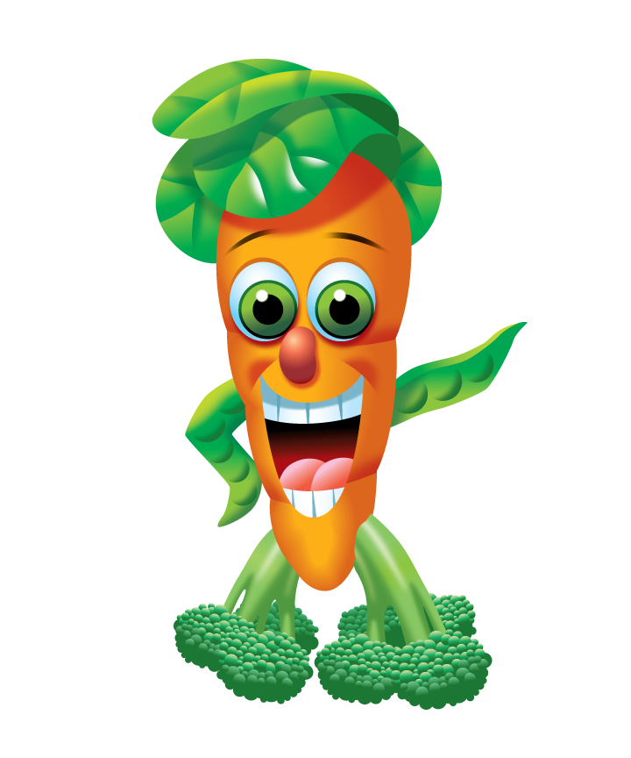
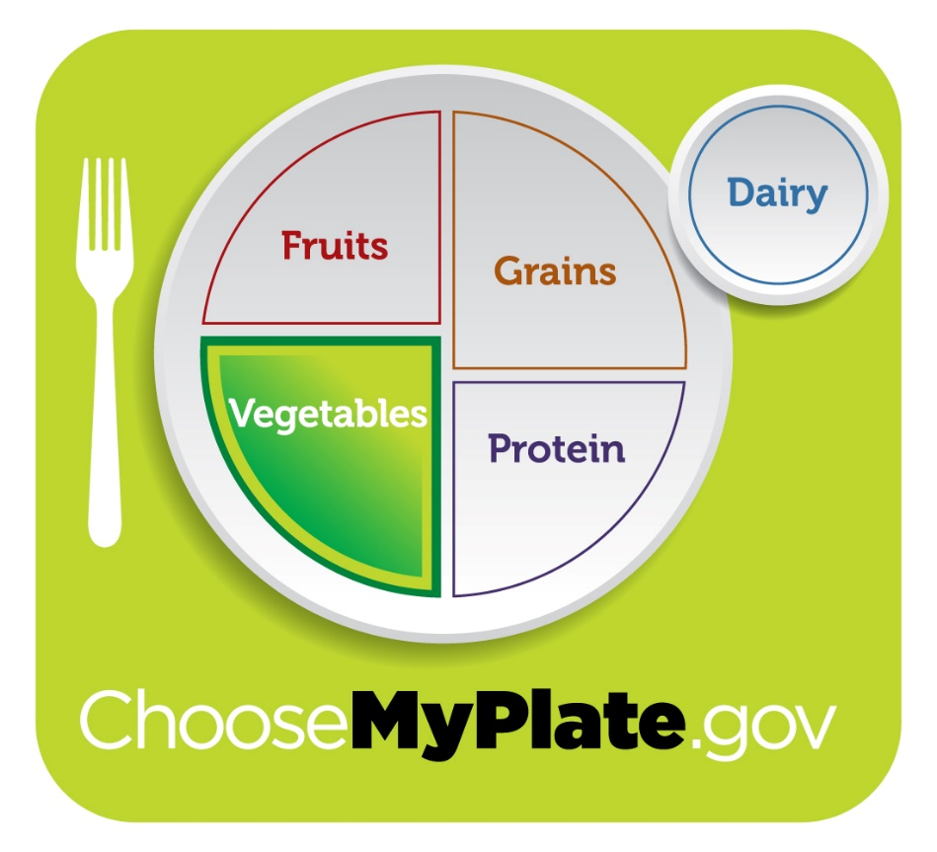
Reggie Veggie
Notes:
Foods in the Vegetable Group also give our bodies a RAINBOW of colors to keep all parts of our bodies working correctly. But, they are less sweet than fruits. Who can name a food that belongs in the Vegetable Group? Reggie Veggie is our friend from the Vegetable Group; he is made from different vegetables.
Pictures:
MyPlate Image: www.choosemyplate.gov
Food Group Friends Image: https://www.fns.usda.gov/tn/discover-myplate-nutrition-education-kindergarten

Slide 26
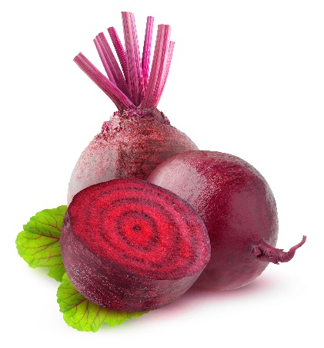
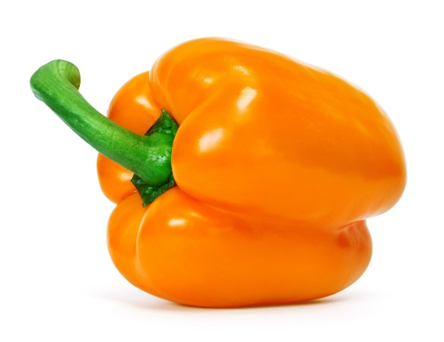
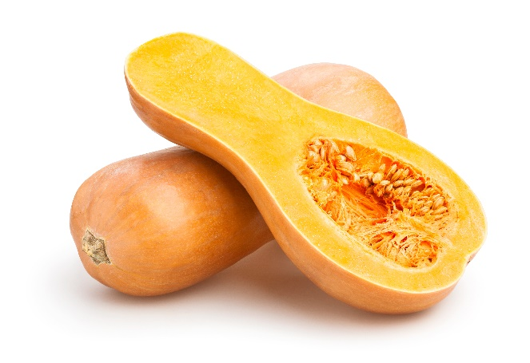
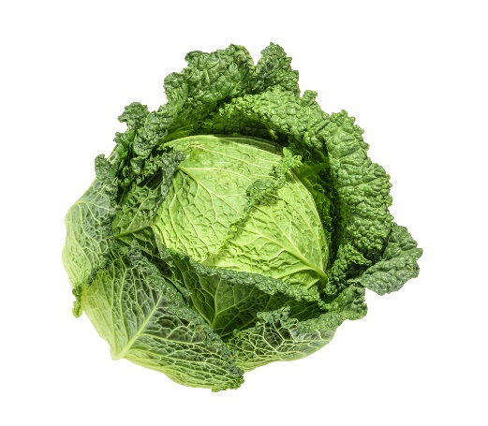











Notes:
Here are some other foods from the Vegetable Group. Vegetables also come in lots of different colors!
Pictures:
All vegetable photos Purchased from https://www.istockphoto.com

Slide 27


Eat a RAINBOW
of Fruits & Veggies
Notes:
Eat a RAINBOW of fruits and vegetables to give your body what needs to stay healthy.
Pictures:
Fruit and vegetable rainbow: Purchased from https://www.istockphoto.com

Slide 28


Jane Grain
Notes:
The Grains Group foods give our bodies energy to learn, move and play. These foods all come from plants and are mostly brown or white. Who can remember which foods belong in the Grains Group? The MyPlate Friend from the Grains Group is Jane Grain. She is made from foods in the Grains Group.
Pictures:
MyPlate Image: www.choosemyplate.gov
Food Group Friends Image: https://www.fns.usda.gov/tn/discover-myplate-nutrition-education-kindergarten

Slide 29









Notes:
Here are some other foods from the Grains Group.
Pictures:
All grains photos Purchased from https://www.istockphoto.com

Slide 30


Grains give us ENERGY!
Choose Whole Grains!
Notes:
Foods from the Grains Group give our bodies energy to learn, move and play.. The healthiest grains are called WHOLE GRAINS.
Pictures:
Girl jumping: Purchased from https://www.istockphoto.com
Whole grains: Purchased from https://www.istockphoto.com

Slide 31


Dean Protein
Notes:
Foods from the Protein Group give our bodies protein, which we need to grow and heal. Some of these foods come from animals and some come from plants. What kinds of foods belong in the Protein Group? Dean Protein is our friend from the Protein Group. Dean Protein is made from protein foods.
Pictures:
MyPlate Image: www.choosemyplate.gov
Food Group Friends Image: https://www.fns.usda.gov/tn/discover-myplate-nutrition-education-kindergarten

Slide 32















Notes:
Here are some other foods from the Protein Group.
Pictures:
All protein photos purchased from https://www.istockphoto.com

Slide 33


Protein foods give us PROTEIN
to GROW!
and HEAL!
Notes:
Foods from the Protein Group give our bodies protein, which we use as building blocks to grow and heal.
Pictures:
Boy with growth measurements: Purchased from https://www.istockphoto.com
Roller blade boy hurt: Purchased from https://www.istockphoto.com

Slide 34


Mary Dairy
Notes:
And, last, but not least…. The Dairy Group gives us calcium, which helps us build strong bones and teeth. The dairy group foods are all made from milk. Mary Dairy is our friend from the Dairy Group. Mary Dairy is made from yogurt, milk, and cheese.
Pictures:
MyPlate Image: www.choosemyplate.gov
Food Group Friends Image: https://www.fns.usda.gov/tn/discover-myplate-nutrition-education-kindergarten

Slide 35








Notes:
Here are some other foods from the Dairy Group.
Pictures:
All dairy photos Purchased from https://www.istockphoto.com

Slide 36

Dairy gives us CALCIUM
for STRONG BONES!
Notes:
Foods from the Dairy Group have lots of CALCIUM to help build strong bones and teeth.
Pictures:
Human skeleton: Purchased from https://www.istockphoto.com

Slide 37






The 5 Food Groups
Jane Grain
Farrah Fruit
Mary Dairy
Dean Protein
Reggie Veggie
Notes:
This year, we will learn more about each of the food groups and the healthy foods we should eat. All five food groups are important for keeping us healthy, so we want to eat healthy foods from all five food groups every day!
Pictures:
Farrah Fruit: https://www.fns.usda.gov/tn/graphics-library
Reggie Veggie: https://www.fns.usda.gov/tn/graphics-library
Dean Protein: https://www.fns.usda.gov/tn/graphics-library
Mary Dairy: https://www.fns.usda.gov/tn/graphics-library
Jane Grain: https://www.fns.usda.gov/tn/graphics-library
MyPlate: https://www.choosemyplate.gov/myplate-graphic-resources

Slide 38

MyPLATE MyBODY REVIEW
Quick
Quiz!
Notes:
Let’s do a Quick Quiz to review what we learned.
Pictures:
MyPlate Images: www.choosemyplate.gov

Slide 39
Which plate looks the most like “MyPlate”?
Notes:
Let's see if you can recognize what a healthy plate looks like. I'll show you two pictures, and I want you to tell me which one looks the most like MyPlate. Hold up one finger if you think it's #1; hold up two fingers if you think it's #2.
Pictures:
MyPlate Image: www.choosemyplate.gov

Slide 40



1.
2.
Notes:
Plate #1: chicken, sweet potato, corn, tomatoes, greens, milk
Plate #2: steak, potatoes
Pictures:
Plate #1: Photo taken by DINE team
Plate #2: Purchased from https://www.istockphoto.com

Slide 41




1.
2.
Notes:
Plate #1: chicken, rice, macaroni and cheese, potatoes, milk
Plate #2: salmon, green beans, rice, fruit salad, milk
Photos:
Plate #1: Photo taken by DINE team
Plate #2: Healthy salmon dinner: Purchased from https://www.istockphoto.com; Fruit salad: Purchased from https://www.istockphoto.com; Milk in the glass: Purchased from https://www.istockphoto.com.

Slide 42


1.
2.
Notes:
Plate #1: chicken, bread, fruit salad, green salad and milk
Plate #2: cheeseburger, French fries, soda
Pictures:
Plate #1: Photo taken by DINE team
Take out meal: Purchased from https://www.istockphoto.com

Slide 43

?
Notes:
You are right – Meal #1 looks more like MyPlate, but this meal looks pretty tasty too, doesn’t it?! How could we make this meal more like MyPlate?
Pictures:
Take out meal: Purchased from https://www.istockphoto.com

Slide 44




Notes:
Those are some great ideas! Here I’ve switched the cheeseburger for a grilled chicken sandwich; the fries for a side salad and apple slices; and the soda for milk. This meal now looks a lot more like MyPlate, and it still looks pretty tasty!
Pictures:
Chicken sandwich: Purchased from https://www.istockphoto.com
Milk carton: Purchased from https://www.istockphoto.com
Apple slices: Purchased from https://www.istockphoto.com
Salad: Purchased from https://www.istockphoto.com

Slide 45

You Are What You Eat!
Notes:
https://www.youtube.com/watch?v=l4Ot0nU19AE (Wayne Brady, disneymusic)

Slide 46




CHALLENGE
Pick one new healthy habit to practice this week!
Notes:
Today we have learned about how to be the BEST YOU. Remember, being "the best you" is about taking care of your body and doing the things - the healthy habits - that will help you build the BEST YOU! Eating food from all five food groups will help us do that.
Challenge: Pick one new healthy habit to practice this week! (examples: practice eating a meal mindfully, try a new exercise, wash your hands before every meal or snack, eat foods from all five food groups)
Pictures:
Girl with raspberries: Purchased from https://www.istockphoto.com
Jump rope: Purchased from https://www.istockphoto.com
Washing hands: Purchased from https://www.istockphoto.com
School dinner: Purchased from https://www.istockphoto.com

Slide 47
Let’s Taste

Slide 48

Don’t Yuck My Yum!
Don’t say
Nasty
Disgusting
Do say
That’s new
I’ve never tasted that before
Gross
That’s different
It’s not to my taste but I’m glad I tried it!
Ewwwww

Slide 49
Describe what you taste!
Salty
Savory
Crunchy
Soft
Chewy
Dry
Moist
Tangy
Sour
Mild
Fruity
Spicy
Flavorful
Sweet
Zesty
Creamy

