Slide 1


Protein
K-1st Grade
This institution is an equal opportunity provider. This material was funded by USDA’s Supplemental Nutrition Assistance Program-SNAP.
Notes:
Today we are going to talk all about the protein group, but before we do that, let’s review what we talked about last time I was here.

Slide 2
Objectives
Students will state that foods in the Protein group provide protein to help the body grow and heal.
Students will name one meat (animal) and one non-meat (plant) food in the Protein group.

Slide 3
Quick
Quiz!
Grains Lesson Review
Notes:
Who remembers what we talked about last time I was here? [Optional: Quick Quiz questions from previous lesson]
I gave you a challenge last time I was here. Does anyone remember what it was? Does anyone want to share how they did with the challenge?

Slide 4
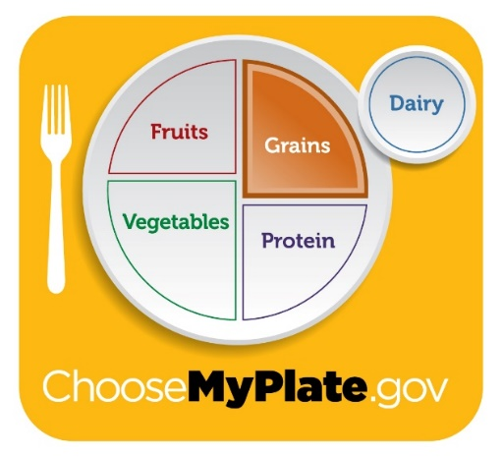

Yes or No?
.
Foods in the grains group give your body ENERGY.
YES
NO
Notes:
Raise your hand if you think grains group foods give you ENERGY!
Pictures:
MyPlate –ps://www.choosemyplate.gov/myplate-graphic-resources

Slide 5


YES!
Grains give our bodies ENERGY!
Notes:
If your hand is raised, you are correct! Grains give our bodies energy!
Pictures:
Girl jumping – purchased from https://www.istockphoto.com/
Thumbs up – purchased from https://www.istockphoto.com/

Slide 6
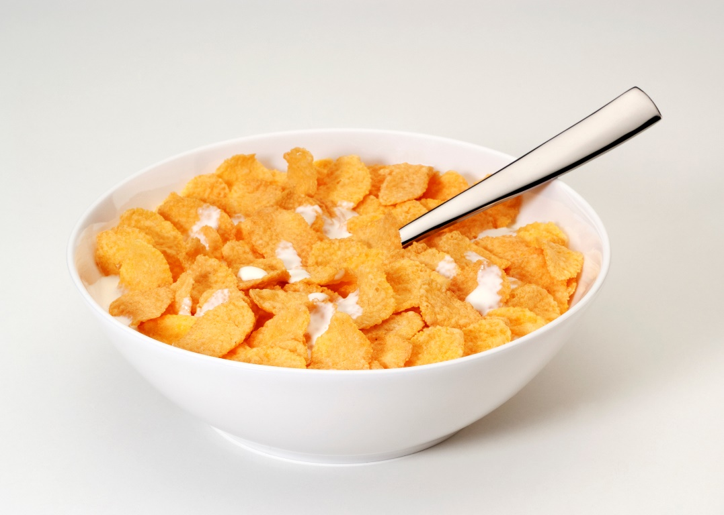

Yes or No?
.
Cereal is in the grains group.
YES
NO
Notes:
Raise your hand if you think CEREAL is in the GRAINS group
Pictures:
Cereal: purchased from www.istockphoto.com

Slide 7

Cereal is in the GRAINS group.
Breakfast cereals can be made from wheat, oats, corn and other grains.
YES!
Notes:
If your hand is raised, you are correct! Cereal is in the GRAINS group. Breakfast cereals can be made from wheat, oats, corn and other grains.
Picture:
Thumbs Up– purchased from https://www.istockphoto.com/

Slide 8
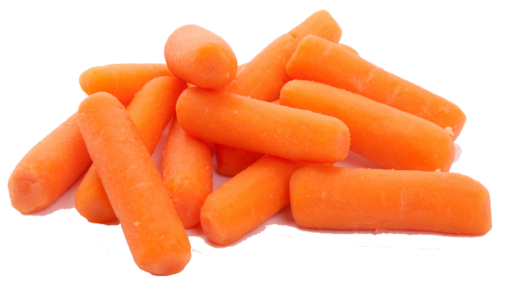
CARROTS are in the GRAINS group.
Yes or No?
.
YES
NO
Notes:
Are CARROTS in the Grains group? Give me a thumbs UP if you think YES. Give me a thumbs DOWN if you think NO.
Pictures:
Carrots: purchased from https://www.istockphoto.com/
Thumbs up and down: purchased from https://www.istockphoto.com/

Slide 9

Carrots are NOT in the GRAINS group.
They are in the VEGETABLE group
NO
Notes:
No! Carrots are very healthy for us, but they are in the vegetable group, not the grains group.
Picture:
Thumbs Down - purchased from https://www.istockphoto.com/

Slide 10
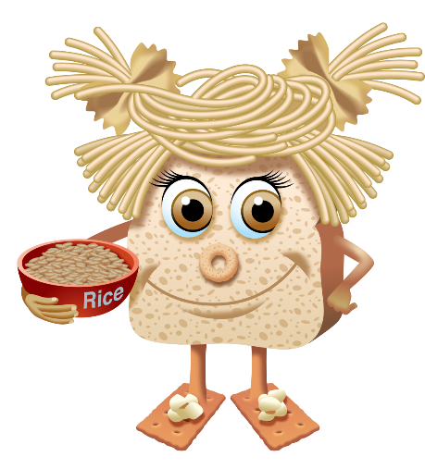

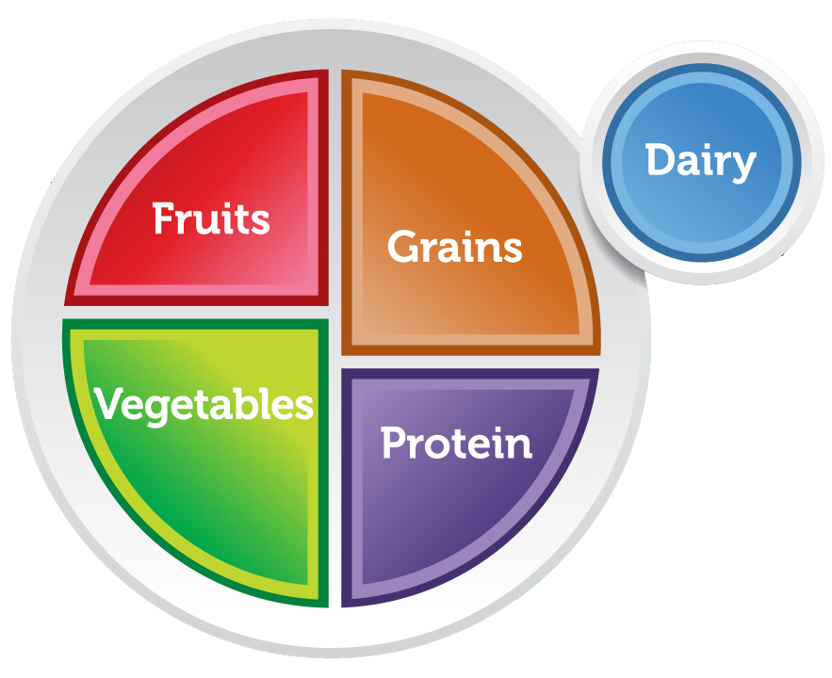

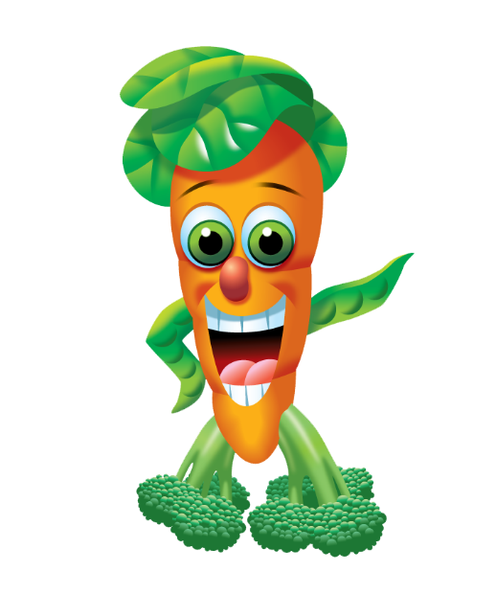

The 5 Food Groups
Jane Grain
Farrah Fruit
Mary Dairy
Dean Protein
Reggie Veggie
Notes:
It is important to eat foods from all 5 food groups everyday so that our bodies get all the nutrients it needs to grow and be strong. Today we are going to meet Dean Protein and learn all about the protein group.
Pictures:
Farrah Fruit: https://www.fns.usda.gov/tn/graphics-library
Reggie Veggie: https://www.fns.usda.gov/tn/graphics-library
Dean Protein: https://www.fns.usda.gov/tn/graphics-library
Mary Dairy: https://www.fns.usda.gov/tn/graphics-library
Jane Grain: https://www.fns.usda.gov/tn/graphics-library
MyPlate: https://www.choosemyplate.gov/myplate-graphic-resources

Slide 11

Notes:
Lego House
This is a house made out of Legos. If I wanted to build this house, what would I need? I would need individual Lego blocks. The Legos are the building blocks of the house. We can look around this room and see the different kinds of building blocks used to make it (cinder blocks, glass, ceiling tiles, etc.).
Just as this house is made of blocks of Legos, our bodies are also made from small building blocks. These blocks are called proteins.
Everything in our bodies is made of at least some protein. Our muscles, skin, hair, eyes, and body organs, such as the heart, are all made from protein. If we are made up of so much protein, it must be pretty important!
Pictures:
Lego house: purchased from www.istockphoto.com

Slide 12
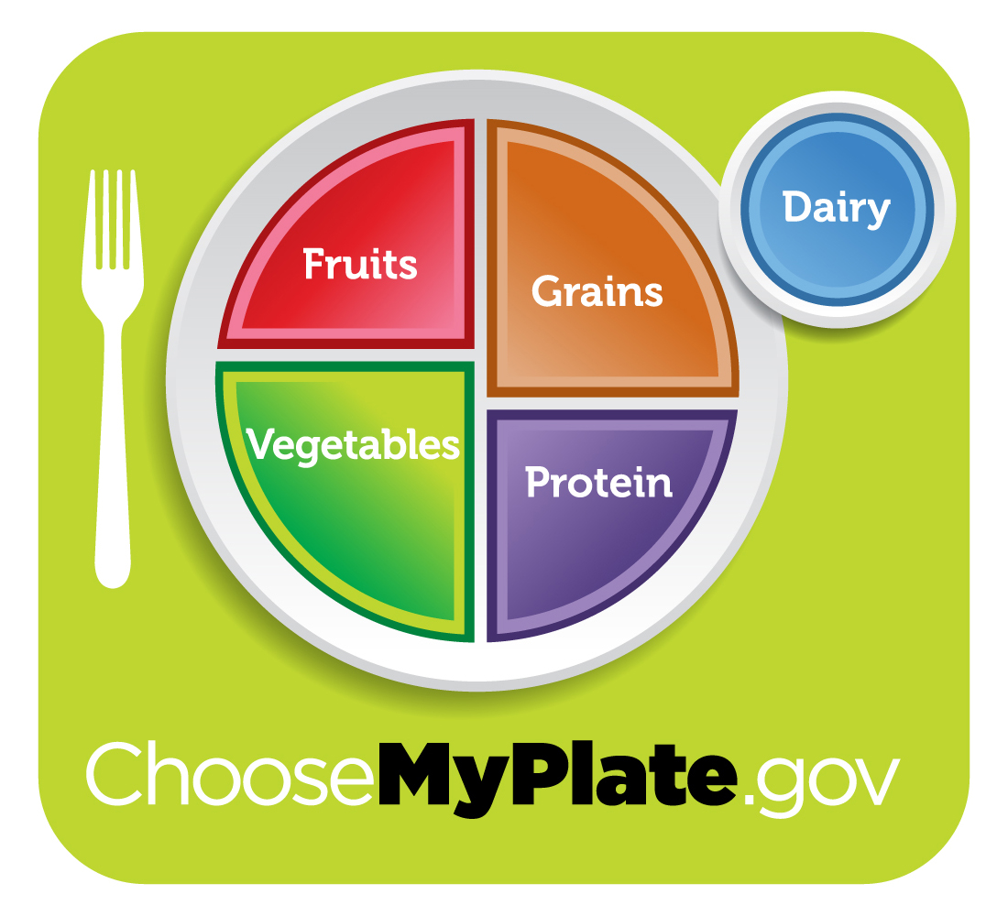
Notes:
Today we are going to talk about the purple area on MyPlate. It is called the Protein group because all the foods in this group have a lot of protein for our bodies.
The foods in this group help us grow and heal.
Pictures:
MyPlate graphic: https://www.choosemyplate.gov/myplate-graphic-resources

Slide 13
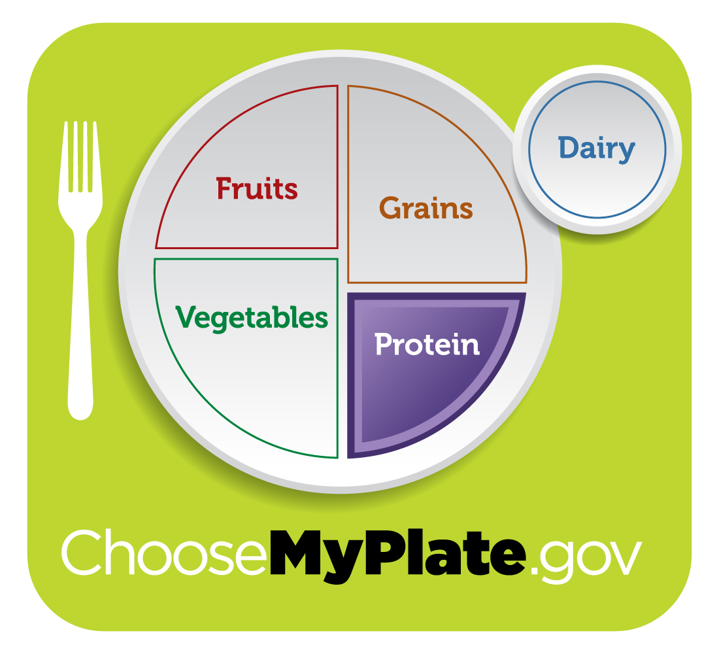

DEAN PROTEIN
Notes:
To help us remember the foods in the Protein group, we have our food group friend, Dean Protein. Let's take a closer look at Dean Protein.
Pictures:
MyPlate graphic: https://www.choosemyplate.gov/myplate-graphic-resources
Dean Protein: https://www.fns.usda.gov/tn/graphics-library

Slide 14

What foods is DEAN PROTEIN made of?
Notes:
Option 1: [Look at Dean Protein together and have students identify the foods he is made of.]
Pictures:
Dean Protein: https://www.fns.usda.gov/tn/graphics-library

Slide 15
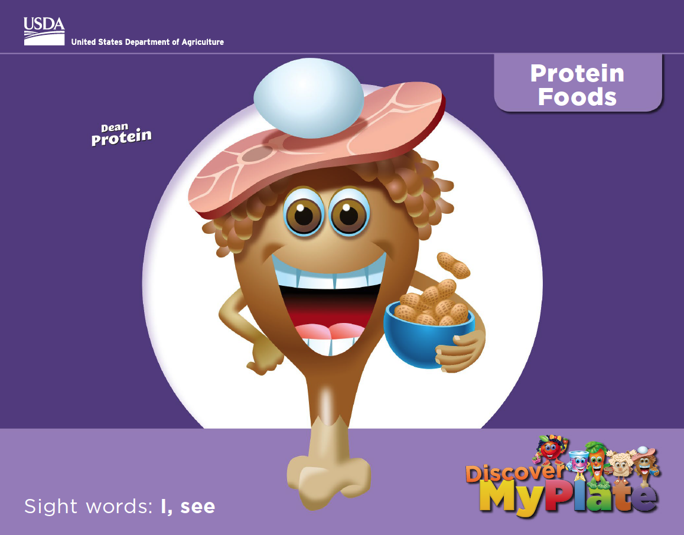
Notes:
-As we look at Dean Protein we are going to practice reading.
Pictures:
Discover MyPlate Book: https://www.fns.usda.gov/tn/discover-myplate-emergent-reader-mini-books

Slide 16
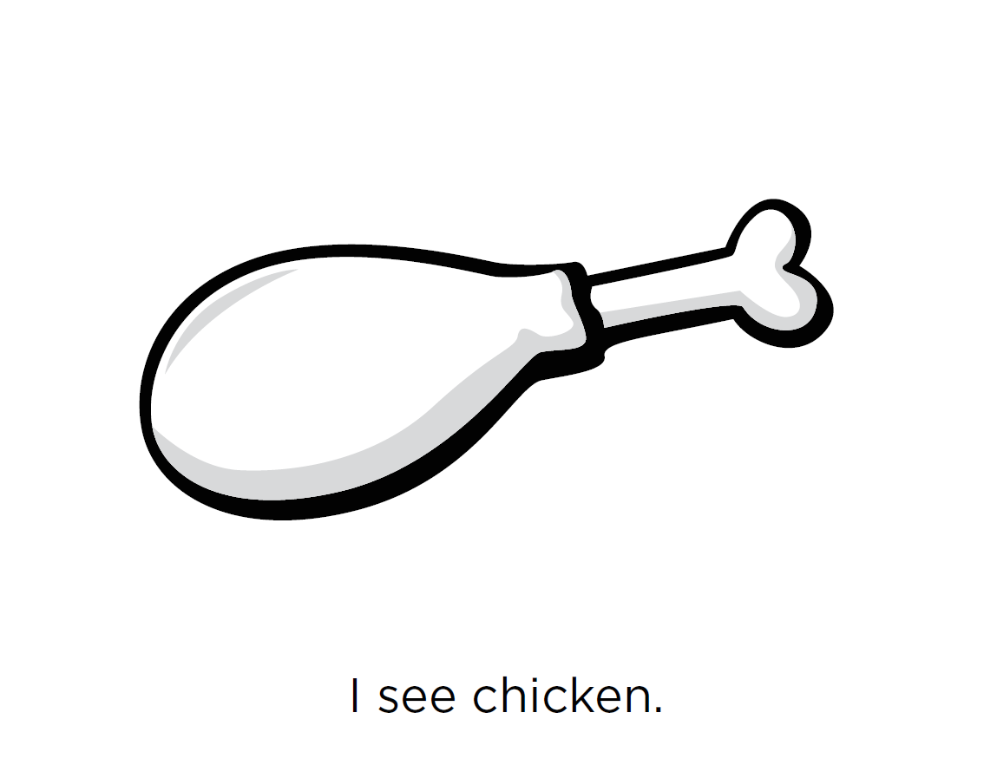

Notes:
Let's do the first one together. "I see chicken." "Yo veo pollo.“ Where is the chicken on Dean Protein?
Pictures:
Discover MyPlate Book: https://www.fns.usda.gov/tn/discover-myplate-emergent-reader-mini-books

Slide 17
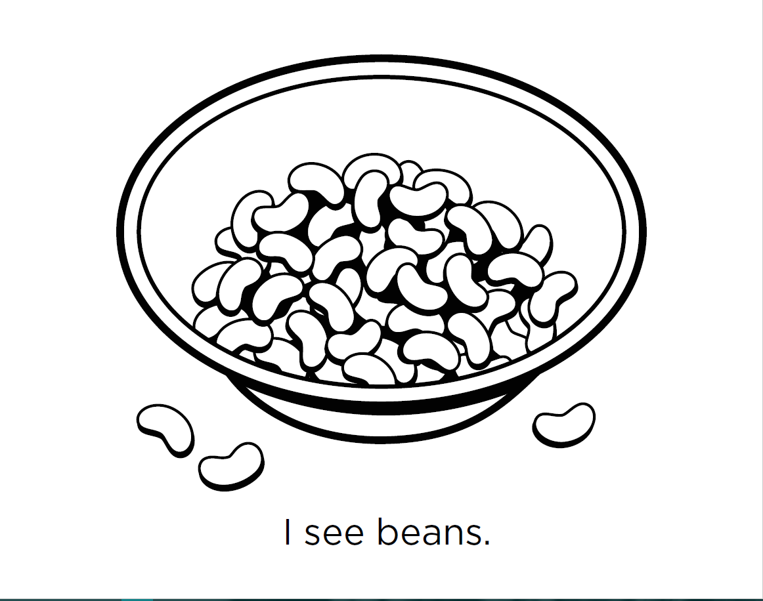
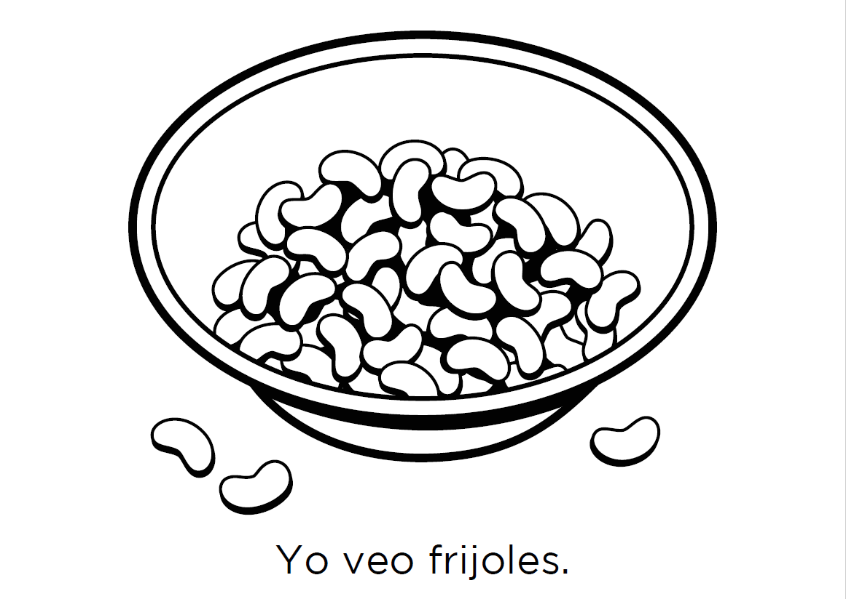
Notes:
-"I see beans." "Yo veo frijoles." [read together as a class, or if the children are more advanced, have them read it to you]. Can anyone find the beans on Dean Protein?
Pictures:
Discover MyPlate Book: https://www.fns.usda.gov/tn/discover-myplate-emergent-reader-mini-books

Slide 18
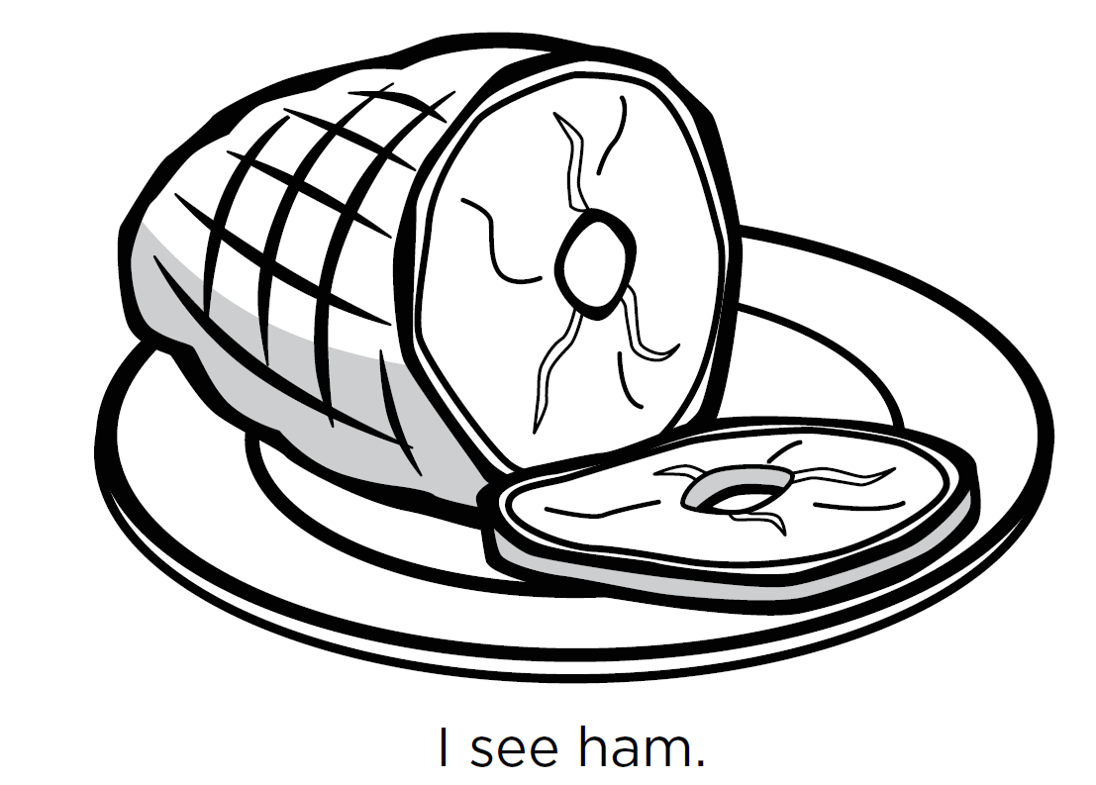
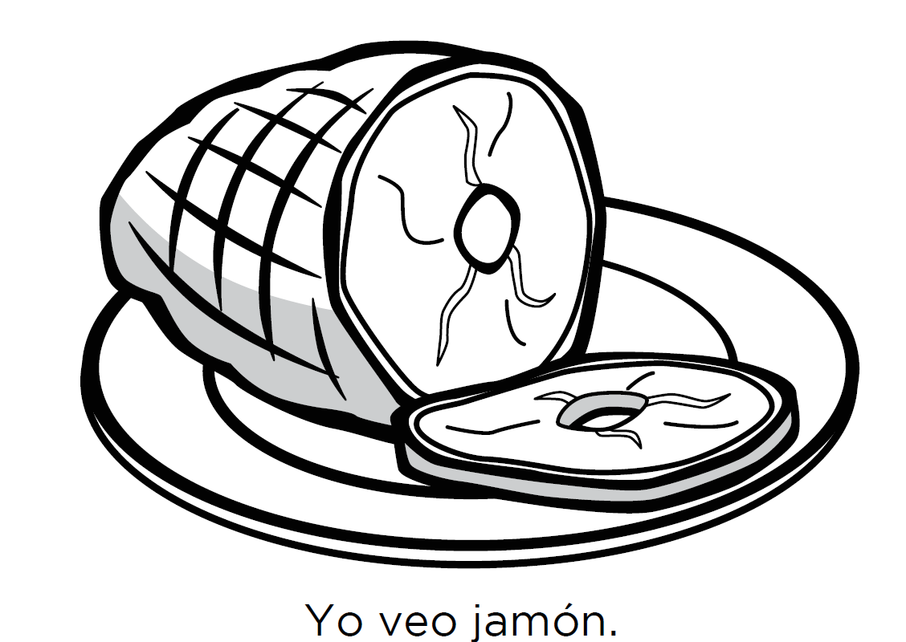
Notes:
-"I see ham." "Yo veo jamon." [read together as a class, or if the children are more advanced, have them read it to you]. Can anyone find the ham on Dean Protein?
Pictures:
Discover MyPlate Book: https://www.fns.usda.gov/tn/discover-myplate-emergent-reader-mini-books

Slide 19
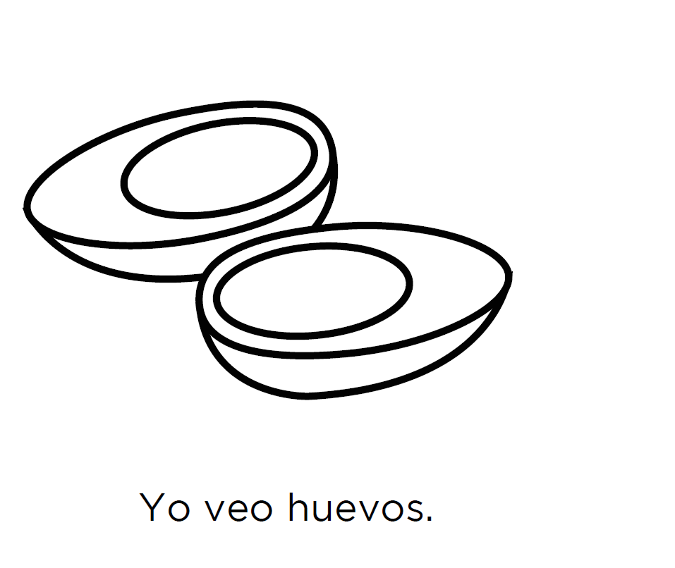
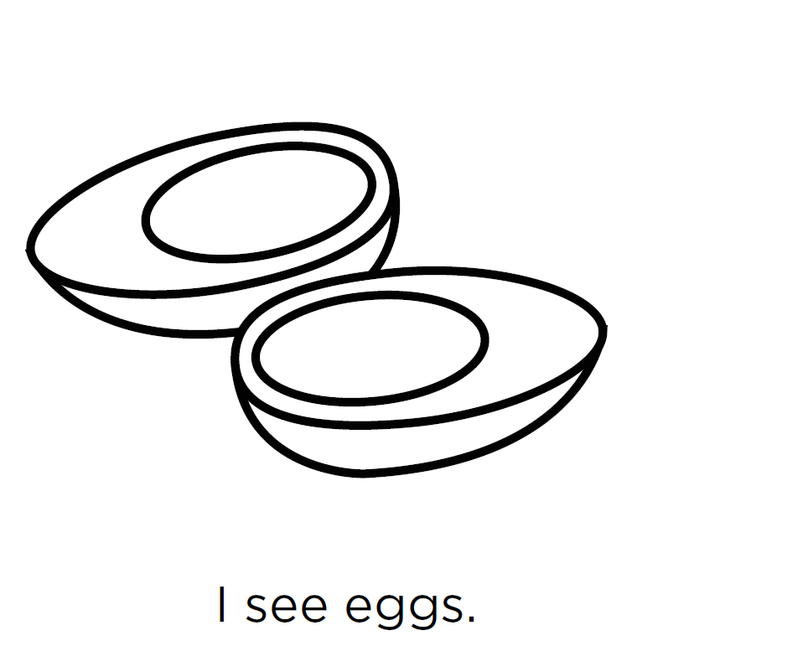
Notes:
-"I see eggs." "Yo veo huevos." [read together as a class, or if the children are more advanced, have them read it to you]. Can anyone find the egg on Dean Protein?
Pictures:
Discover MyPlate Book: https://www.fns.usda.gov/tn/discover-myplate-emergent-reader-mini-books

Slide 20
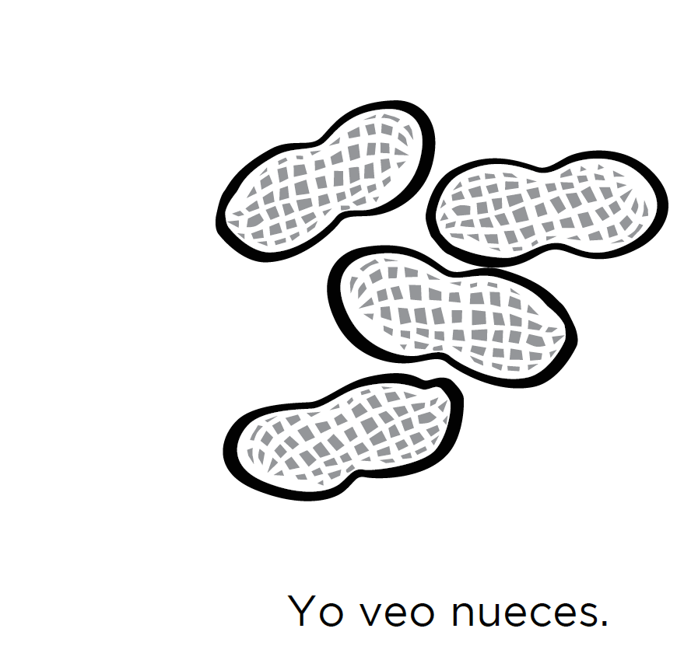

Notes:
-"I see nuts." "Yo veo nueces." [read together as a class, or if the children are more advanced, have them read it to you]. Can anyone find the peanuts on Dean Protein?
Pictures:
Discover MyPlate Book: https://www.fns.usda.gov/tn/discover-myplate-emergent-reader-mini-books

Slide 21
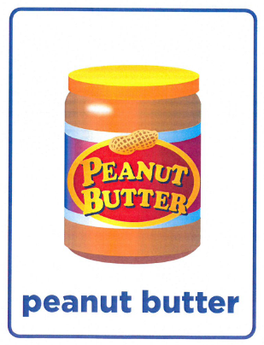
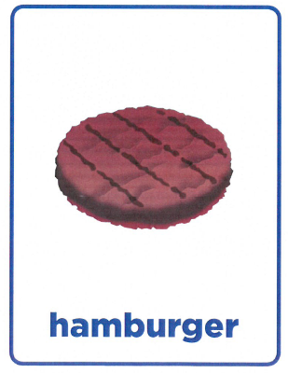
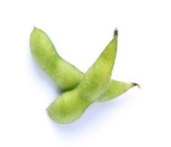
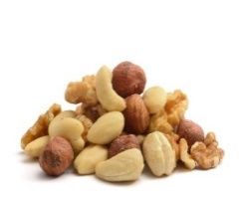
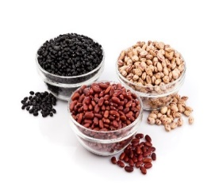
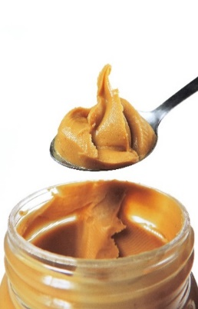
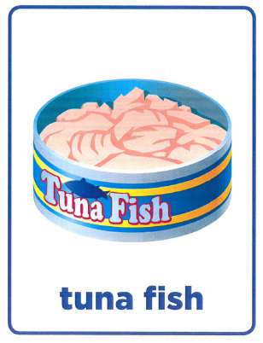
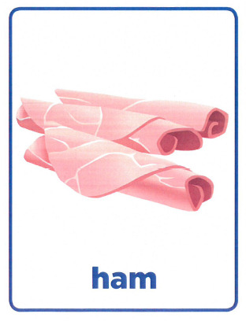
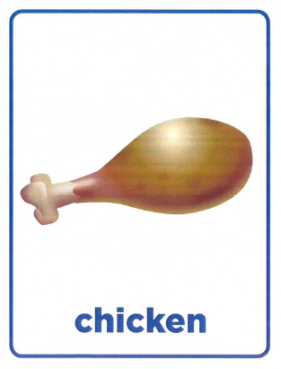
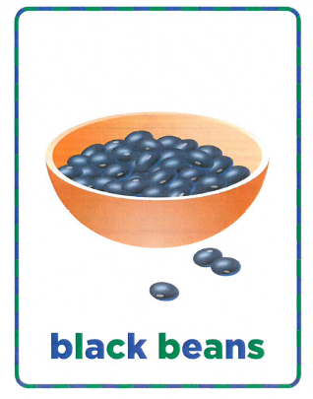

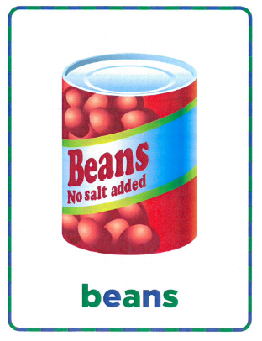
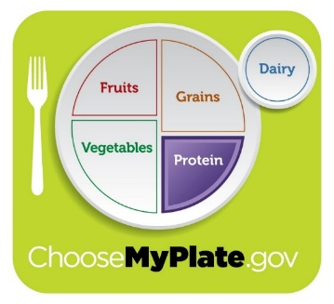
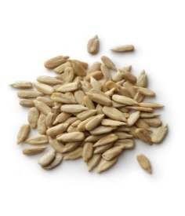
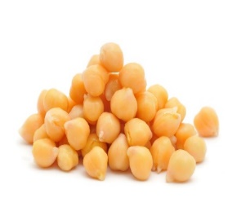
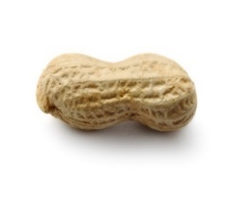
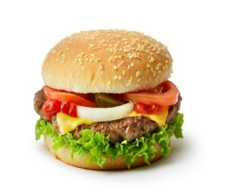
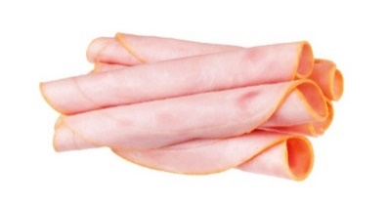
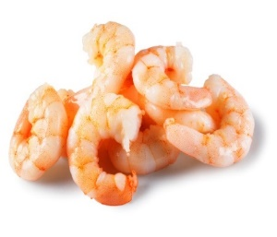
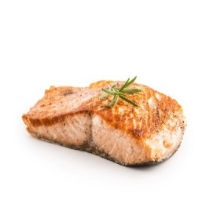
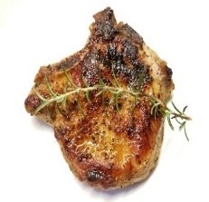
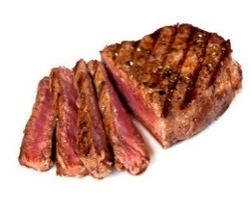
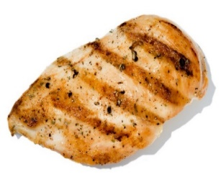
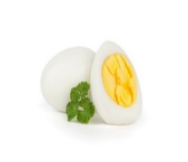
Notes:
-Great job! Dean Protein helps us remember some of the foods in the Protein Group. Let's look at some more foods that are in this group. Give me a thumbs up if you like these foods, a thumbs down if you don’t and a thumbs in the middle if you’ve never tried them.
Pictures:
MyPlate graphic: https://www.choosemyplate.gov/myplate-graphic-resources
Dean Protein: https://www.fns.usda.gov/tn/graphics-library
Edamame: purchased from www.istockphoto.com
Mixed nuts shelled: purchased from www.istockphoto.com
Three kinds of beans: purchased from www.istockphoto.com
Peanut butter: purchased from www.istockphoto.com
Chick Peas: purchased from www.istockphoto.com
Nuts Sunflower Seed: purchased from www.istockphoto.com
Peanut: purchased from www.istockphoto.com
Prawns: purchased from www.istockphoto.com
Salmon: purchased from www.istockphoto.com
Hamburger: purchased from www.istockphoto.com
Ham: purchased from www.istockphoto.com
Grilled pork chop: purchased from www.istockphoto.com
Steak: purchased from www.istockphoto.com
Grilled chicken: purchased from www.istockphoto.com
A hard boiled egg: purchased from www.istockphoto.com
Protein food cards: https://fns-prod.azureedge.net/sites/default/files/tn/dmp_foodcards.pdf

Slide 22

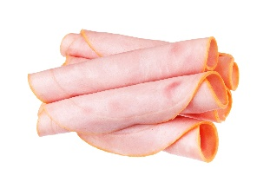
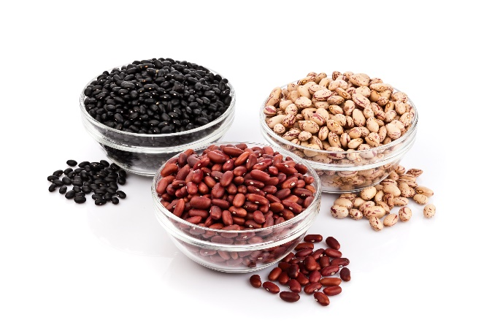
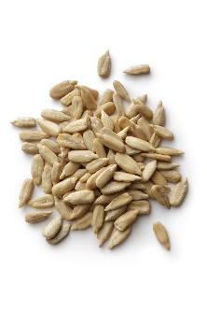
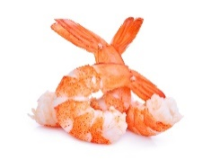
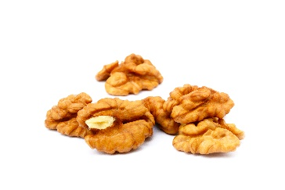
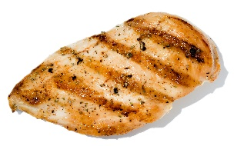
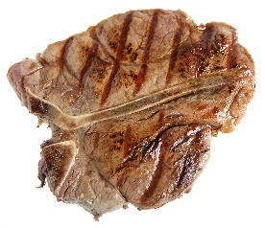
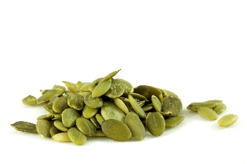
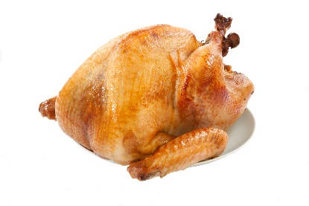
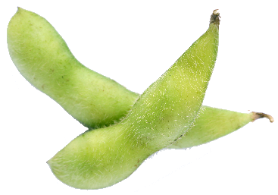











Plant
(Beans, Nuts and Seeds)
Animal
Notes:
Some of the foods in this group we get from animals, and some of the foods we get from plants. Plant proteins are things like beans, nuts and seeds. Animal proteins are foods from animals, like cows, chickens, and pigs. Often protein foods we get from animals is called meat. [Optional: Would anyone like to share with me their favorite protein food?]
Pictures:
Edamame: purchased from www.istockphoto.com
Three kinds of beans: purchased from www.istockphoto.com
Peanut butter: purchased from www.istockphoto.com
Chick Peas: purchased from www.istockphoto.com
Pumpkin seeds: purchased from www.istockphoto.com
Healthy walnuts: purchased from www.istockphoto.com
Nuts Sunflower Seed: purchased from www.istockphoto.com
Peanut: purchased from www.istockphoto.com
Bowl full of red split lentils: purchased from www.istockphoto.com
Cubes of tofu: purchased from www.istockphoto.com
Shrimps: purchased from www.istockphoto.com
Salmon: purchased from www.istockphoto.com
Roasted turkey: purchased from www.istockphoto.com
Hamburger: purchased from www.istockphoto.com
Ham: purchased from www.istockphoto.com
Grilled pork chop: purchased from www.istockphoto.com
Grilled T-bone: purchased from www.istockphoto.com
Grilled chicken: purchased from www.istockphoto.com
One egg: purchased from www.istockphoto.com
Cooked bacon: purchased from www.istockphoto.com
StarKist Tuna Can: purchased from www.istockphoto.com
Mixed nuts: purchased from www.istockphoto.com

Slide 23















VARIETY
Eating lots of different foods from the food group rather than the same food.
Plants
Animals
Notes:
It is important to eat foods from the Protein group several times each day. It is a good idea to choose a VARIETY of foods from this group. What does the word "variety" mean?
Choosing many different foods from this group rather than eating the same foods every day.
For example, instead of eating hamburgers every day, you might choose different animal protein foods like chicken, shrimp or eggs sometimes, and other times you might choose plant protein foods such as almonds, peanut butter, or beans.
Pictures:
Edamame: purchased from www.istockphoto.com
Mixed nuts shelled: purchased from www.istockphoto.com
Three kinds of beans: purchased from www.istockphoto.com
Peanut butter: purchased from www.istockphoto.com
Chick Peas: purchased from www.istockphoto.com
Nuts Sunflower Seed: purchased from www.istockphoto.com
Peanut: purchased from www.istockphoto.com
Prawns: purchased from www.istockphoto.com
Salmon: purchased from www.istockphoto.com
Hamburger: purchased from www.istockphoto.com
Ham: purchased from www.istockphoto.com
Grilled pork chop: purchased from www.istockphoto.com
Steak: purchased from www.istockphoto.com
Grilled chicken: purchased from www.istockphoto.com
A hard boiled egg: purchased from www.istockphoto.com

Slide 24


Plant or Animal?
Notes:
Since Protein group foods are from both plants and animals, let's look at some protein foods and see if you can figure out if it is from a plant or from an animal. [Optional game: Have students pretend to be a plant or an animal as you go through the different foods in the protein group. See if students can name which animal for the animal protein foods.]
Pictures:
Plant: PowerPoint icons
Cow: PowerPoint icons

Slide 25
Plant
Notes:
Pictures:
Beans: USDA Team Nutrition Discover MyPlate Food Cards https://fns-prod.azureedge.net/sites/default/files/tn/dmp_foodcards.pdf

Slide 26
Animal
Notes:
Pictures:
Eggs: USDA Team Nutrition Discover MyPlate Food Cards https://fns-prod.azureedge.net/sites/default/files/tn/dmp_foodcards.pdf

Slide 27
Plant
Notes:
Pictures
Peanut butter: USDA Team Nutrition Discover MyPlate Food Cards https://fns-prod.azureedge.net/sites/default/files/tn/dmp_foodcards.pdf

Slide 28
Animal
Notes:
Pictures:
Ham: USDA Team Nutrition Discover MyPlate Food Cards https://fns-prod.azureedge.net/sites/default/files/tn/dmp_foodcards.pdf

Slide 29
Animal
Notes:
Pictures:
Hamburger: USDA Team Nutrition Discover MyPlate Food Cards https://fns-prod.azureedge.net/sites/default/files/tn/dmp_foodcards.pdf

Slide 30
Animal
Notes:
Pictures:
Tuna: USDA Team Nutrition Discover MyPlate Food Cards https://fns-prod.azureedge.net/sites/default/files/tn/dmp_foodcards.pdf

Slide 31
Plant
Notes:
Pictures:
Black beans: USDA Team Nutrition Discover MyPlate Food Cards https://fns-prod.azureedge.net/sites/default/files/tn/dmp_foodcards.pdf

Slide 32

Animal
Notes:
Pictures:
Shrimp: USDA Team Nutrition Discover MyPlate Food Cards https://fns-prod.azureedge.net/sites/default/files/tn/dmp_foodcards.pdf

Slide 33
Animal
Notes:
Pictures:
Chicken: USDA Team Nutrition Discover MyPlate Food Cards https://fns-prod.azureedge.net/sites/default/files/tn/dmp_foodcards.pdf

Slide 34
Plant
Animal
Notes:
Pictures:
Beans, peanut butter, black beans, tuna fish, shrimp, chicken, eggs, ham, hamburger: USDA Team Nutrition Discover MyPlate Food Cards https://fns-prod.azureedge.net/sites/default/files/tn/dmp_foodcards.pdf

Slide 35
Why are the foods in the PROTEIN group so important?
Dean Protein
Notes:
Remember, Dean Protein helps us remind us of the foods in the protein group. Let's learn why these foods are so good for our bodies.
Pictures:
Dean Protein: https://www.fns.usda.gov/tn/graphics-library

Slide 36


When I eat
foods from
the PROTEIN GROUP
I give my body
PROTEIN
to GROW and HEAL.
Notes:
Repeat after me: When I eat foods from the Protein group, I give my body PROTEIN to grow and heal.
Pictures:
Dean Protein: https://www.fns.usda.gov/tn/graphics-library
MyPlate graphic: https://www.choosemyplate.gov/myplate-graphic-resources

Slide 37

Protein foods help us GROW!
Notes:
Protein helps us to GROW. Eating foods from the Protein group gives you the protein you need to get taller. It also helps your hair grow, and your muscles, skin, fingernails, and all parts of your body grow.
Pictures:
Measuring Kid Height: purchased from www.istockphoto.com

Slide 38

Protein foods help us HEAL!
Notes:
Protein helps us HEAL. If we get cut, we need protein to heal the cut. Remember the Lego house we talked about earlier? If there was a hole in the house, we would use a Lego block to fix it. Our bodies do the same thing-if we have a cut, our body helps it heal by adding protein blocks to the cut.
Pictures:
Girl with bandage: purchased from www.istockphoto.com

Slide 39
Let’s Play…
Help
Dean
Protein
Grow!
Notes:
Optional: Game: "Can You Help Dean Protein Grow?" [see additional activities]
Pictures:
Dean Protein: https://www.fns.usda.gov/tn/graphics-library

Slide 40
Quick
Quiz!
Notes:
Today we learned all about foods in the protein group and why they are so important for our bodies. Let’s take a Quick quiz to review what we’ve learned today.

Slide 41


Chicken is in the PROTEIN group.
Yes or No?
YES
NO
Notes:
Pictures:
Approved and rejected signs: purchased from www.istockphoto.com
Chicken drumstick: purchased from www.istockphoto.com

Slide 42

Chicken is a protein food!
YES!
Notes:
Pictures:
Thumbs up and down: purchased from www.istockphoto.com
Dean Protein: https://www.fns.usda.gov/tn/graphics-library
Chicken drumstick: purchased from www.istockphoto.com

Slide 43
Protein foods only come from animals.
Yes or No?
YES
NO
Notes:
Pictures:
Thumbs up and down: purchased from www.istockphoto.com

Slide 44



Protein foods come from plants and animals
No
Notes:
Pictures:
Thumbs up and down: purchased from www.istockphoto.com
Plant: PowerPoint icon
Cow: PowerPoint icon

Slide 45
Protein foods help our bodies grow and heal?
Yes or No?
YES
NO
Notes:
Pictures:
Thumbs up and down: purchased from www.istockphoto.com

Slide 46


Protein foods help our bodies grow and heal.
YES!
Notes:
Pictures:
Thumbs up and down: purchased from www.istockphoto.com
Dean Protein: https://www.fns.usda.gov/tn/graphics-library
Chicken drumstick: purchased from www.istockphoto.com

Slide 47










CHALLENGE
CHALLENGE
Eat a protein food that comes from a PLANT today!
Notes:
Eat a protein food that comes from a PLANT today! Maybe some peanuts or peanut butter, almonds or beans.
Pictures:
Edamame: purchased from www.istockphoto.com
Mixed nuts shelled: purchased from www.istockphoto.com
Three kinds of beans: purchased from www.istockphoto.com
Peanut butter: purchased from www.istockphoto.com
Chick Peas: purchased from www.istockphoto.com
Nuts Sunflower Seed: purchased from www.istockphoto.com
Peanut: purchased from www.istockphoto.com
Walnuts: purchased from www.istockphoto.com

Slide 48
Let’s Taste!

Slide 49


Don’t Yuck My Yum!
Don’t say
Nasty ☹
Disgusting ☹
Do say
That’s new ☺
I’ve never tasted that before ☺
Gross ☹
That’s different ☺
It’s not to my taste but I’m glad I tried it! ☺
Ewwwww ☹

Slide 50
Describe what you taste!
Salty
Savory
Crunchy
Soft
Chewy
Dry
Moist
Tangy
Sour
Mild
Fruity
Spicy
Flavorful
Sweet
Zesty
Creamy

