Slide 1


Dairy
K-1st Grade
This institution is an equal opportunity provider. This material was funded by USDA’s Supplemental Nutrition Assistance Program-SNAP.
Notes:
Today we are going to talk all about the Dairy Group, but before we do that, let’s review what we talked about last time I was here.

Slide 2
Objectives
Students will be able to identify two dairy foods.
Students will be able to explain that calcium is necessary for strong bones and teeth.

Slide 3
Quick
Quiz!
Protein Lesson Review
Notes:
Let’s an some review questions about the Protein Group.

Slide 4
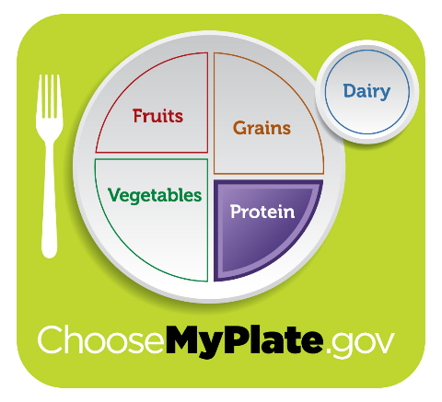
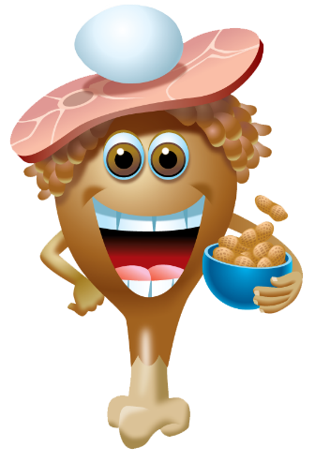
When I eat
foods from
the PROTEIN GROUP
I give my body
PROTEIN
to GROW and HEAL.
Notes:
Last time I was here we talked all about the Protein Group. Repeat after me.
When I eat
foods from
the PROTEIN GROUP
I give my body
PROTEIN
to GROW and HEAL
Pictures:
Dean Protein: https://www.fns.usda.gov/tn/graphics-library
MyPlate: https://www.fns.usda.gov/tn/graphics-library

Slide 5
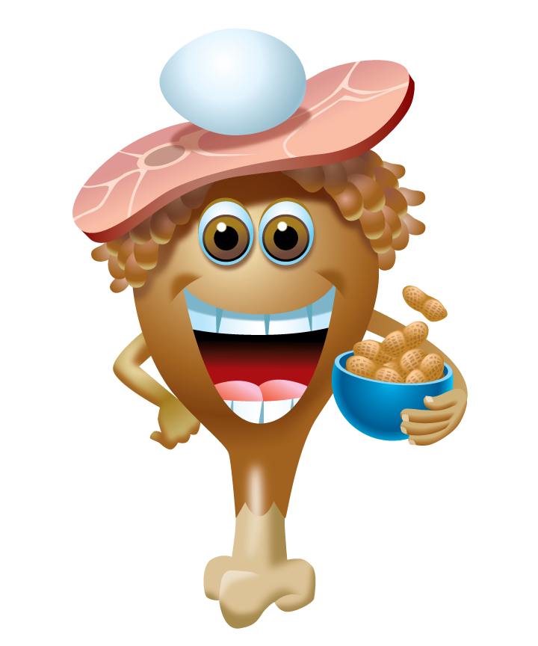
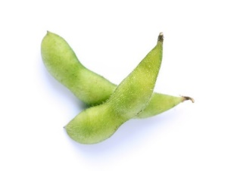
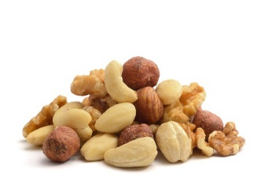
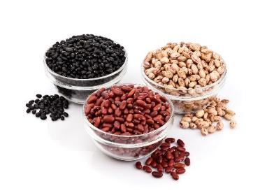
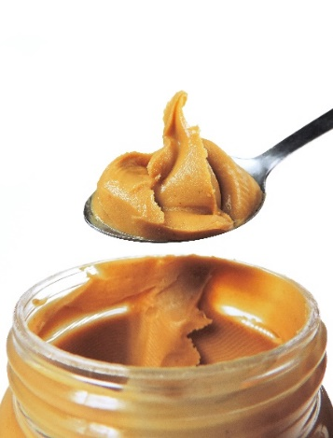
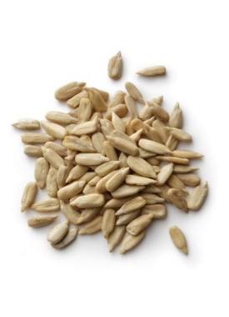
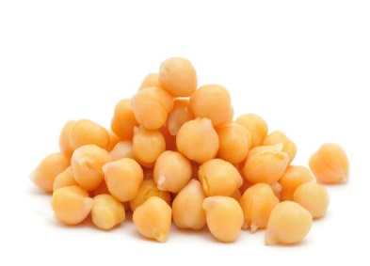
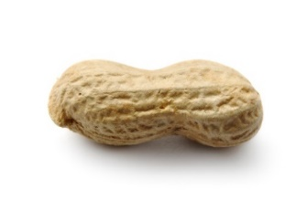
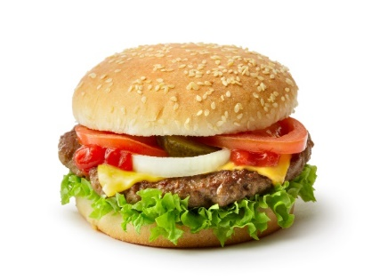
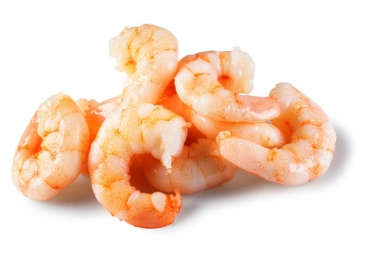
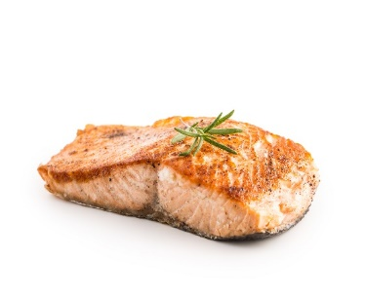
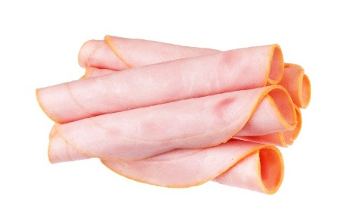
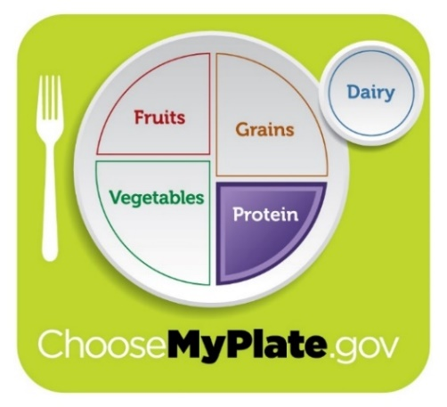
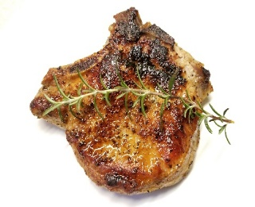
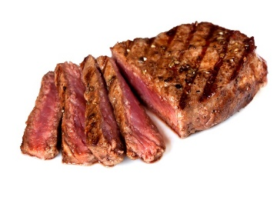
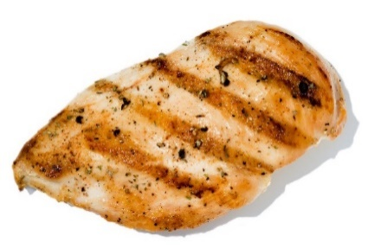
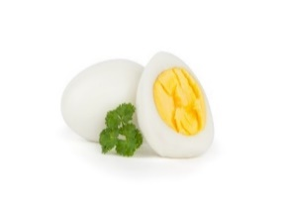
Name a food from the Protein Group
Dean Protein
Notes:
Raise your hand if you can name a food in the Protein group that comes from a plant? One from an animal? Good job!!
Pictures:
Dean Protein & MyPlate: https://www.fns.usda.gov/tn/graphics-library
Chick Peas:https://www.istockphoto.com/photo
Prawns: https://www.istockphoto.com/photo
Salmon: https://www.istockphoto.com/photo
Ham: https://www.istockphoto.com/photo
Mixed nuts shelled: https://www.istockphoto.com/photo
Three kinds of beans: https://www.istockphoto.com/photo
Peanut butter: https://www.istockphoto.com/photo
Sunflower Seed: https://www.istockphoto.com/photo
Peanut: https://www.istockphoto.com/photo
Hamburger: https://www.istockphoto.com/photo
Grilled pork chop: https://www.istockphoto.com/photo
Steak: https://www.istockphoto.com/photo
Grilled chicken: https://www.istockphoto.com/photo
Hardboiled egg: https://www.istockphoto.com/photo
Edamame: https://www.istockphoto.com/photo

Slide 6
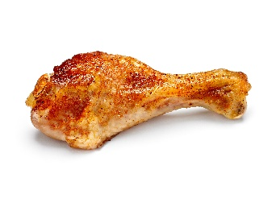

Chicken is in the PROTEIN group.
Yes or No?
YES
NO
Notes:
Yes or No? Chicken is in the Protein Group.
Pictures:
Thumbs up and down: purchased from www.istockphoto.com
Chicken drumstick: purchased from www.istockphoto.com

Slide 7

Chicken is a protein food!
YES!
Notes:
Yes! Chicken is a protein food.
Pictures:
Thumbs up and down: purchased from www.istockphoto.com
Dean Protein: https://www.fns.usda.gov/tn/graphics-library
Chicken drumstick: purchased from www.istockphoto.com

Slide 8
Protein foods only come from animals.
Yes or No?
YES
NO
Notes:
Yes or No? Protein foods only come from animals.
Pictures:
Thumbs up and down: purchased from www.istockphoto.com

Slide 9


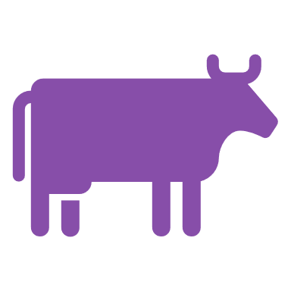
Protein foods come from plants and animals
No
Notes:
No. Protein foods come from plants and animals.
Pictures:
Thumbs up and down: purchased from www.istockphoto.com
Plant: PowerPoint icon
Cow: PowerPoint icon

Slide 10
Protein foods help our bodies grow and heal?
Yes or No?
YES
NO
Notes:
Yes or No? Protein foods help our bodies grow and heal?
Pictures:
Thumbs up and down: purchased from www.istockphoto.com

Slide 11

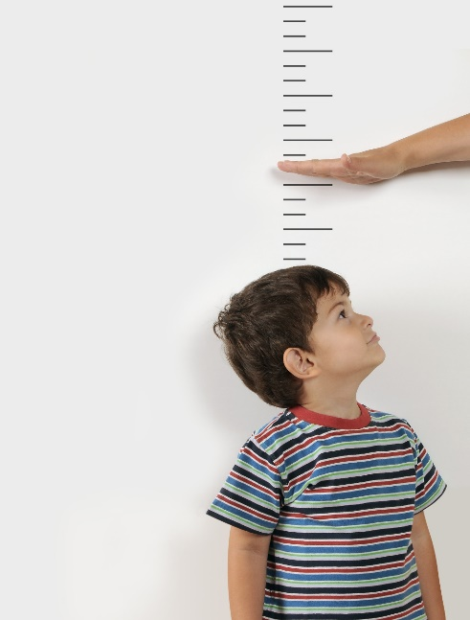
Protein foods help our bodies grow and heal.
YES!
Notes:
Yes. Protein foods help our bodies grow and heal.
Pictures:
Thumbs up and down: purchased from www.istockphoto.com
Dean Protein: https://www.fns.usda.gov/tn/graphics-library
Chicken drumstick: purchased from www.istockphoto.com

Slide 12
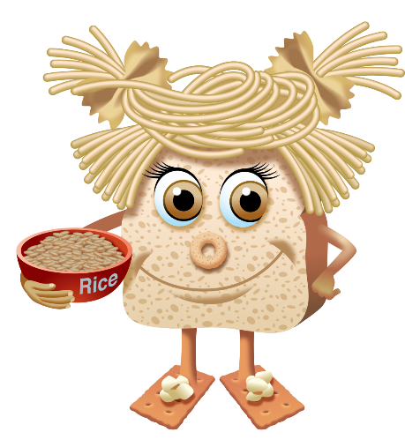
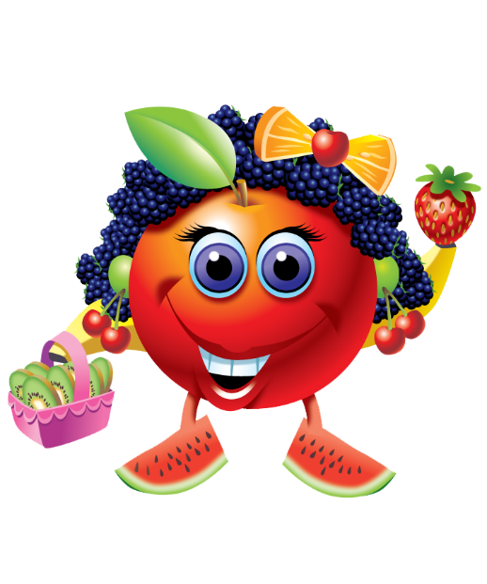
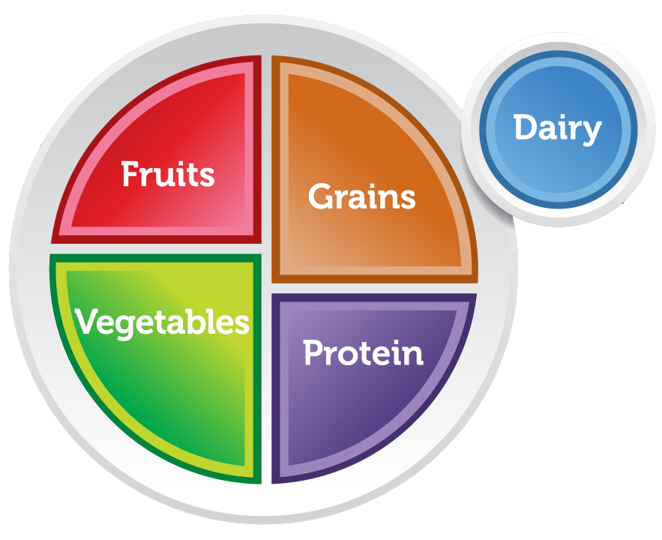
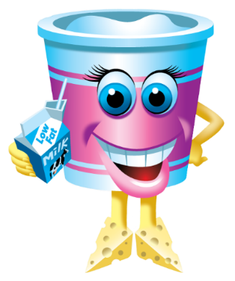
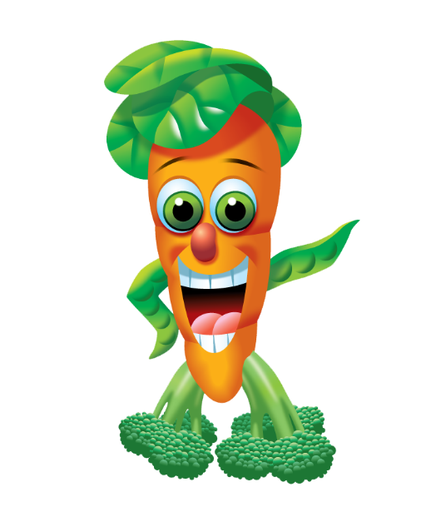

The 5 Food Groups
Jane Grain
Farrah Fruit
Mary Dairy
Dean Protein
Reggie Veggie
Notes:
It’s important to eat foods from all 5 food groups everyday. Today we are going to meet Mary Dairy and learn all about the dairy group.
Pictures:
Farrah Fruit: https://www.fns.usda.gov/tn/graphics-library
Reggie Veggie: https://www.fns.usda.gov/tn/graphics-library
Dean Protein: https://www.fns.usda.gov/tn/graphics-library
Mary Dairy: https://www.fns.usda.gov/tn/graphics-library
Jane Grain: https://www.fns.usda.gov/tn/graphics-library
MyPlate: https://www.choosemyplate.gov/myplate-graphic-resources

Slide 13
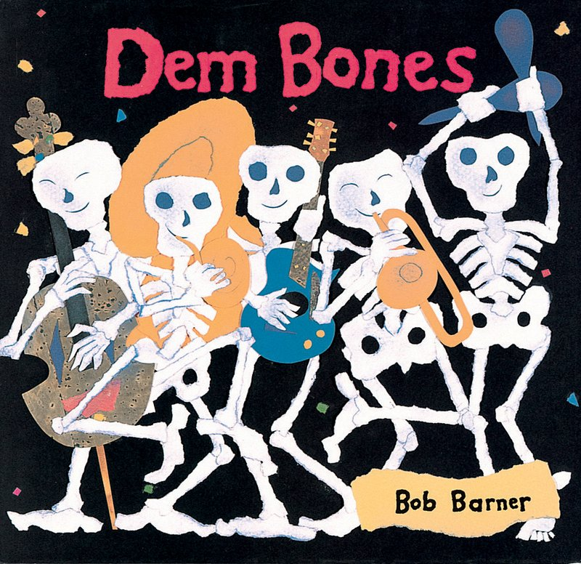
Notes:
Let’s start by reading Dem Bones. While I’m reading, quietly listen and think to yourself about why I might be reading this book.
[<2mins if reading only large font]
Pictures:
Dem Bones: https://www.scholastic.com/teachers/books/dem-bones-by-bob-barner/

Slide 14
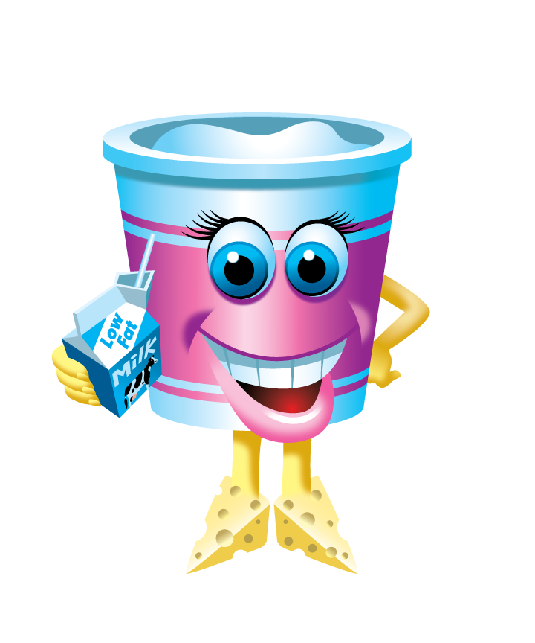
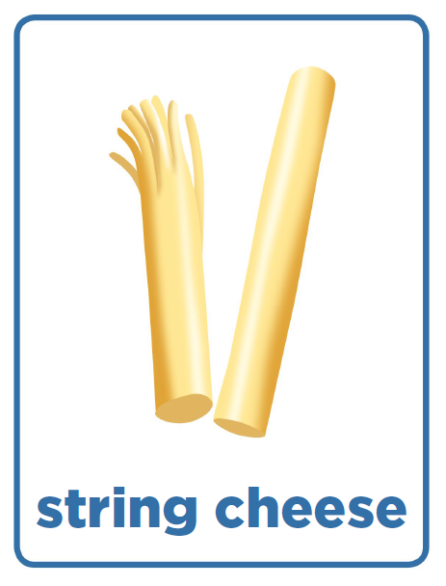
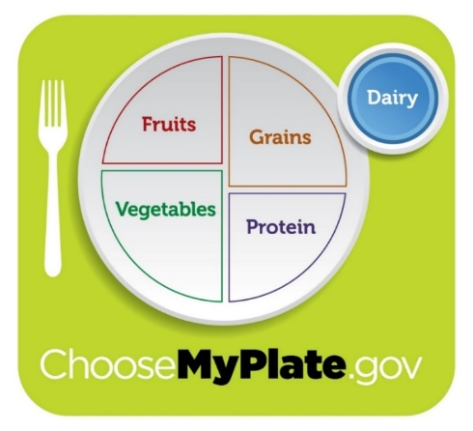
Cottage
cheese
yogurt
milk
Soy milk
Mary Dairy
Notes:
Now let’s meet Mary Dairy. She’s here to remind us of the foods that are found in the Dairy group. The dairy group is the blue group on MyPlate.
Let’s take a closer look at Mary Dairy.
What is her body made of? (yogurt) What is she holding? (milk) What are her feet made of? (cheese)
Those are clues to which foods are in the dairy food group.
Let’s take a look at some foods in the dairy group. If you like these foods, give me a thumbs up, a thumbs down if you don’t, and a thumbs in the middle if you’ve never tried it before. Get your thumbs ready! [click through dairy pictures]
Pictures:
Mary Dairy: https://www.fns.usda.gov/tn/graphics-library
MyPlate: https://www.fns.usda.gov/tn/graphics-library
Dairy Food Cards: https://fns-prod.azureedge.net/sites/default/files/tn/dmp_foodcards.pdf

Slide 15
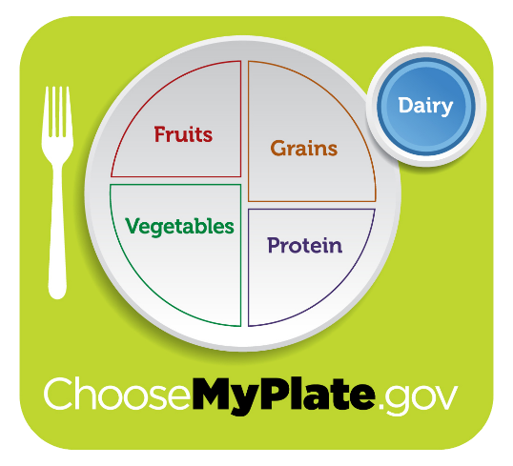
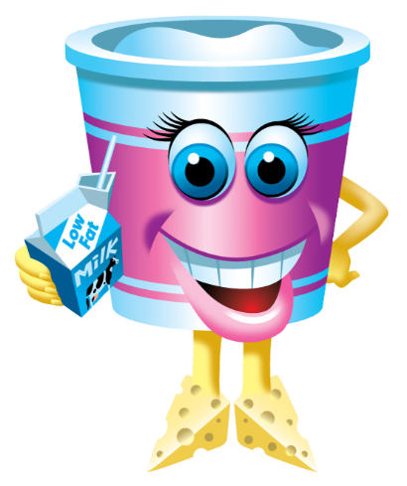
When I eat
foods from
the DAIRY GROUP
I give my body
CALCIUM
to build strong BONES & TEETH.
Notes:
Why are foods in the dairy group so important for our bodies?
Repeat after me.
When I eat
foods from
the DAIRY GROUP
I give my body
CALCIUM
to build strong BONES & TEETH.
Pictures:
Mary Dairy: https://www.fns.usda.gov/tn/graphics-library
MyPlate: https://www.fns.usda.gov/tn/graphics-library

Slide 16

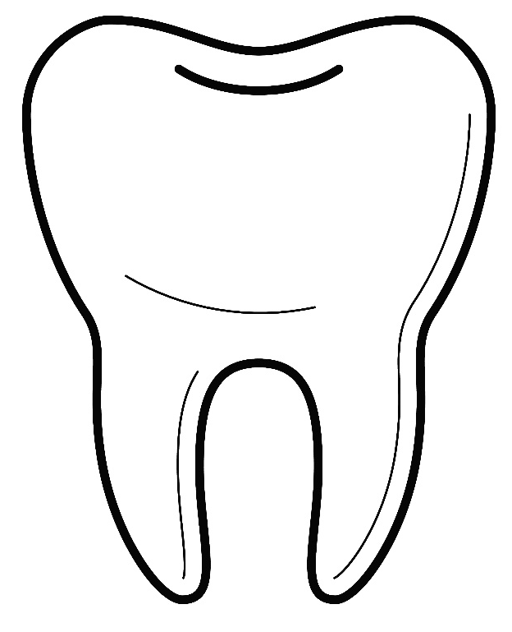
Our BONES and TEETH need CALCIUM!
206!
Notes:
Building the best body includes not just the parts of your body that you can see on the outside but also the parts of your body that are on the inside that you don’t see. This includes our bones. (We can see our teeth when we smile but we are going to talk about them along with the bones because they both need the same thing to be healthy. CALCIUM !
Can you say “Calcium”? Good! CALCIUM is something our bones and teeth needs lot of. We need to feed our bodies CALCIUM so we can build strong bones and teeth. The Dairy group foods have the most Calcium for our bones.
Your bodies have been growing bigger since the day you were born. Your BONES have also been growing and getting bigger. BUT, if you do not give them enough calcium every day, your bones will not grow and you won’t grow into a strong adult!
Raise your hand if you can guess how many bones and teeth are in our bodies. 206!
Pictures:
Bone: purchased from https://www.istockphoto.com
Tooth: purchased from https://www.istockphoto.com
Piggy Bank: purchased from https://www.istockphoto.com

Slide 17
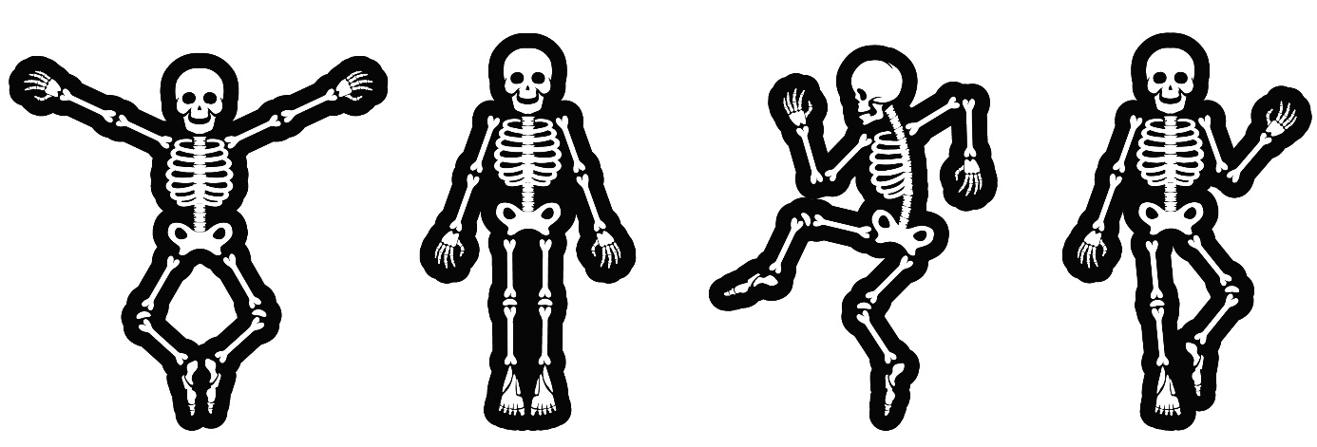

Do the
WIGGLE DANCE!
Notes:
Let’s do the Wiggle Dance and move all 206 of our bones. It’s like Simon Says, Wiggle the body part I say…
Wiggle toes
Wiggle toes then feet
Wiggle toes, feet, then legs
Wiggle toes, feet, legs, then hips
Wiggle toes, feet, legs, then hips, then rib cage
Wiggle toes, feet, legs, hips, rib cage, then shoulders
Wiggle toes, feet, legs, hips, rib cage, shoulders, then arms
Wiggle toes, feet, legs, hips, rib cage, shoulders, arms, then wrists
Wiggle toes, feet, legs, hips, rib cage, shoulders, arms, wrists, then fingers
Wiggle toes, feet, legs, hips, rib cage, shoulders, arms, wrists, fingers, then neck, head
One last time!!
Wiggle toes, feet, legs, hips, rib cage, shoulders, arms, wrists, fingers, then neck, head and TEETH.
Pictures:
Dancing Skeletons: https://www.istockphoto.com

Slide 18

Why do we need BONES?
Notes:
Why do we have bones? Our bones help us in three main ways.
Pictures:
Bone: purchased from https://www.istockphoto.com

Slide 19
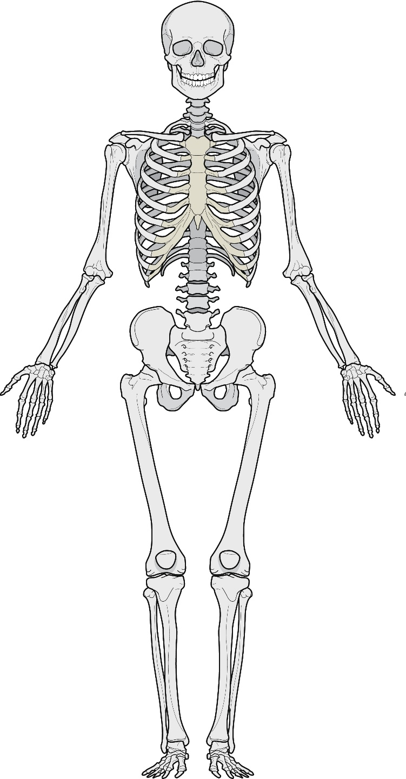

SHAPE
Notes:
One - Shape: We need bones to give our bodies their shape. Do you think we would be able to stand or sit up if we didn’t have any bones? NO!
What would we be like without bones? A blob.
Pictures:
Skeleton: https://www.istockphoto.com
Blue Blob: https://www.istockphoto.com

Slide 20
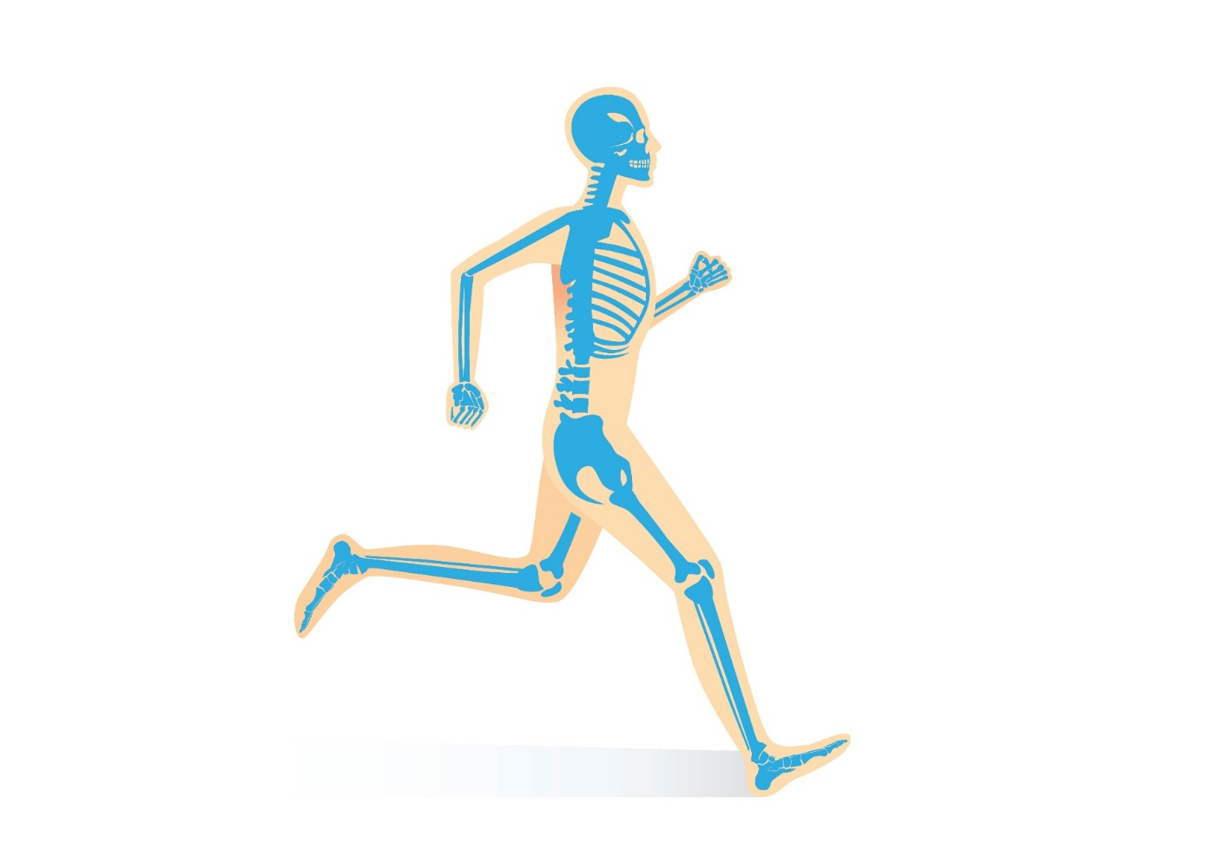
MOVEMENT
Notes:
Two - Movement: We also need bones to help us move. Do you think you would be able to walk/ run if you didn’t have any bones? Our leg muscles that help us walk and arm muscles that help us lift stuff are attached to our bones.
Pictures:
Moving Skeleton: https://www.istockphoto.com/

Slide 21
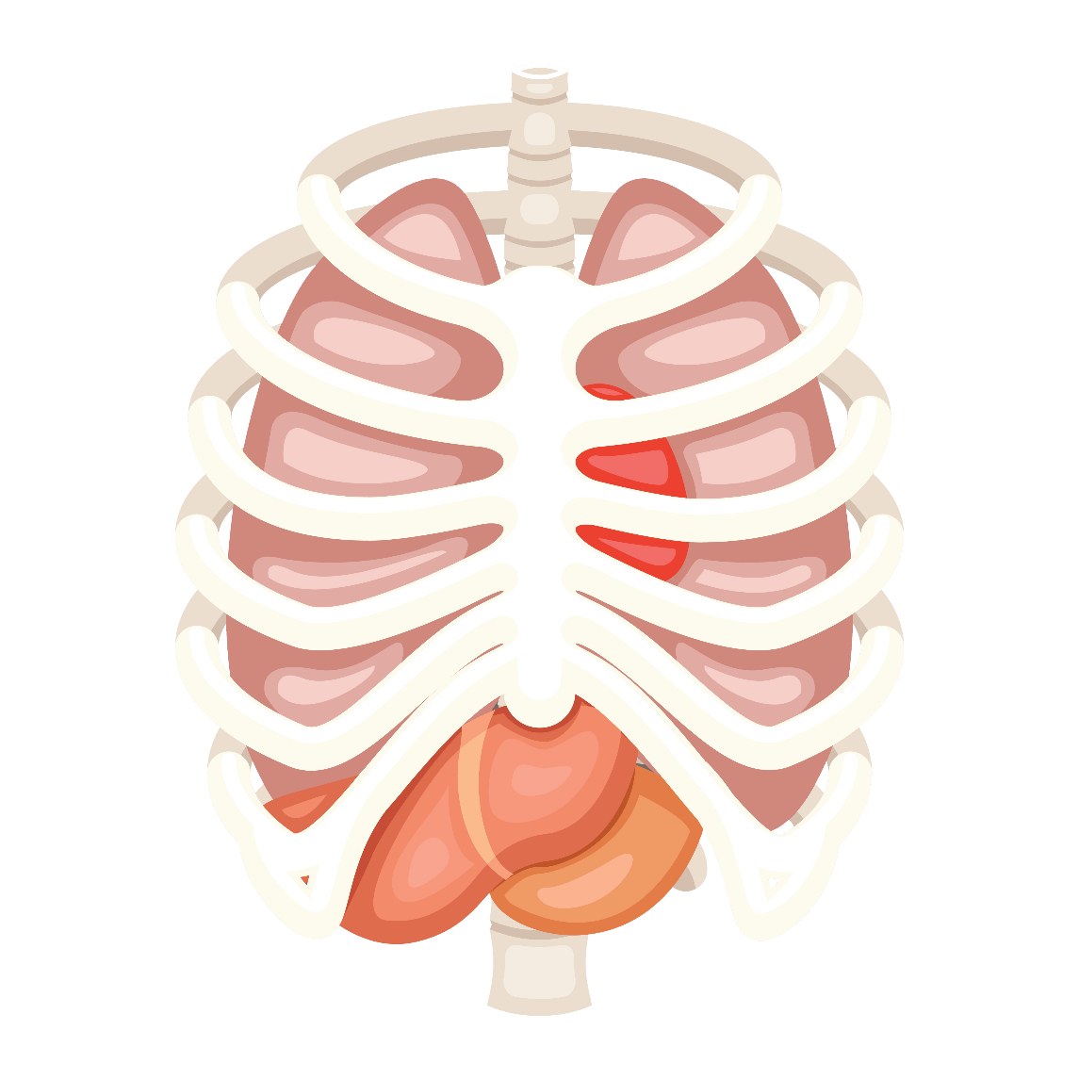
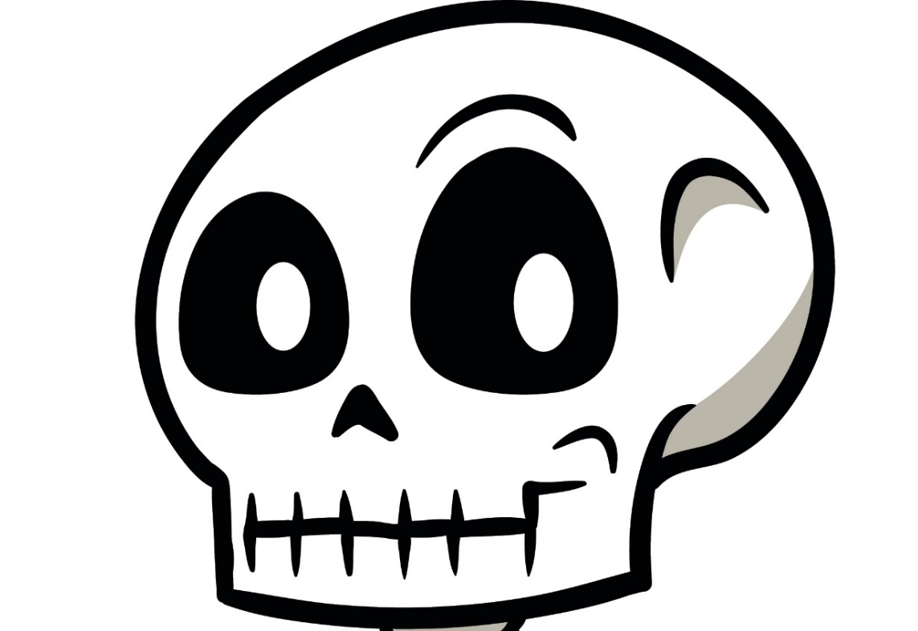
PROTECTION
Notes:
Three - Protection: Lastly, we need bones to protect other body parts that are INSIDE our body.
What do our rib bones protect? Organs like lungs and heart.
What does our head bone or skull protect? Brain! AND… its hold our teeth inside our mouth.
Bones are very important to protect parts of our body that keep us alive!
Pictures:
Internal Organs: https://www.istockphoto.com
Skeleton head: https://www.istockphoto.com

Slide 22
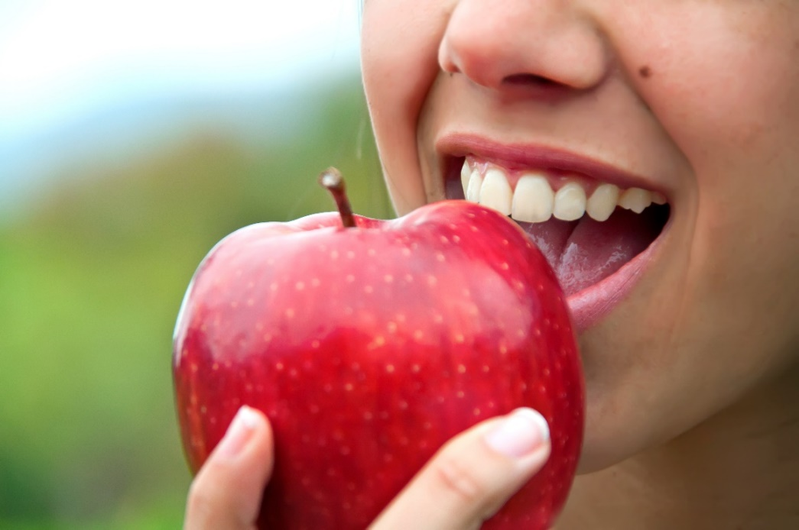

Why do we need teeth?
Bite and chew food
Talk
(by pronouncing words correctly)
Notes:
What about our teeth? Why are they important?
Biting and Chewing---we could not eat all the amazing healthy foods we are talking about this year without teeth. Without teeth we would have to eat like babies, just liquids and mashed up food. No more crunchy apples, yummy sandwiches or zesty pizzas.
Talking—when we talk our tongue and teeth help us shape our mouths to make the correct letter and word sounds. We could still talk without teeth but it would sounds a little funny and be a little hard to understand.
Pictures:
Biting into Apple: https://www.istockphoto.com
Students Talking: https://www.istockphoto.com

Slide 23
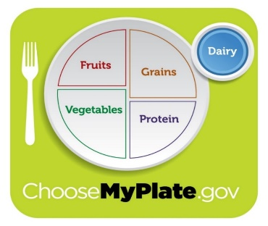



How do we keep our bones and teeth healthy?
Calcium
Exercise
Notes:
There are two important things we need to do every day to build and keep strong bones our whole lives:
We need to get plenty of calcium from what we eat and drink.
We need to get plenty of exercise by moving the big parts of our bodies.
Pictures:
MyPlate: : https://www.fns.usda.gov/tn/graphics-library
Kids drinking milk: https://www.istockphoto.com
Kids playing tag: https://www.istockphoto.com

Slide 24
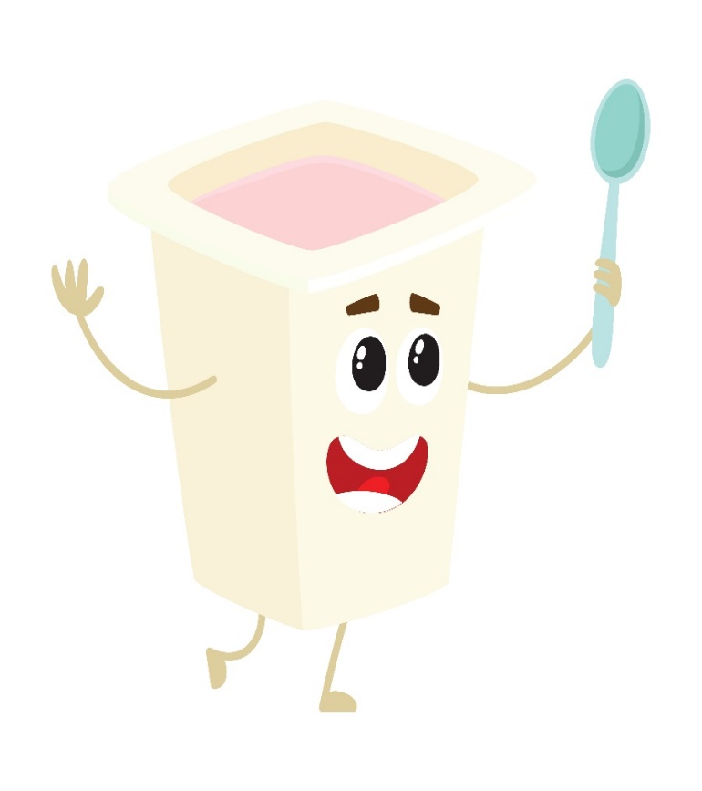
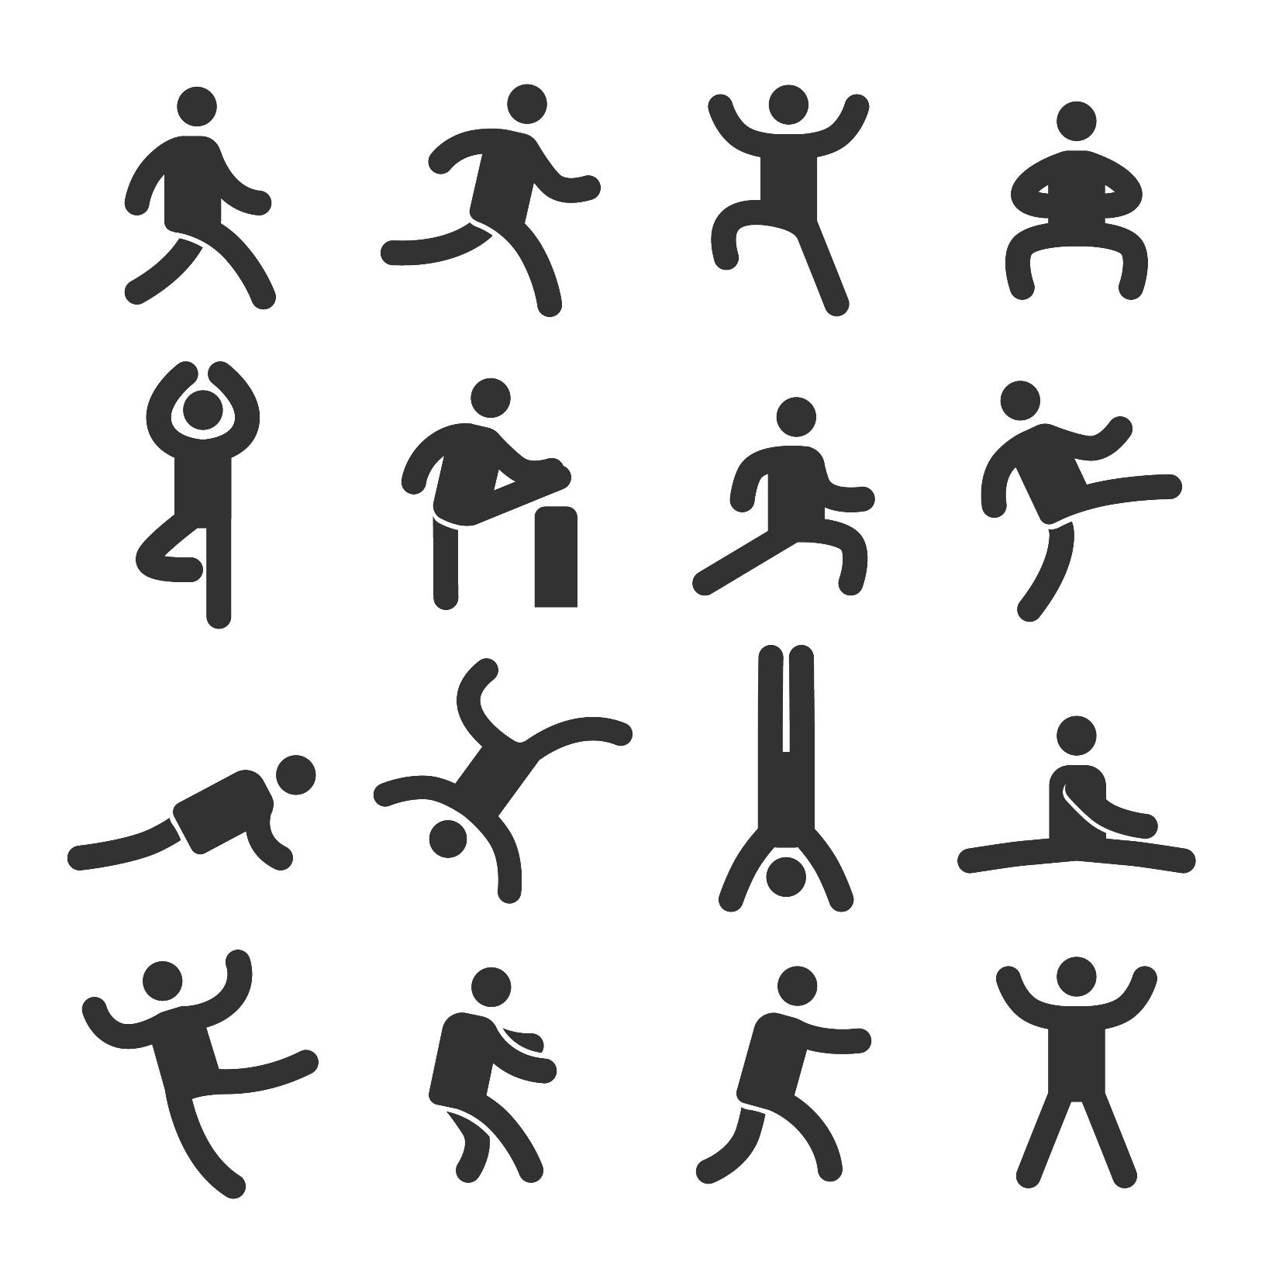
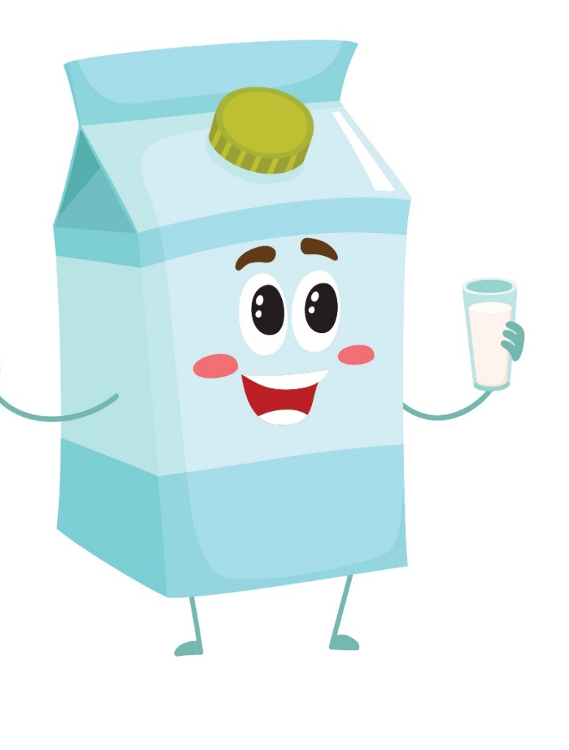

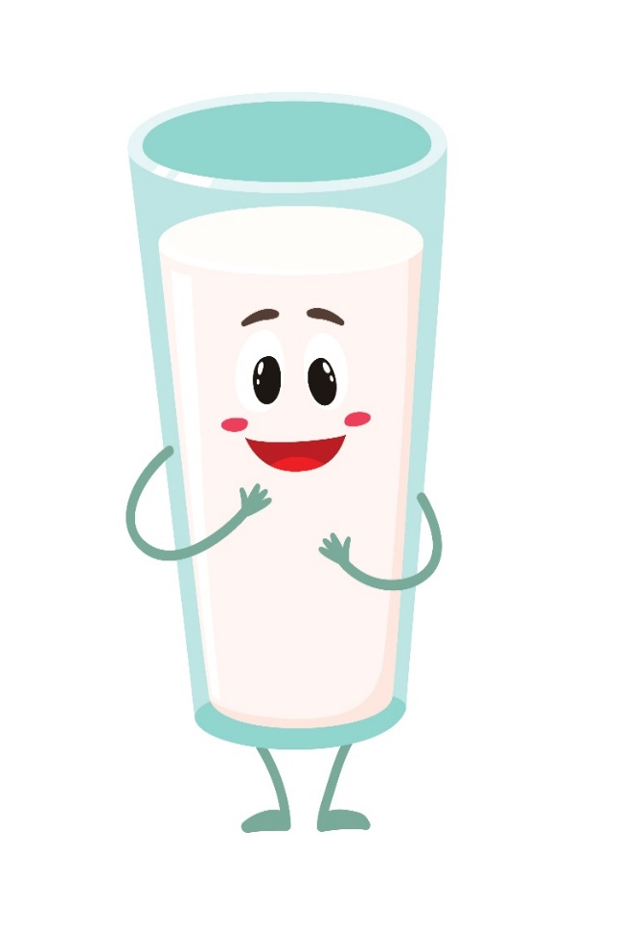





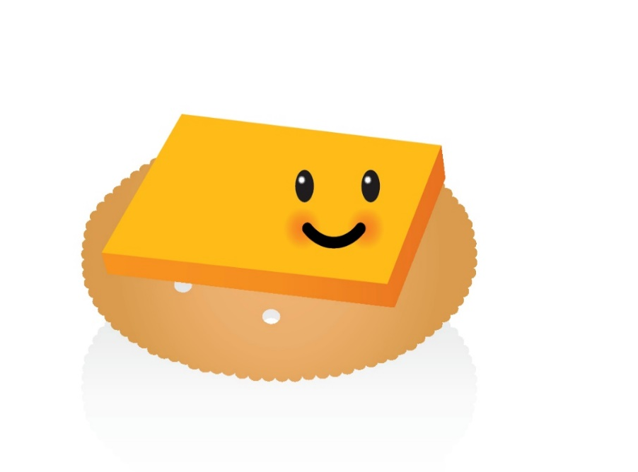
Notes:
Let’s practice some exercises that will make our bones stronger!
Reach for the ceiling if you like milk
Pretend to swim in place if you like cereal with milk on it
Squat down if you like cheese for a snack
Run in place if you like to drink milk with lunch at school
Lunge if you like cheese on crackers
Balance on 1 leg if you like yogurt
Pictures:
Action Icons: purchased from https://www.istockphoto.com
Swim icon: purchased from https://www.istockphoto.com
Glass of milk cartoon: purchased from https://www.istockphoto.com
Milk carton and Cheese cartoons: purchased from https://www.istockphoto.com
Yogurt Cartoon: purchased from https://www.istockphoto.com
Cereal and milk cartoon: purchased from https://www.istockphoto.com
Cheese and cracker cartoon: purchased from https://www.istockphoto.com

Slide 25
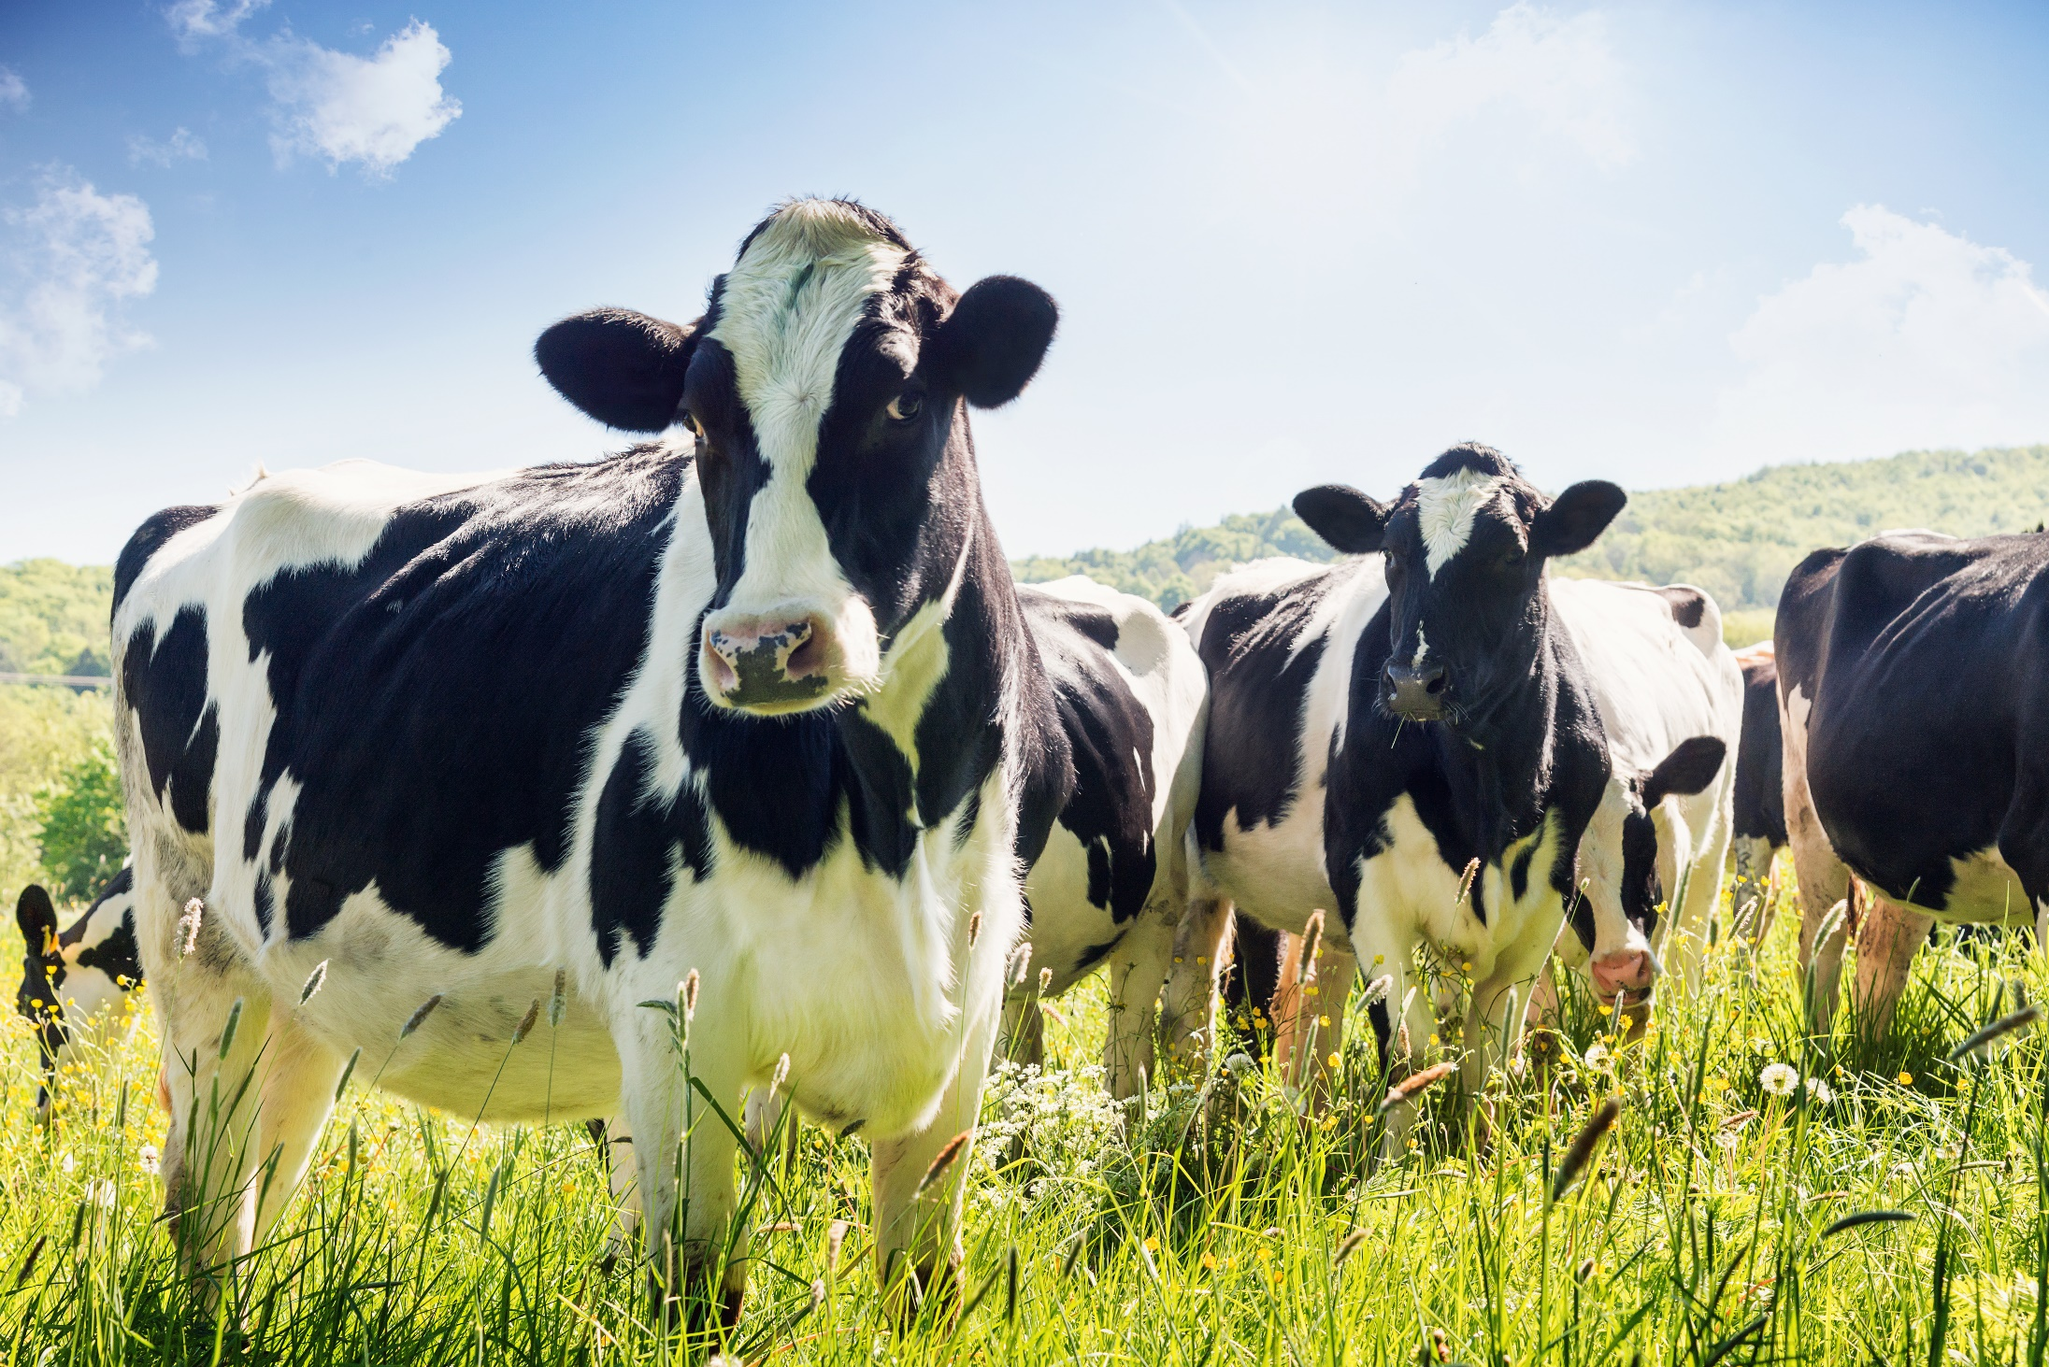
Notes:
Most of our dairy foods comes from what animals?... [wait a second for students to call out animal name] COWS!
Picture:
Cow in field: purchased from https://www.istockphoto.com

Slide 26
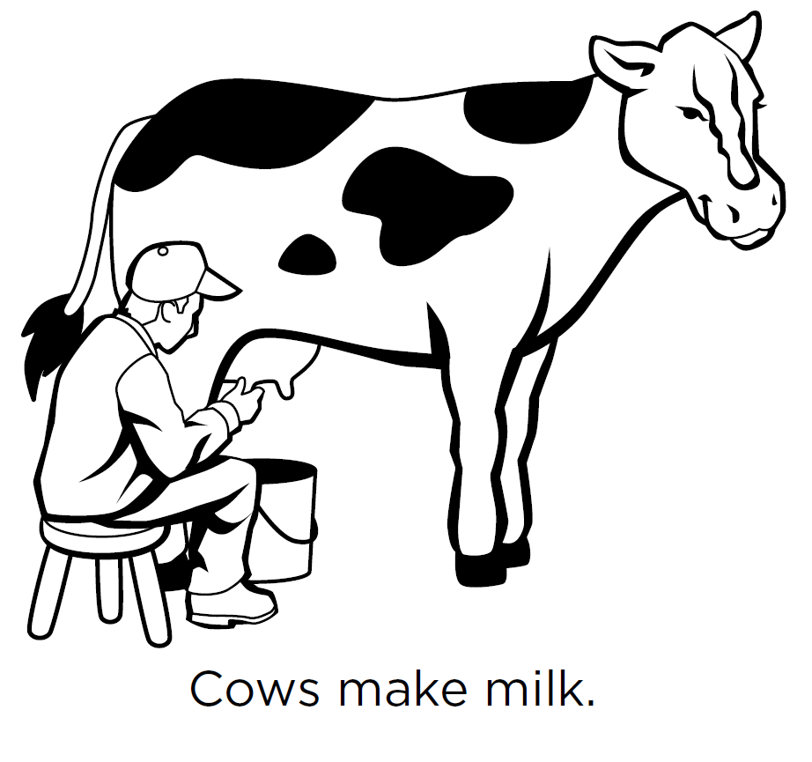
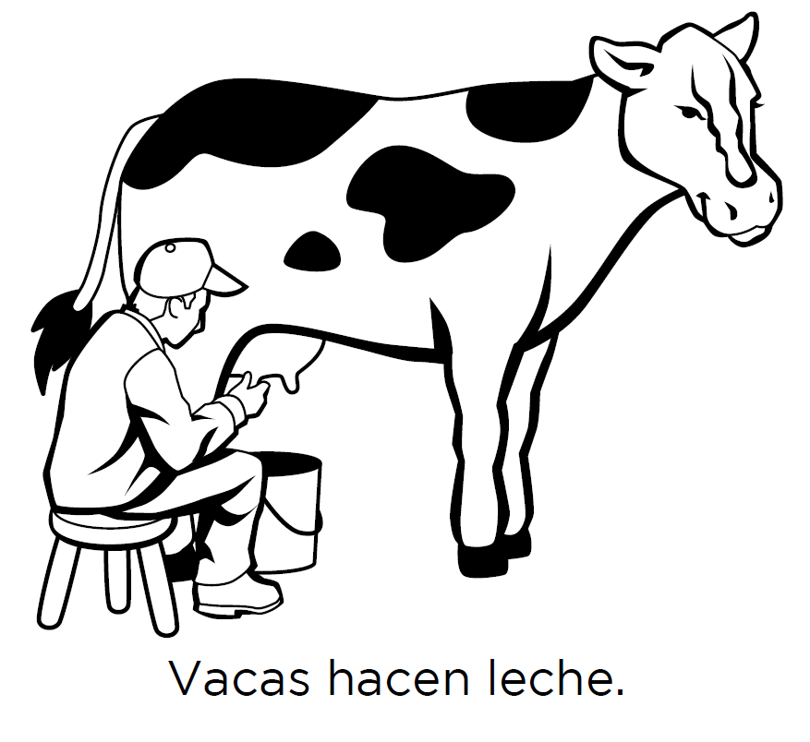
Notes:
Let’s have a little fun with Spanish and learn some words.
Repeat after me.
Cows make milk…
Now in Spanish… Vacas (va-Kas)… hacen (Ah-cen)… leche…
Cows make milk…
Vacas hacen leche…
Great! Muy bien!
Picture:
Cows make milk: https://www.fns.usda.gov/tn/discover-myplate-emergent-reader-mini-books

Slide 27
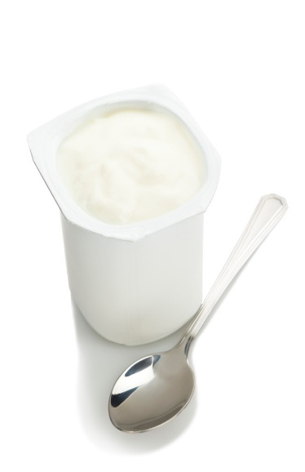












Name a food from the DAIRY Group
Mary Dairy
Cottage
cheese
yogurt
milk
Soy milk
Notes:
Now that you know all about Mary Dairy and the dairy group, let’s do a quick review.
Foods from Dairy group have CALCIUM
Calcium builds strong BONES and TEETH
Most dairy foods come from cow’s but there are other foods that will give us good sources of calcium.
Pictures:
Mary Dairy: https://www.fns.usda.gov/tn/graphics-library
MyPlate: https://www.fns.usda.gov/tn/graphics-library
Ice cream: purchased from https://www.istockphoto.com
Yogurt: purchased from https://www.istockphoto.com
Cottage cheese: purchased from https://www.istockphoto.com
Glass milk: purchased from https://www.istockphoto.com
Sliced cheese: purchased from https://www.istockphoto.com
Milk carton: purchased from https://www.istockphoto.com
Stack of cheese: purchased from https://www.istockphoto.com
String Cheese: purchased from https://www.istockphoto.com

Slide 28
Quick
Quiz!
Notes:
Today we learned all about foods in the dairy group and why they are so important for our bodies. Let’s take a Quick quiz to review what we’ve learned today.

Slide 29

BREAD is in the dairy group.
Yes or No?
YES
NO
Notes:
Yes or Now? Bread is in the dairy group.
Pictures:
Bread: purchased from https://www.istockphoto.com
Mary Dairy: https://www.fns.usda.gov/tn/graphics-library
Thumbs up and down: purchased from https://www.istockphoto.com

Slide 30

Bread is an example of a food in the
Grains Group.
NO
Notes:
No. Bread is an example of a food in the Grains group, look at her body.
Pictures:
Bread: purchased from https://www.istockphoto.com
Jane Grain: https://www.fns.usda.gov/tn/graphics-library
Thumbs up and down: purchased from https://www.istockphoto.com

Slide 31

YOGURT is in the dairy group.
Yes or No?
YES
NO
Notes:
Yes or No? Yogurt is in the dairy group?
Pictures:
Mary Dairy: https://www.fns.usda.gov/tn/graphics-library
Yogurt: purchased from https://www.istockphoto.com

Slide 32
Yogurt is in the Dairy group.
Yes
Notes:
YES. Yogurt is in the dairy group, see her body.
Pictures:
Mary Dairy: https://www.fns.usda.gov/tn/graphics-library
Thumbs up and down: purchased from https://www.istockphoto.com

Slide 33


Foods in the dairy group make our BONES and TEETH strong?
Yes or No?
YES
NO
Notes:
Yes or No? Foods in the dairy group make our bones and teeth strong?
Pictures:
Mary Dairy: https://www.fns.usda.gov/tn/graphics-library
Bone: purchased from https://www.istockphoto.com
Tooth: purchased from https://www.istockphoto.com
Thumbs up and down: purchased from https://www.istockphoto.com

Slide 34


DAIRY foods make our BONES and TEETH strong.
Yes
Notes:
Yes, dairy foods make our bones and teeth strong.
Pictures:
Mary Dairy: https://www.fns.usda.gov/tn/graphics-library
Bone: purchased from https://www.istockphoto.com
Tooth: purchased from https://www.istockphoto.com
Thumbs up and down: purchased from https://www.istockphoto.com

Slide 35




CHALLENGE
Eat 3 high CALCIUM
foods each day!
Notes:
I challenge you eat 3 high calcium foods each day, such as milk, cheese, yogurt, soymilk, or spinach.
Pictures:
Mary Dairy & MyPlate: https://www.fns.usda.gov/tn/graphics-library
Soy milk: purchased from https://www.istockphoto.com
Assortment of Dairy: purchased from https://www.istockphoto.com
Spinach: purchased from https://www.istockphoto.com

Slide 36
Let’s Taste
Notes:
TASTE TEST IDEAS
Smoothies
Cottage cheese spinach dip
Yogurt parfait

Slide 37


Don’t Yuck My Yum!
Don’t say
Nasty
Disgusting
Do say
That’s new
I’ve never tasted that before
Gross
That’s different
It’s not to my taste but I’m glad I tried it!
Ewwwww

Slide 38
Describe what you taste!
Salty
Savory
Crunchy
Soft
Chewy
Dry
Moist
Tangy
Sour
Mild
Fruity
Spicy
Flavorful
Sweet
Zesty
Creamy

