Slide 1
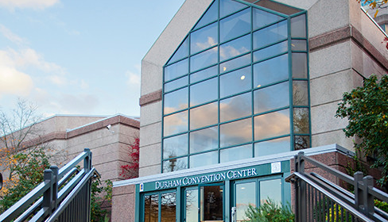
Community Conversations
Public Safety
January 27, 2018

Slide 2
Durham County
Emergency Medical Services
Kevin Underhill
179 FTEs
Serves as the initial emergency medical response for all Durham County residents (over 305,000 population covering 299 square miles)

Slide 3
Durham County
Emergency Medical Services

Slide 4
Durham County
Emergency Medical Services
Current or Major Initiative
  Implementing a pilot “Community Paramedic” program with three new positions
    To better manage and support patients within the community suffering from chronic health issues, the homeless, and those with behavioral health issues
  Shared facilities with Durham Fire Department – Station 17 (under construction)

