Slide 1
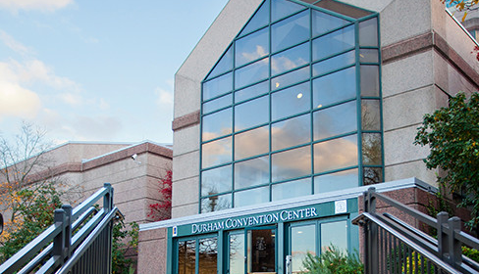
Community Conversations
Public Safety
January 27, 2018

Slide 2
Durham County Sheriff’s Office
Sheriff Mike Andrews
474 FTEs
Provides animal control services, serves civil processes, transports prisoners, provides court security, and runs a safe and secure detention facility

Slide 3
Durham County Sheriff’s Office

Slide 4
Durham County Sheriff’s Office

Slide 5
Durham County Sheriff’s Office
Current or Major Initiative
  Providing a dedicated space and support in the detention facility for detainees with mental health issues
    To better serve and support a vulnerable population with higher acuity care.

