Slide 1
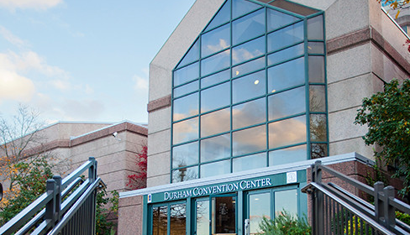
Community Conversations
Public Safety
January 27, 2018

Slide 2
Durham County
Fire Marshal & Emergency Management
Jim Groves
65 FTEs
The purpose of the department is to protect, prevent, prepare, respond, and recover from any hazard or purposeful act so that the workers, residents, students, and visitors of Durham County have a safe and resilient community

Slide 3
Durham County
Fire Marshal & Emergency Management

Slide 4
Durham County
Fire Marshal & Emergency Management
Current or Major Initiatives
  Continued expansion of Durham County’s mass notification system, “Alert Durham”, which will offer residents more access to emergency information than ever before
  Continued development of “Continuity of Operations Plans” for all County departments in case of a mass event

Slide 5
Durham County
Fire Marshal & Emergency Management
Current or Major Initiatives (cont.)
  Development of long-term community recovery plan for Durham & Durham County
  Delivery of “Stop the bleed”, “Until Help Arrives”, and “Bystander CPR” programs as part of the Community Emergency Response Team (CERT) outreach

