Slide 1

2015-16 County Manager’s Recommended Budget
Presented by
Wendell M. Davis, County Manager
May 26, 2015

Slide 2
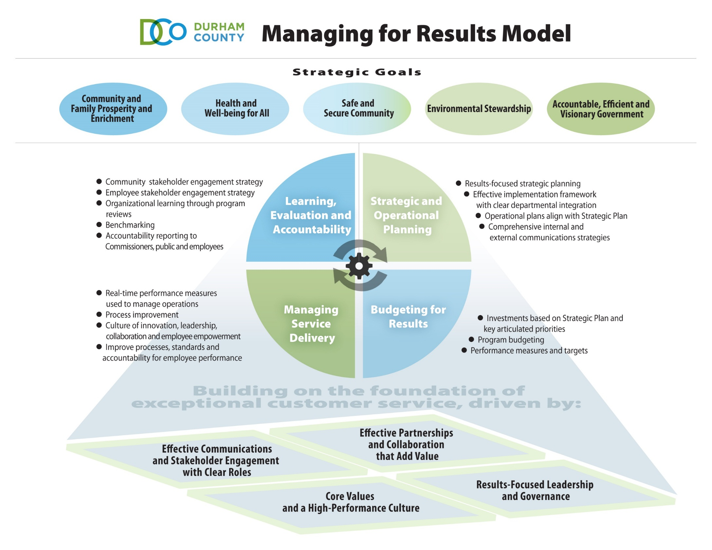
Notes:
Last summer and fall, we engaged more than 100 staff as part of key stakeholder group. Teams were organized and Design Labs held to plan our model and prepare for early implementation.
We received your concurrence with the model and timeline last November.
Durham County’s business model to:
Plan for what we want to achieve
Budget for the results we want
Manage to ensure we are achieving those results
And evaluate and learn to determine how we can make improvements

Slide 3
FY 2015-16 Manager’s Recommended Budget
Maintenance Budget
  Meets debt obligations
  Increases net funding for Durham Public Schools
    Per pupil funding remains constant
  Operational increases for public safety
    Emergency Medical Services
    Fire District operations
    Sheriff’s Office
  Supports “human capital”
    Compensation study implementation
  Replace and update vital equipment and vehicles
Notes:
Per pupil funding remains constant

Slide 4
FY 2015-16 Budget Process
January 2015 Nonprofit budget process started
February 2015 Departmental budget process started
March 2015 BOCC and department budget retreat
March-May 2015 Recommended Budget development
May 26, 2015 Manager’s Recommended Budget presentation
June 1, 3, and 4, 2015 Budget work sessions
June 8, 2015 Public Hearing for FY 2015-16 Budget
June 22, 2015 FY 2015-16 Budget approval
Notes:
We started the budget process in January
The BOCC budget retreat occurred in March
We will begin budget worksessions next week
Public Hearing on June 8
Adopt budget June 22

Slide 5
FY 2015-16 Property Tax
Tax base valuation increase of $655.8 million (budget to budget) or 2.09%
Collection rate remains constant at 99.30%
Total: an additional $4.7 million due to natural growth for General Fund operating and Capital Finance Fund
Notes:
From FY 2014-15 to FY 2015-16, we project a property valuation growth of 2.09% or $655.8 million
We are projecting our collection rate at 99.03%.
This results in an additional $4.7 million due to natural growth to support the overall budget.

Slide 6
Tax Base Variances
Category | FY 2014-15 Original Budget | FY 2015-16 Budget Estimate | % Change FY16 from FY15 Budget
Real Property | $ 25,708,434,347 | $ 26,152,065,688 | 1.73%
Auto Value | $ 1,799,900,000 | $ 1,894,000,000 | 5.23%
Personal Value | $ 3,373,609,112 | $ 3,440,862,642 | 1.99%
Public Service | $ 489,915,862 | $ 540,732,429 | 10.37%
Total | $31,371,859,321 | $32,027,660,759 | 2.09%
Notes:
This slide shows the revenue growth type by category
The annual property valuation growth rate is slightly higher than the five-year average.
Next slide

Slide 7
FY 2015-16 Property Tax by Fund
Property Tax | FY 2014-15 Original Budget | FY 14-15 Tax Rate | FY 2015-16 Recommended | FY 15-16 Recommended Tax Rate
General Fund | $218,034,642 | 69.99 | $223,641,981 | 70.32
Capital Financing Fund | $29,033,903 | 9.32 | $28,591,317 | 8.99
Total | $247,068,545 | 79.31 | $252,233,298* | 79.31
*Prior year tax collection decreases $475,000
Notes:
We budget our property tax revenue in two categories to support general fund operating expenses and the dollars to fund the capital finance fund, which funds all major capital projects (including debt service and paygo) undertaken by the county.
You will see the overall tax rate remains flat.
Next slide

Slide 8
FY 2015-16 Property Tax
No net property tax rate increase for FY 2015-16
0.33 cents will be moved from the Capital Financing Fund to the General Fund
Notes:
There is no net property tax increase
.33 cents is moved from the capital financing fund to the general fund.
This decrease is due to a pause in capital spending as the long-range master plan is developed and a decrease funds needed to support the annual debt service.

Slide 9
Debt Service: Education
Debt Areas | Debt Service
Durham Public Schools | $30,160,166
Durham Tech Community College | $1,078,752
NC Museum of Life and Science | $1,495,845
County-Related | $25,482,361
Total Debt Service | $58,217,124
Notes:
This captures the overall debt.
You will see, majority of the debt service payment supports educational capital project obligations

Slide 10
Tax Rates for Fire Districts
Fire Districts
District | FY 2014-15 Original Budget Tax Rate | FY 2015-16 Requested Tax Rate | FY 2015-16 Recommended Tax Rate | Change from FY 2014-15
Lebanon | 0.1065 | 0.1065 | 0.1065 | -
Parkwood | 0.1135 | 0.0000 | 0.0000 | (0.1135)
Redwood | 0.1386 | 0.1386 | 0.1386 | -
New Hope* | 0.0995 | 0.0995 | 0.0995 | -
Eno* | 0.0799 | 0.0799 | 0.0799 | -
Bahama | 0.0987 | 0.0987 | 0.0987 | -
Bethesda Service | 0.1350 | 0.0000 | 0.0000 | (0.1350)
Durham County Fire & Rescue Service | 0.0000 | 0.1300 | 0.1300 | 0.1300
*The New Hope and Eno fire tax district rates are established by neighboring Orange County through an inter-local agreement.
Notes:
No changes are required to existing fire tax district rates for FY 2015-16.
A new Durham County Fire and Rescue Service District will be created to cover the combined areas of the former Bethesda Fire and Rescue Service District and Parkwood Fire District.
This change will allow better distribution of services across both districts.
The rate for the Durham County Fire & Rescue District is .13

Slide 11
FY 2015-16 Sales Tax
Durham County has estimated an overall 15.09% increase
in all local sales taxes for FY 2015-16
Sales Tax Article | FY 2014-15 Original Budget | FY 2014-15 12 Month Estimate | % from FY 2014-15 Budget | FY 2015-16 Manager Recommended | % from FY 2014-15 Budget
Article 39 | $17,899,671 | $20,891,544 | 16.71% | $21,357,953 | 19.32%
Article 40 | $10,137,717 | $10,937,909 | 7.89% | $11,375,429 | 12.21%
Article 42 | $12,211,133 | $13,849,730 | 13.42% | $14,233,465 | 16.56%
Article 44 | $0 | $1,789 | N/A | $0 | N/A
Article 46 | $10,300,000 | $11,692,495 | 13.52% | $11,800,000 | 14.56%
Inter-local | $9,976,851 | $10,445,533 | 4.70% | $10,894,599 | 9.20%
Total | $60,525,372 | $67,819,000 | 12.05% | $69,611,446 | 15.09%
Notes:
Across the state, sales tax revenue is up compared to last year. We are budgeting revenues close to actual
Article 39: General Fund use
Article 40 and 42: 100% of both support DPS related debt service per BOCC Capital Financing Policy
Article 44: No longer collected
Article 46: 67.12% for DPS, 8.97% for DTCC, 2.17% for Pre-K programs, 21.7% for DPS related debt service – All per BOCC policy
Inter-local: Agreement between City of Durham and Durham County to split sales tax collected between both entities at a 58% (County)/42% (City) distribution

Slide 12
Revenue Highlights
Other Key Revenues | FY 2013-14 Actual Revenues | FY 2014-15 Original Budget | FY 2014-15 12 Month Estimate | FY 2015-16 Manager Recommended
ABC Profit Distribution | $1,500,000 | $1,500,000 | $1,500,000 | $1,500,000
Register of Deeds Fees | $2,146,408 | $2,550,000 | $1,669,524 | $1,750,000
Investment Income | $133,785 | $130,000 | $152,672 | $140,000
EMS Patient Income | $5,775,768 | $7,020,900 | $7,020,900 | $8,074,035
Solid Waste Management Fee | $1,732,735 | $1,945,957 | $1,896,294 | $1,896,294

Slide 13
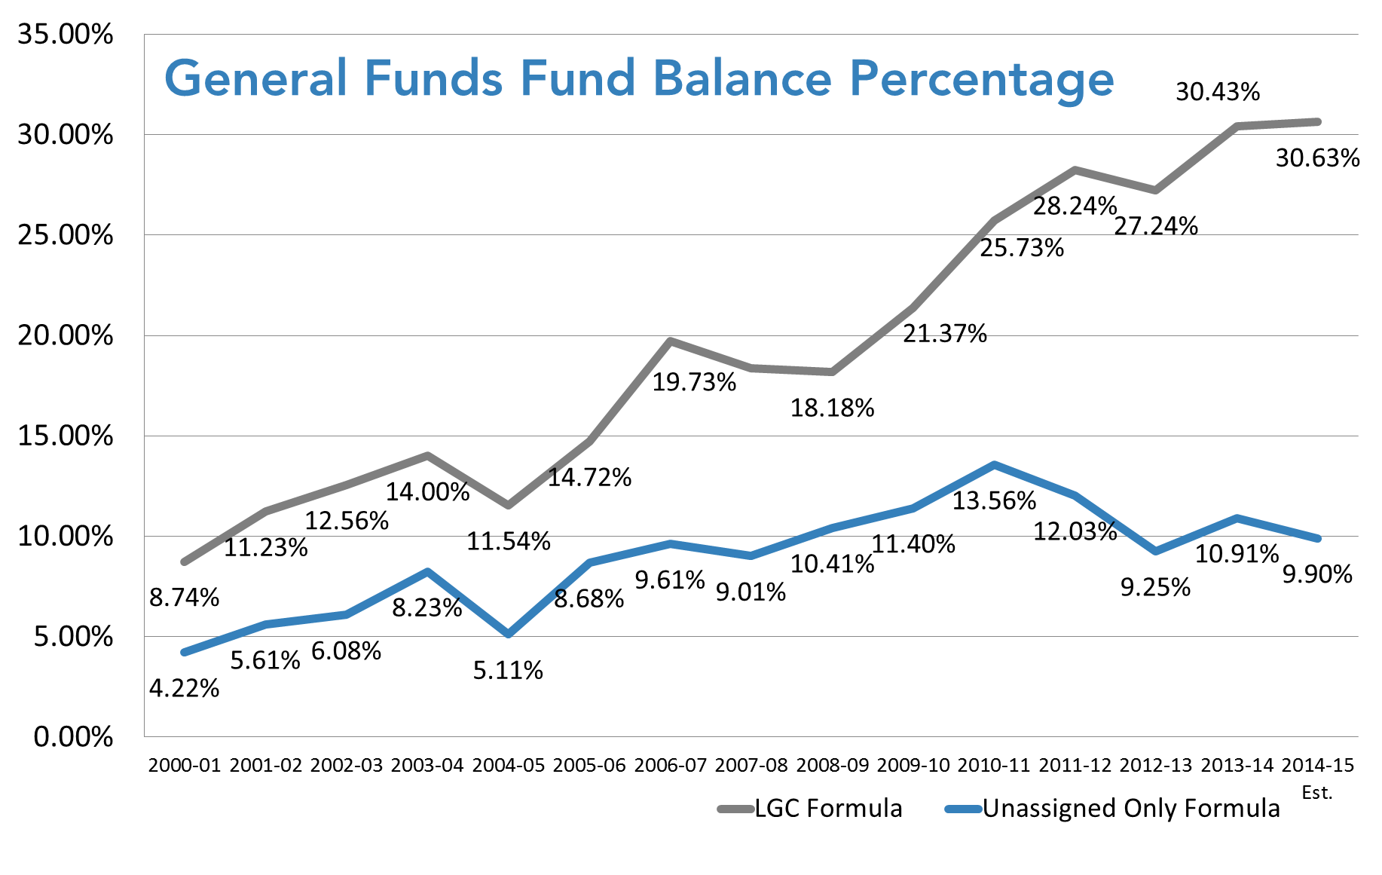
Notes:
FY 2013-14 is latest CAFR Fund Balance Numbers
FY 2014-15 is estimated Fund Balance Numbers

Slide 14
All Funds Summary
Fund | FY 2013-14 Actual Expenditures | FY 2014-15 Original Budget | FY 2014-15 12 Month Estimate | FY 2015-16 Manager Recommended | % Difference (Budget to Budget)
General | $349,244,979 | $378,794,804 | $369,523,757 | $394,757,221 | 4.21%
Total All Funds | $557,501,806 | $550,563,262 | $540,034,855 | $564,124,229 | 2.46%

Slide 15
General Fund Revenues
Total Amount = $394,757,221
Other Revenues
Other Financing Sources = 4.90%
Other Revenues = 0.13%

Slide 16
General Fund Revenues
Funding Source | FY 2013-14 Actual Expenditures | FY 2014-15 Original Budget | FY 2014-15 12 Month Estimate | FY 2015-16 Manager Recommended | % Change (Budget to Budget)
Taxes | $282,232,973 | $283,741,515 | $291,977,753 | $298,158,424 | 5.08%
Licenses and Permits | $1,357,467 | $791,500 | $1,046,505 | $976,000 | 23.31%
Intergovernmental | $50,723,858 | $54,114,346 | $53,084,066 | $57,250,044 | 5.79%
Contributions and Donations | $248,393 | $49,767 | $40,682 | $138,133 | 177.56%
Investment Income | $133,785 | $130,000 | $152,672 | $140,000 | 7.69%
Rental Income | $627,872 | $505,751 | $497,956 | $460,074 | (9.03%)
Service Charges | $15,770,300 | $17,683,185 | $15,781,653 | $17,785,041 | 0.58%
Sewer Connection Fees | $245,058 | $201,000 | $72,488 | $1,000 | (99.50%)
Other Revenues | $1,105,086 | $929,062 | $707,160 | $506,991 | (45.43%)
Other Financing Sources | $9,000,112 | $20,648,678 | $9,823,792 | $19,341,514 | (6.33%)
Total | $361,444,904 | $378,794,804 | $373,184,725 | $394,757,221 | 4.21%
Notes:
Explanation for 177.56% change in contributions & donations; explanation for sewer connection fees (CLAUDIA TO ADD)

Slide 17
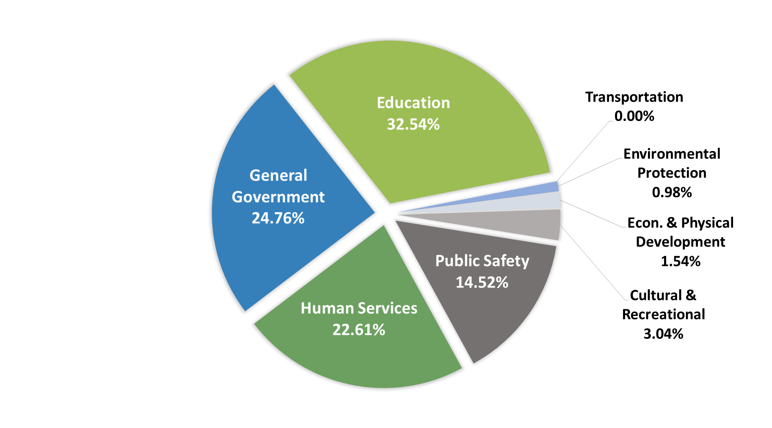
General Fund Expenditures
Total Amount = $394,757,221

Slide 18
General Fund Expenditures
Functional Area | FY 2013-14 Actual Expenditures | FY 2014-15 Original Budget | FY 2015-16 Requested | FY 2015-16 Manager Recommended | % Change (Budget to Budget)
General Government | $76,783,900 | $92,496,650 | $96,258,083 | $97,731,645 | 5.66%
Public Safety | $48,919,291 | $53,324,193 | $72,309,391 | $57,309,106 | 7.47%
Transportation | $12,500 | $12,500 | $12,500 | $12,500 | 0.00%
Environmental Protection | $3,174,840 | $3,720,399 | $3,878,050 | $3,886,750 | 4.47%
Econ. & Physical Development | $4,596,988 | $5,269,761 | $6,904,354 | $6,082,940 | 15.43%
Human Services | $79,354,866 | $85,939,210 | $90,621,357 | $89,258,670 | 3.86%
Education | $125,721,000 | $126,454,721 | $135,314,432 | $128,465,669 | 1.59%
Cultural & Recreational | $10,681,595 | $11,577,370 | $13,000,241 | $12,009,942 | 3.74%
Total | $349,244,979 | $378,794,804 | $418,298,408 | $394,757,221 | 4.21%
Notes:
Explanation for economic/physical development
$600,000 increase from FY 2014-15
21c Museum/Hotel - $200,000
Concord Hospitality - $400,000

Slide 19
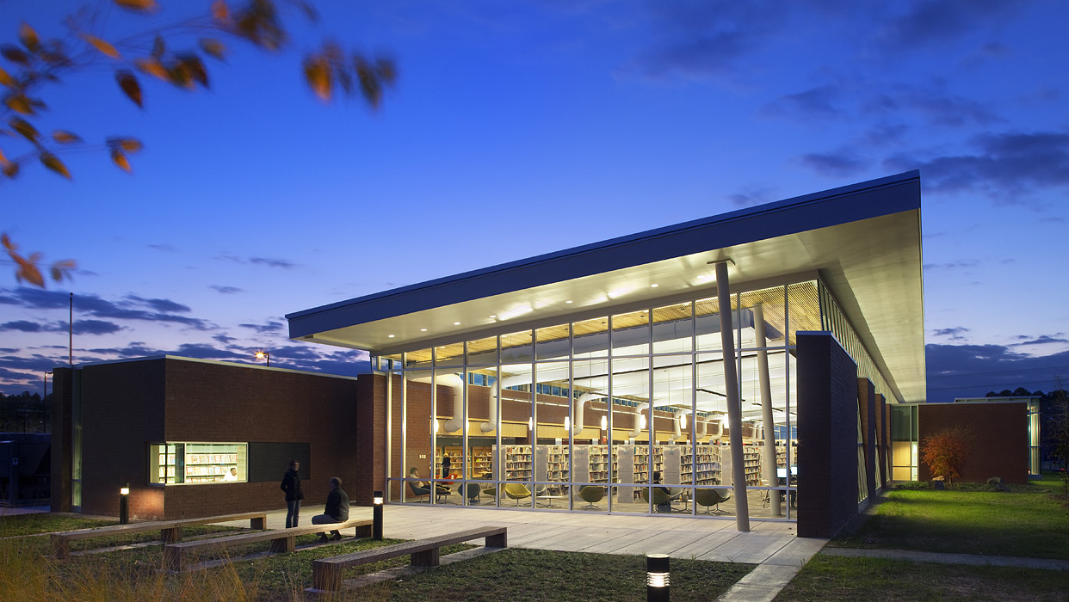
Budget Highlights
Goal 1: Community and Family Prosperity and Enrichment

Slide 20
Durham Public Schools Funding
Category | FY 2013-14 Actual Expenditures | FY 2014-15 Original Budget | FY 2015-16 Requested | FY 2015-16 Manager Recommended | % Change (Budget to Budget)
Current Expense | $118,233,311 | $118,863,146 | $126,710,764 | $120,685,356 | 1.53%
Capital Outlay | $1,370,000 | $1,370,000 | $1,370,000 | $1,370,000 | 0.00%
Total | $119,603,311 | $120,233,146 | $128,080,764 | $122,055,356 | 1.52%
School Debt Service | $26,820,112 | $30,114,672 | $30,160,166 | $30,160,166 | 0.15%
Total Funding | $146,423,423 | $150,347,818 | $158,240,930 | $152,215,522 | 1.24%

Slide 21
Durham Public Schools Funding
Current expense increase: $1,822,210
Article 46 sales tax growth
  DPS: $1,472,891
  Pre-K: $47,618
  Additional General Fund support: $301,701

Slide 22
Durham Public Schools Funding
Current expense: $120,685,356
  DPS: $120,218,568
  Pre-K: $466,788
DPS student projections
  DPS: 33,900 (250 expected growth)
  Charter: 5,424 (340 expected growth)
  Total: 39,324 (590 expected growth)
Per pupil funding: $3,069 per pupil

Slide 23
Over 12 years, DPS has spent $162 million more than the next nearest peer county (per pupil funding).
$162 million
New Hanover Co.
Mecklenburg Co.

Slide 24
NC Report Card Data – Dept. of Public Instruction
Source: NC Department of Public Instruction, FY 2013-14 Report Cards

Slide 25
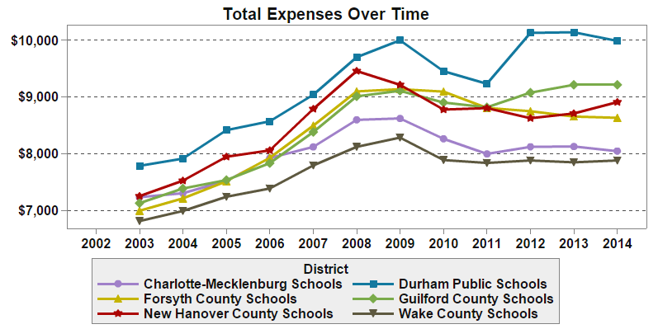
NC Report Card Data – Dept. of Public Instruction
Source: NC Department of Public Instruction, FY 2013-14 Report Cards

Slide 26
Overall End of 3rd Grade Proficiency
Source: DPI Report Cards 13-14

Slide 27
Overall End of 5th Grade Proficiency
Source: DPI Report Cards 13-14

Slide 28
NC Report Card Data – Dept. of Public Instruction
Annual Measurable Objectives
County | Targets Met | Targets Assigned | % Met
Durham | 109 | 188 | 58.0%
Forsyth | 133 | 188 | 70.7%
Guilford | 135 | 208 | 64.9%
Mecklenburg | 159 | 205 | 77.6%
New Hanover | 144 | 169 | 85.2%
Wake | 155 | 206 | 75.2%

Slide 29
Budget Highlights:
Goal 1: Community and Family Prosperity and Enrichment
Durham Technical Community College
  $196,430 increase in Article 46 sales tax revenue.
Libraries
  $210,000 technology van (mobile outreach)
Museum of Life and Science
  $88,997 to support operating expense increases
Goal 2: Health and Well-being for All
Notes:
DTCC – Durham Technical Community College requested an additional $275,00 to support operating budget and minor repairs and renovations. I am recommending that the BOCC amend its policy on the one-quarter cent sales tax (article 46) to expand DTCC’s use of funds for critical operating budget needs.
Library funded technology van (book mobile) at $210,000. The Library Foundation will donate $50,000 to offset the cost associated with this expense.

Slide 30
Goal 1: Community and Family Prosperity and Enrichment
Nonprofit Funding
  79 applications for funding = $1,926,233
    Of those 79 applicants, 46 were funded in FY 2014-15
  42 agencies funded
    Three (3) funded in FY 2014-15 did not reapply
    Senior PharmAssist is now funded by Public Health
  Total: $640,038, a 21.82% reduction from FY 2014-15
  No new funding recommended for nonprofits
  (currently funded and new applicants)
Notes:
Process change fund Senior PharmAssist in Public Health for operational efficiencies. They have partnered with the Health Department for over X years.
Policy discussion about the nonprofit process will occur in Fall. Recommended changes will be a part of the FY 2016-17 budget cycle.

Slide 31
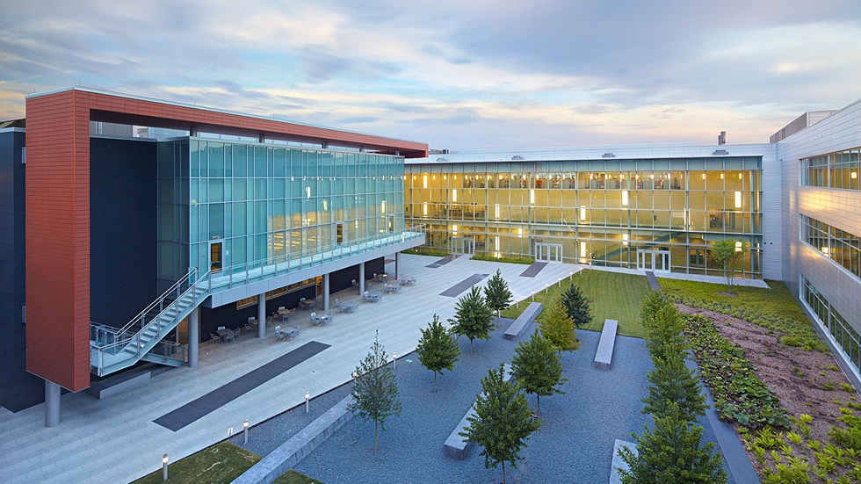
Budget Highlights
Budget Highlights
Goal 2: Health and Well-being for All

Slide 32
Goal 2: Health and Well-being for All
Department of Social Services
  11 part-time positions transitioned to full-time
  2.65 FTE impact, ($109,642)
  Realignments support increased services for Child Support, Home-centered Care, Adult Services, and Durham Public Schools’ social workers
Notes:
As previously mentioned, DSS redirected over $936,000 in existing funds.
These measures helped to reduce the pressure on the property tax base.

Slide 33
Goal 2: Health and Well-being for All
Public Health
  Funding allocated to support three (3) Public Health school nurses ($225,111) that were previously funded though the Community Health Trust Fund

Slide 34
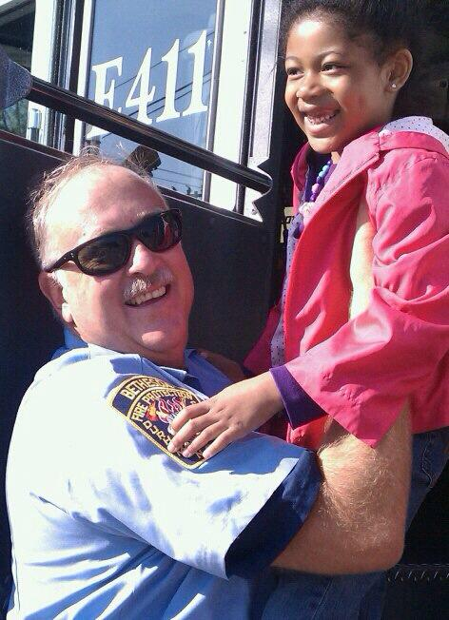
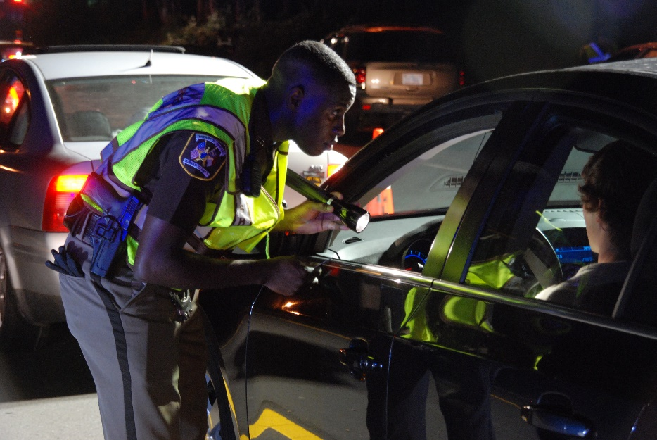
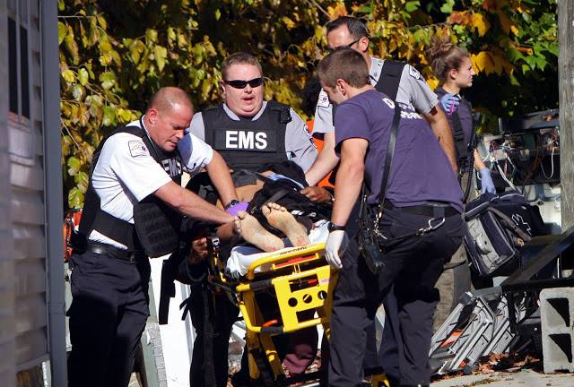
Budget Highlights
Goal 3: Safe and Secure Community

Slide 35
Goal 3: Safe and Secure Community
Emergency Medical Services
  Funds eight (8) positions, equipment and vehicles for existing ambulance deployment; replacement equipment and vehicles
  Changed billing approach to improve operational efficiencies
    Projected to generate an additional $1 million due to process change
Sheriff
  Funds seven (7) positions; supports vehicle and equipment replacement

Slide 36
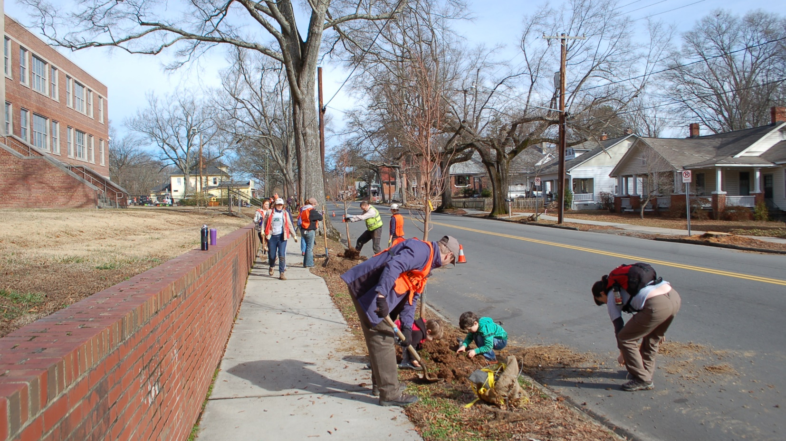
Budget Highlights
Goal 4: Environmental Stewardship

Slide 37
Goal 4: Environmental Stewardship
Soil and Water Conservation
  A Watershed Conservationist position is being created to develop a Local Nutrient Control Strategy to carry out the Falls Lake Watershed Rules mandate ($57,208)

Slide 38
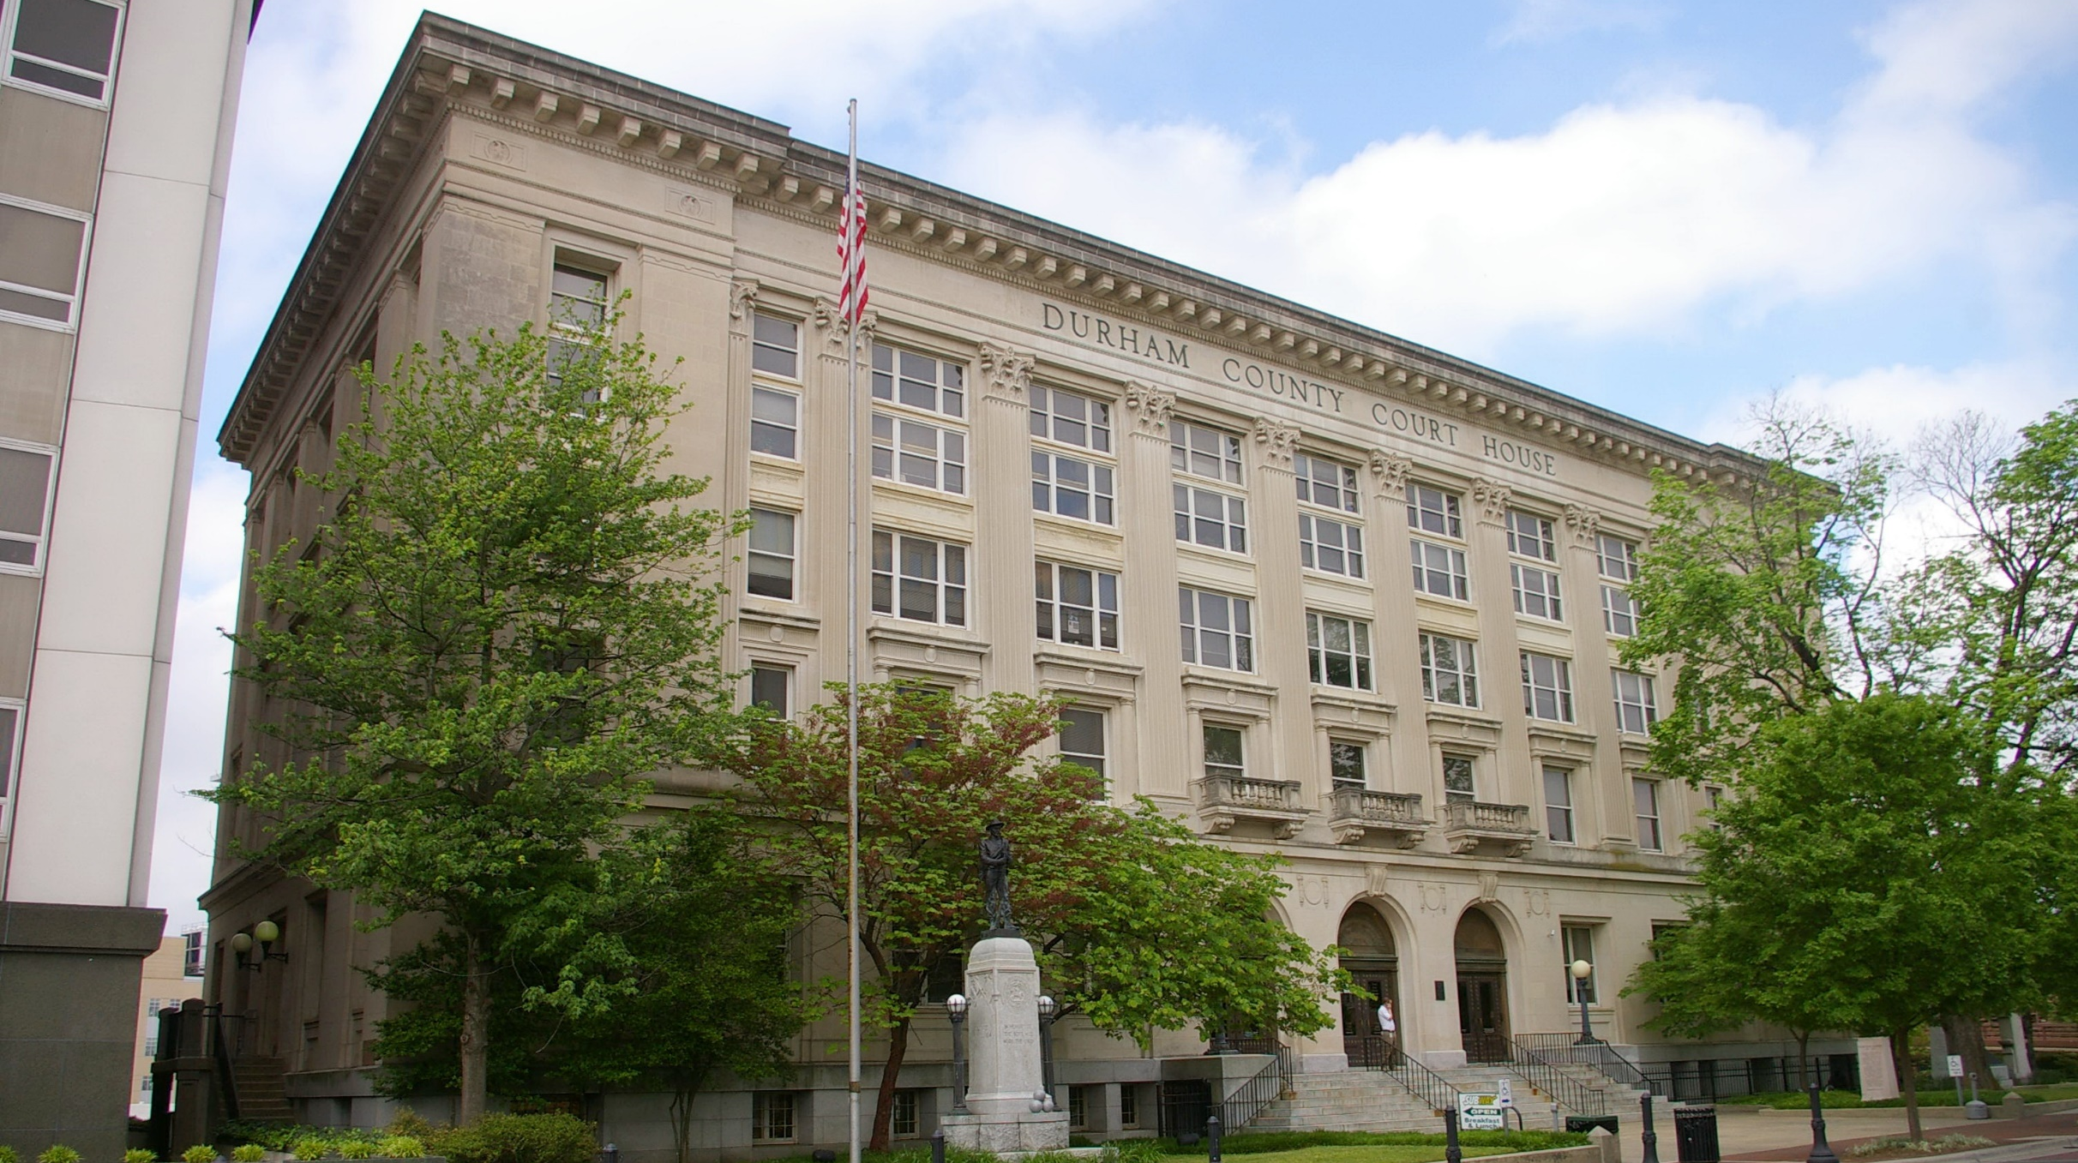
Budget Highlights
Goal 5: Accountable, Efficient,
and Visionary Government

Slide 39
Goal 5: Accountable, Efficient, and Visionary Government
MFR Infrastructure Improvements
  Bolster organizational capacity to improve enterprise resource planning (ERP). Develop plan to integrate Systems Applications Product (SAP) and other platforms required for a successful data management system.
  In August 2015, staff will communicate action plan required for full MFR implementation ($400,000)
Notes:
Expand strategic planning, program budget development and performance measurement training throughout the organization.
$400,000 set aside to begin infrastructure improvements. Staff communicate plan in August.
In addition to $400,000, Also funded positions to support increased communications, finance system changes, and process improvements

Slide 40
Goal 5: Accountable, Efficient, and Visionary Government
Elections
  During the FY 2015-16 budget year, the Board of Elections may be required to conduct 5 elections, including the newly mandated Presidential Preference Primary
Revaluation
  Tax Administration budget increased due to eight-year revaluation which occurs in FY 2015-16

Slide 41
Position Highlights
Addition of 27.65 FTEs
Elimination of 8 FTEs
Net increase of 19.65 FTEs

Slide 42
Public Hearing for the FY 2015-16 Budget
Monday, June 8, 2015
7:00pm
Commissioners’ Chambers

Slide 43
BOCC Budget Review
Monday, June 1 2 pm – 5 pm
Wednesday, June 3 12 pm – 5 pm
Thursday, June 4 9 am – 2 pm

Slide 44
Budget Document Available For Public Viewing
Durham County Website
Clerk To the Board of County Commissioners Office
  Second Floor, Administrative Complex
Durham County Main Library

Slide 45
FY 2015-16 Budget Process
January 2015 Nonprofit budget process started
February 2015 Departmental budget process started
March 2015 BOCC and department budget retreat
March-May 2015 Recommended Budget development
May 26, 2015 Manager’s Recommended Budget presentation
June 1, 3, and 4, 2015 Budget work sessions
June 8, 2015 Public Hearing for FY 2015-16 Budget
June 22, 2015 FY 2015-16 Budget approval

Slide 46
Budget Adoption
Monday, June 22, 2015
7:00pm
Commissioners’ Chambers

